Slide 1
Creation of a Milestone-Driven Simulation Based Resuscitation Course
CLICK TO GO BACK TO KIOSK MENU
Alexandra Mannix, MD ^{1,2}, J. Patrick Hoffman, MD ², Clare Desmond, MD ³, Michelle Sergel, MD ^{1,2}
¹ Rush University Medical Center, ² Cook County Hospital, ³NorthShore Health Systems
Introduction
Intro/Objectives
Accreditation Council for Graduate Medical Education and The American Board of Emergency Medicine have collectively established a set of 23 milestones for Emergency Medicine Residents.
Residents are assessed on these milestones by residency leadership.
A milestone-driven simulation based curriculum may improve assessment.
Milestones
Curriculum
Impact
Conclusion
Educational Objectives
To develop a prioritized list of resuscitation-oriented milestones
To create milestone-driven simulation cases for Emergency Medicine Residents
To improve Emergency Medicine Residents’ ability to perform resuscitation skills
To improve direct observation of milestones

Slide 2
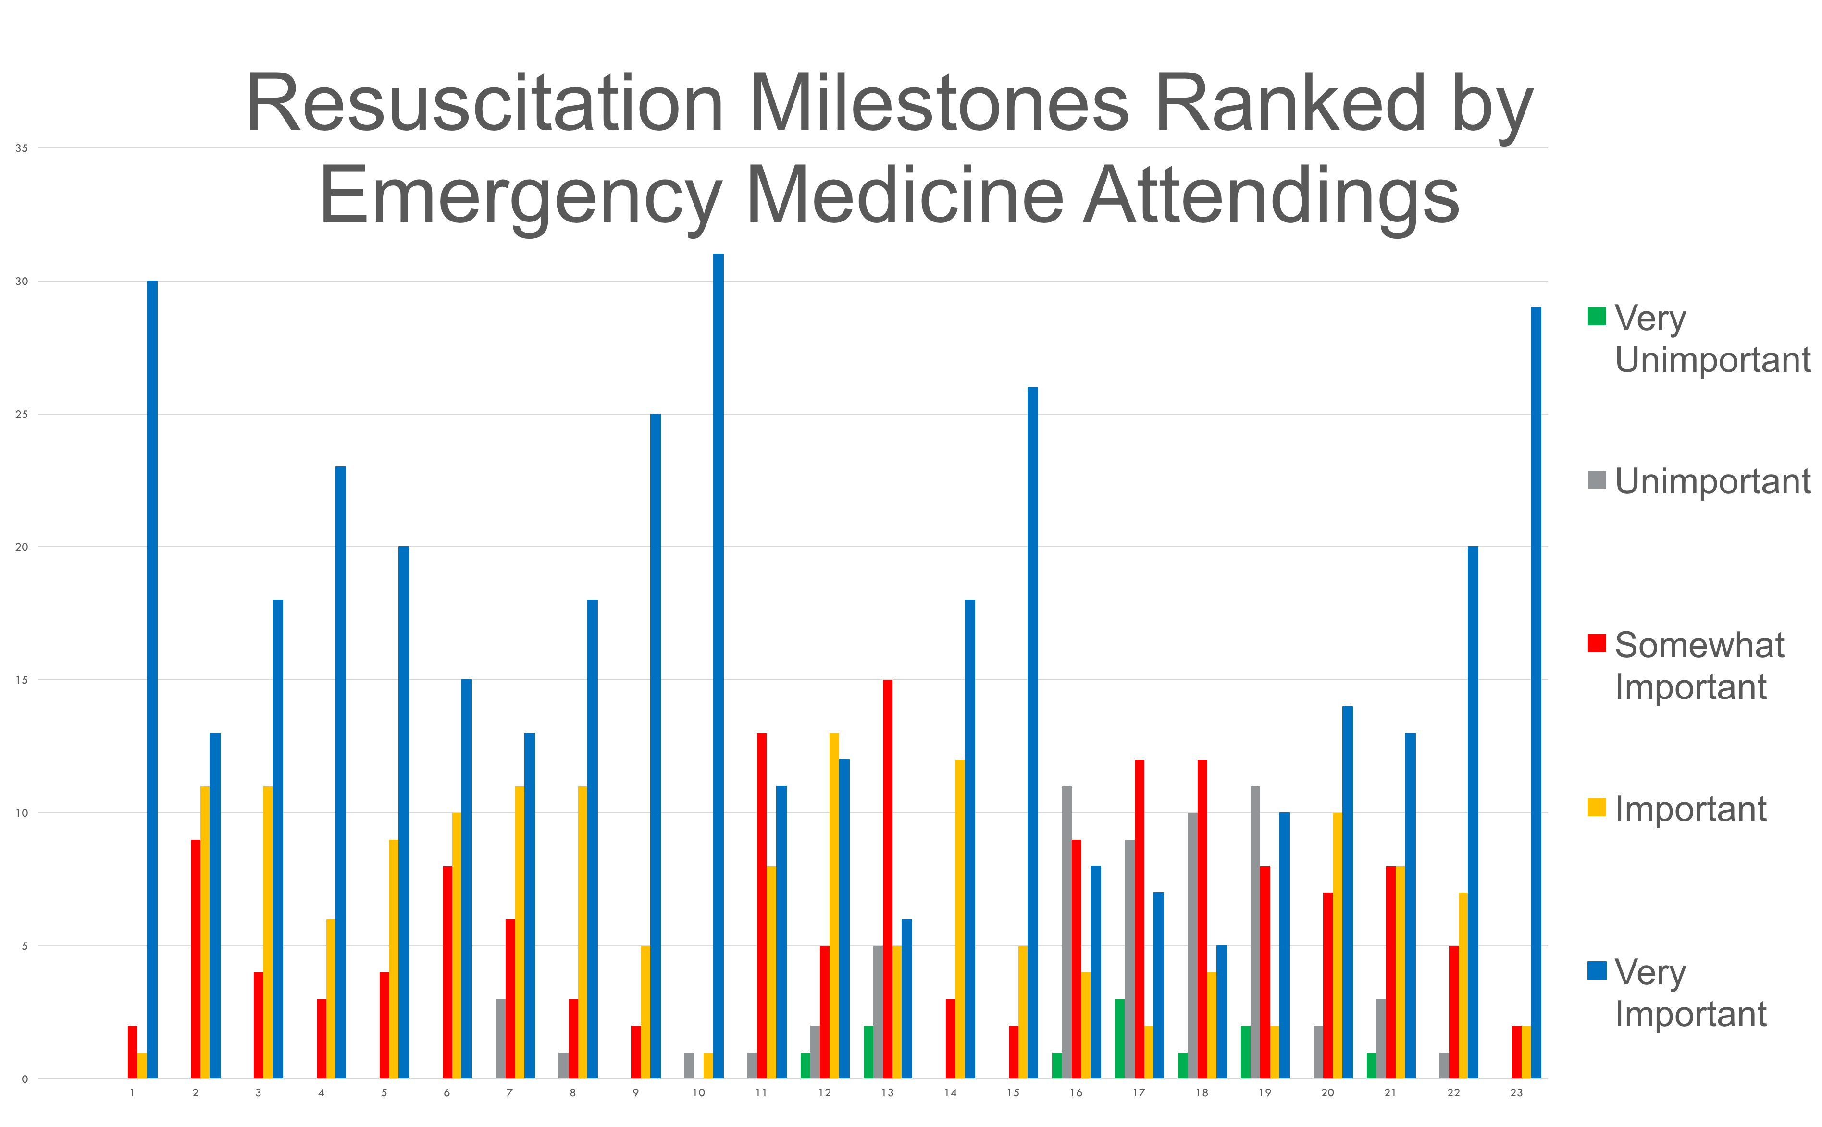
Creation of a Milestone-Driven Simulation Based Resuscitation Course
CLICK TO GO BACK TO KIOSK MENU
Alexandra Mannix, MD, J. Patrick Hoffman, MD, Clare Desmond, MD, Michelle Sergel, MD
Top Resuscitation Milestones
Intro/Objectives
Milestones
MS 10 | Airway Management
MS 1 | Emergency Stabilization
MS 23 | Team Management
MS 15 | Medical Knowledge
MS 9 | General Approach to Procedures
MS 4 | Diagnosis
MS 5 | Pharmacotherapy
MS 14 | Vascular Access
MS 3 | Diagnostic Studies
MS 8 | Multi-tasking
Curriculum
Impact
Conclusion
To prioritize milestones, all 23 Milestones were ranked by 33 Emergency Medicine Attendings on a 1-5 Likert based scale, based on their perceived importance during a resuscitation.

Slide 3
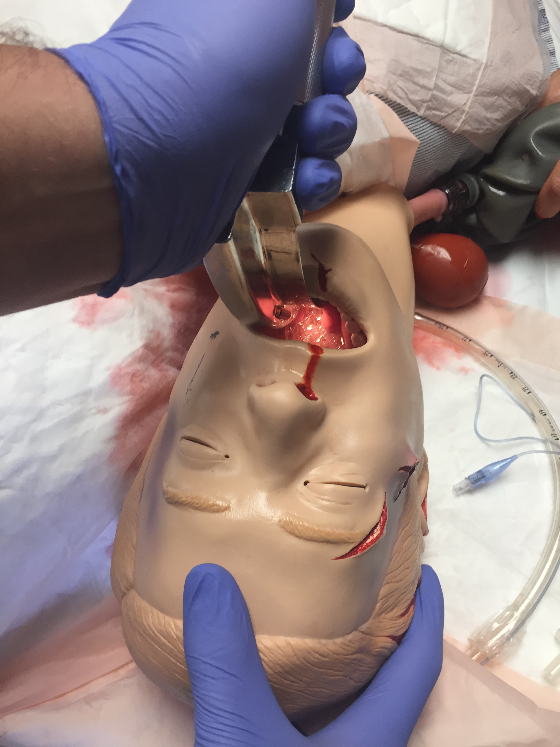
Creation of a Milestone-Driven Simulation Based Resuscitation Course
CLICK TO GO BACK TO KIOSK MENU
Alexandra Mannix, MD, J. Patrick Hoffman, MD, Clare Desmond, MD, Michelle Sergel, MD
Formative Simulation Cases
Pediatric Sepsis
Hypercapnic Respiratory Failure
ST Elevation MI with Symptomatic Bradycardia
Ruptured Ectopic Pregnancy in Anticoagulated Patient
Intro/Objectives
Milestones
Curriculum
Summative Simulation Case
Impact
Impact
Massive Upper Gastrointestinal Bleed
Conclusion
Conclusion
Milestone 1- Emergency Stabilization
Level 1 | Level 2 | Level 3 | Level 4
Recognizes Abnormal Vital Signs | Large bore IVs Fluids Blood Products | Reassesses Interventions | Initiates Massive Transfusion Protocol
Milestone 10- Airway Management
Level 1 | Level 2 | Level 3 |  | Level 4
Performs Basic Airway Interventions | Secures Airway | Post Intubation Management |  | Appropriately Uses Advanced Airway Equipment
Milestone 5- Pharmacotherapy
Level 1 | Level 2 | Level 3 |  | Level 4
Knows Classes of Drugs for GI Bleed | Selects Appropriate Drugs for Upper GI Bleed in Alcoholic | Considers Drug-Drug Interactions

Slide 4
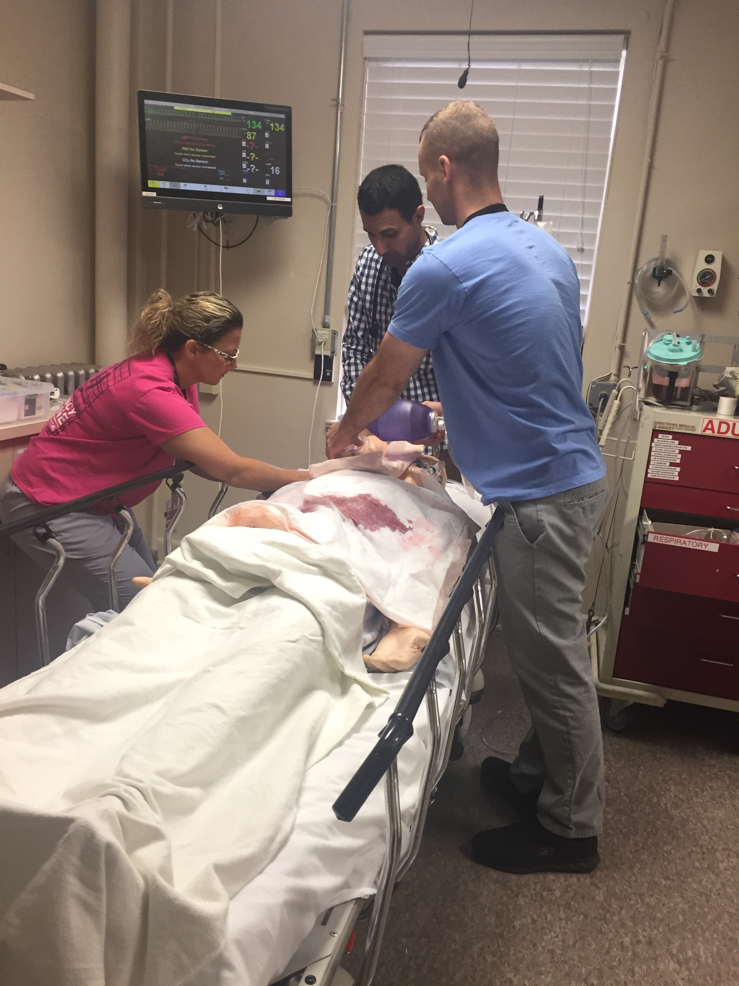
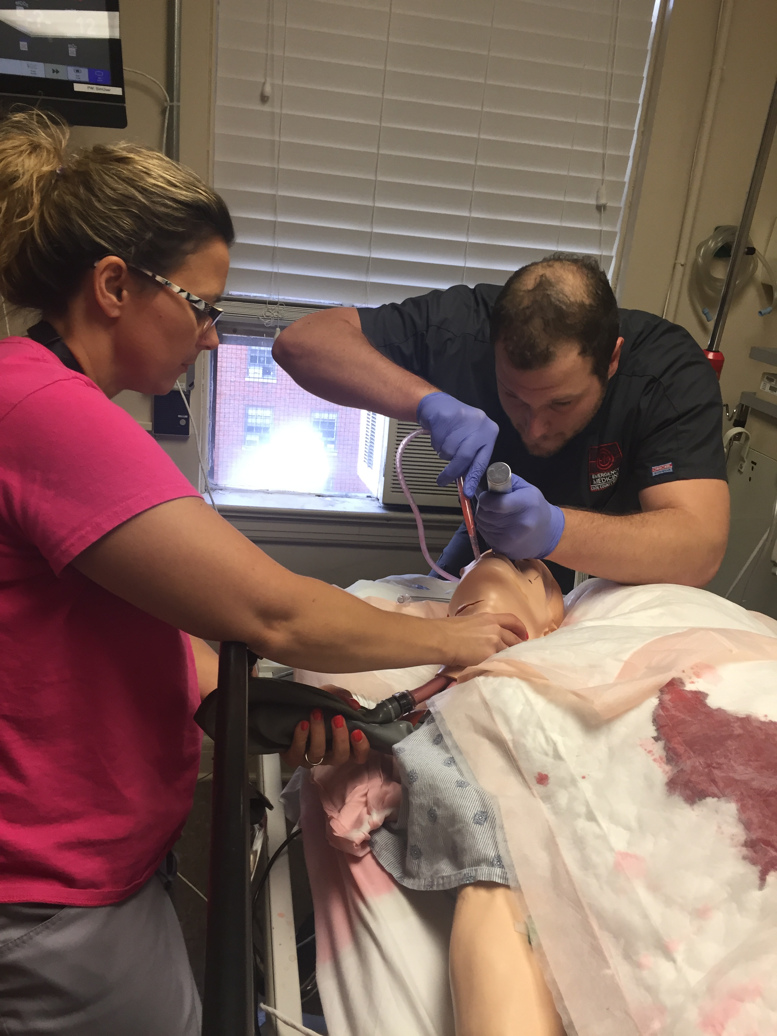
Creation of a Milestone-Driven Simulation Based Resuscitation Course
CLICK TO GO BACK TO KIOSK MENU
Alexandra Mannix, MD, J. Patrick Hoffman, MD, Clare Desmond, MD, Michelle Sergel, MD
Milestone Evaluation
Intro/Objectives
Developed prioritized list of resuscitation-oriented milestones as defined by Emergency Medicine Attending physicians.
Created milestone driven simulation based resuscitation cases for Emergency Medicine Residents.
Directly observed critical milestones performed by Emergency Medicine Residents.
Milestones
Curriculum
Impact
Conclusion
Resuscitation Skills
Improved Emergency Medicine Residents’ ability to perform vital resuscitation skills.
Advanced Emergency Medicine Resident clinical skills and ability to care for critically ill medical patients.

Slide 5
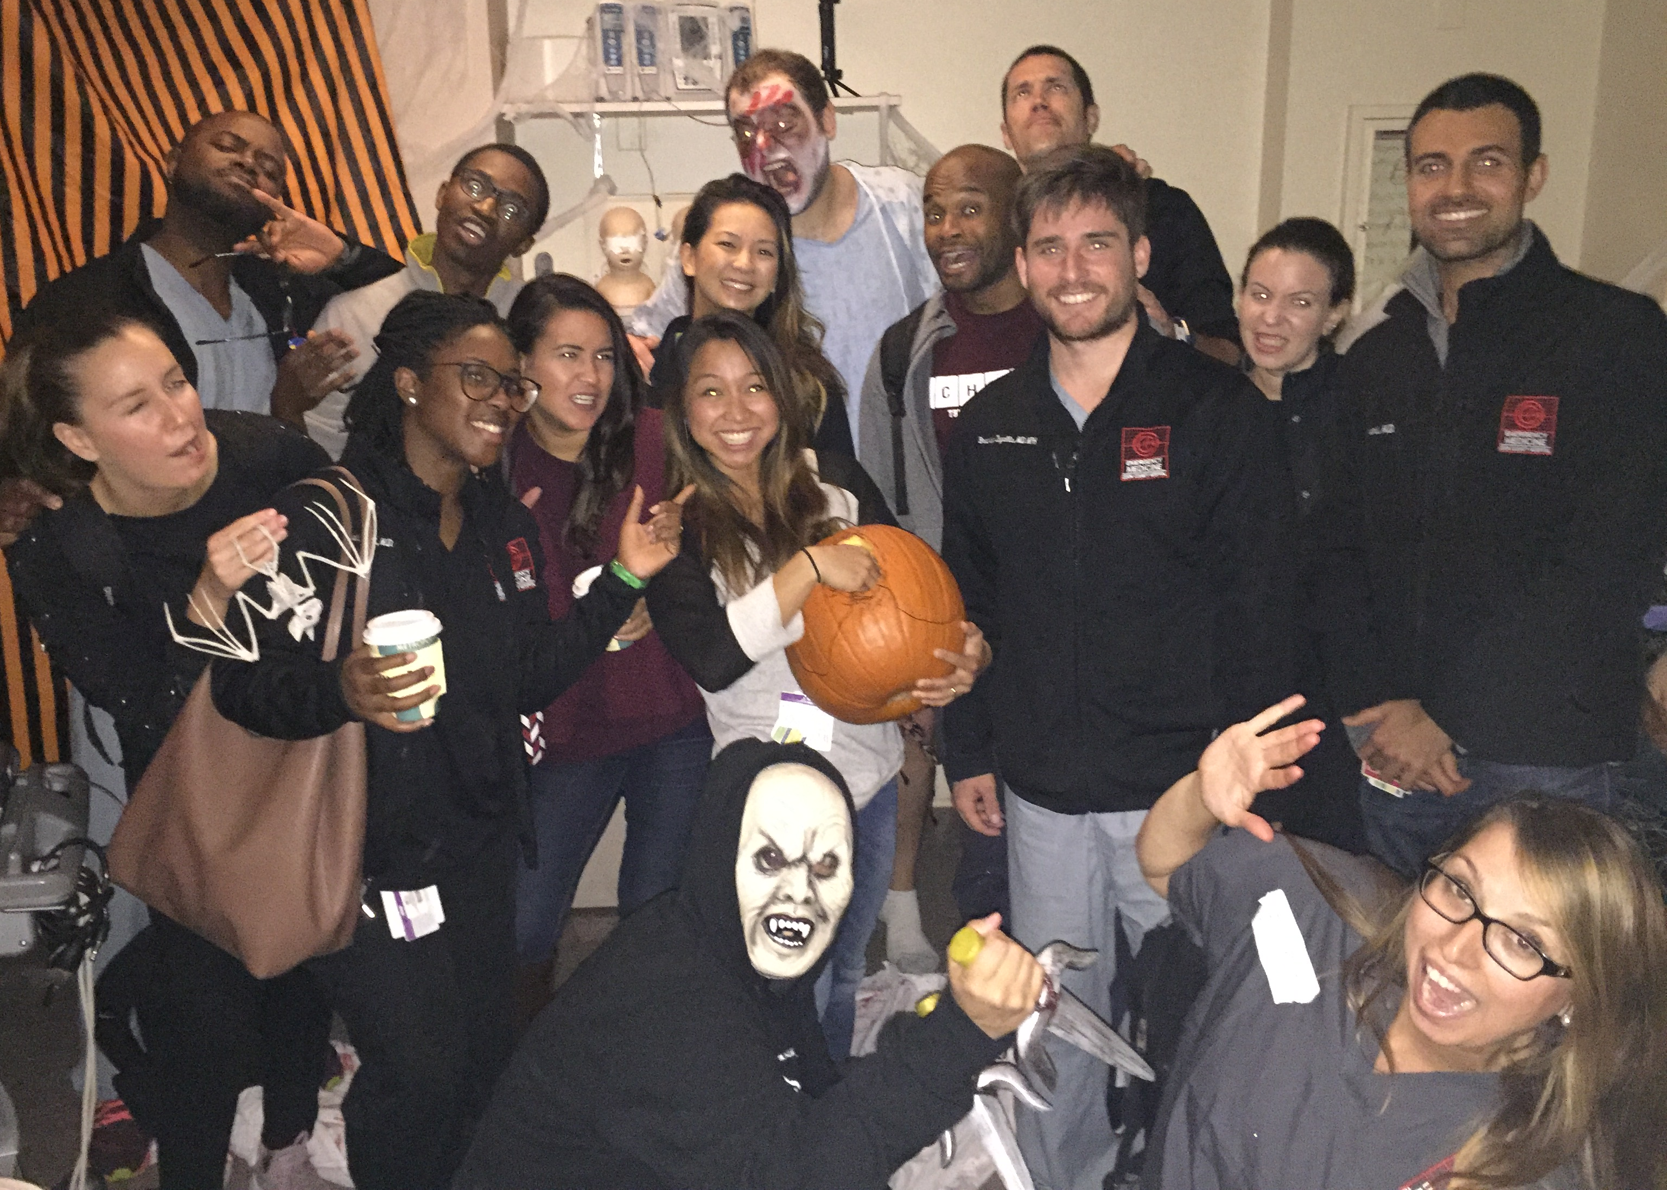
Creation of a Milestone-Driven Simulation Based Resuscitation Course
CLICK TO GO BACK TO KIOSK MENU
Alexandra Mannix, MD, J. Patrick Hoffman, MD, Clare Desmond, MD, Michelle Sergel, MD
Conclusion
This curriculum allows for the direct observation and evaluation of milestones.
Results can be used by residency leadership to evaluate and report milestones.
Intro/Objectives
Milestones
Curriculum
Impact
Conclusion
What’s Next?
Expanding similar curriculum to other post-graduate levels.
Validating this milestone-based assessment tool.
Thank You
Cook County Emergency Medicine Residency
Jillian Spratt, Brendan Kennedy, Tracy Hiller
Shari Schabowski, MD

