Slide 1
Definition of Medical Malpractice
Slides adapted with permission from:
Catherine Glazer, MD
With additional slides from “Malpractice 101”:
Desai B. Malpractice 101. MedEdPORTAL. 2012;8:9222. https://doi.org/10.15766/mep_2374-8265.9222
Notes:
Lecture on definition of medical malpractice part of CORD series
Not discussing military medicolegal issues

Slide 2
Goals and Objectives
History of malpractice
Overview of US legal system and how malpractice fits in
Definition and components of malpractice
Risk reduction methods

Slide 3
Case
Dr. Smith is notified by the hospital legal department that he has been named in a lawsuit
He has never been involved in a lawsuit
Like many ED physicians he does not have extensive legal knowledge and wants to learn more about the malpractice process and what he could do to prevent this in the future…
Notes:
Litigation is a time consuming and stressful process for physicians
Understanding the medicolegal system and the medical litigation process may help physicians be better able to participate in their defense should they be named in a lawsuit and potentially avoid litigation with a better understanding of the process and risk factors.

Slide 4
History
Concept of medical malpractice as a legal wrong is as old as the Roman empire (AMA Journal of ethics)
US malpractice first claim in 1794
Surge in late 1960s
More complex medical tx
Removal of barriers to lawsuits
Change in rules protecting charitable institutions from lawsuits
Notes:
In the United States, medical malpractice claims began to appear in the 1800s [17], but it was not until the 1960s that a surge of medical malpractice claims appeared in the courts [18]. This surge was likely driven by a number of factors: new and more complex treatments with higher risks of iatrogenic harm, a changing legal landscape that removed barriers to lawsuits and changed liability rules that had previously shielded charitable institutions from suit, and changes in satisfaction with the health care system, among others [19]. (most jurisdictions rolled back charitable immunity for hospitals. Courts also moved toward national standards of care and abandoned strict interpretations of the “locality rule,” which had required plaintiffs to find expert witnesses within the defendant’s immediate practice community.)
The rising incidence and costs of malpractice litigation led organized medicine to lobby for state and federal interventions to curb the burdens of the current malpractice liability system
The synergistic effect of changes in legal doctrine, advances in medical science, and the development of more coherent and visible standards of care eventually began to show in surges of litigation and plaintiffs’ victories. By the mid-1970s, many states were facing a malpractice crisis, although the situa- tion varied considerably from state to state.23 Using data from the height of the crisis, Danzon reported that claims rates and average payouts differed by a factor of almost 20 between low-activity states, such as Maine, and high-activity states, such as California and Nebraska.

Slide 5
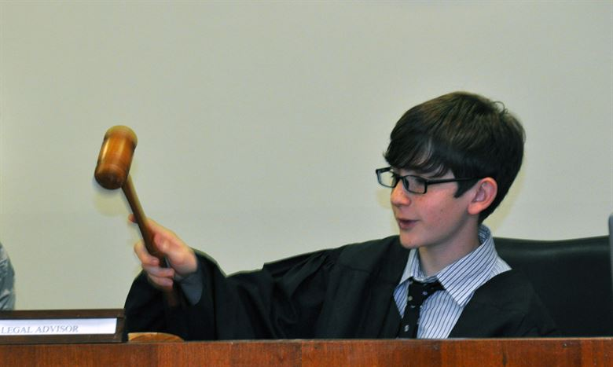
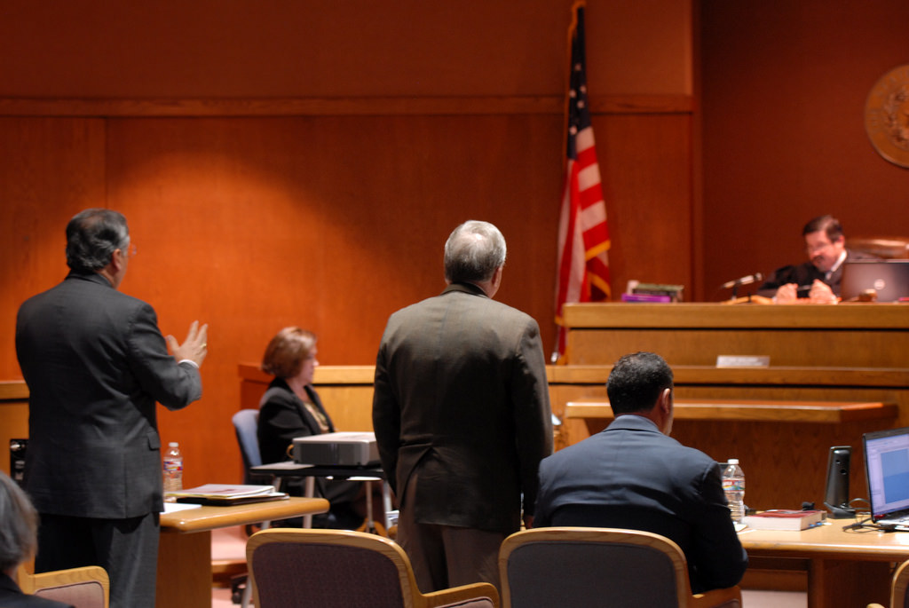
Law 101
Judge
Jury
Lawyers
Notes:
Legal system based on premise of trial advocacy, based on judge, jury and 2 opposing parties.
Judge is decider of questions of law
Jury is decider of facts, this includes whether physician was negligent, committed malpractice, whether there was injury related to the malpractice and if the injury warrants monetary reward
Lawyers job is to represent client, winning does not necessarily equal justice or truth and are paid on contingency collecting only after settlement or award

Slide 6
Law 101
Civil law vs Criminal law
Malpractice is part of tort law (subset of civil law)
Burden of proof
Civil law needs preponderance of evidence
Punishment
Civil law = financial
Notes:
More detail on following slides of each bullet point
Criminal law is where the government brings an action against an individual or entity accused of wrongdoing, government serves as plaintiff
Civil law essentially deals with disputes between individuals or entities
Goal of the medical malpractice system is multipronged: Deter unsafe practices, compensate persons injured through negligence, and exact corrective justice

Slide 7
Law 101
Malpractice falls under tort law
Tort law is defined as a legal wrong committed upon the person or property independent of contract
Subset of civil law as opposed to criminal law
Tort law encompasses categories such as negligence, gross negligence, professional negligence, and acts of intentional harm
Notes:
Tort law is a type of law that is frequently used to seek justice in our legal system, it is the area of law that applies when one person harms another
Tort law is a combination of legislative enactments and common-law principles, may vary substantially from state to state as they are often based on precedents from prior rulings.
Tort comes from a Latin word meaning twisted; thus, a tort is an act twisted from the standard, or a wrong
The ultimate goal of the legal system in resolving a tort is to make the plaintiff whole, which is impossible in many medical situations Failing this, money is awarded to compensate damages that the defendant caused the plaintiff
The nature of the tort system in the United States has been a major contributing factor to the persistence of malpractice litigation

Slide 8
Tort Law
Tort law is divided into 3 categories:
Intentional torts
Strict liability
Negligence
Desai B. Malpractice 101. MedEdPORTAL. 2012;8:9222. https://doi.org/10.15766/mep_2374-8265.9222

Slide 9
Tort Law: Intentional Torts
Injuries that occur when the wrongdoer knows he or she is causing harm
An example of an intentional tort is when a person hits another person
Desai B. Malpractice 101. MedEdPORTAL. 2012;8:9222. https://doi.org/10.15766/mep_2374-8265.9222

Slide 10
Tort Law: Strict liability
A liability incurred even though the defendant did not mean to cause harm and may have even tried to prevent harm
Medication-induced adverse effects, such as liver failure or heart valve damage, are good examples of strict liability
Desai B. Malpractice 101. MedEdPORTAL. 2012;8:9222. https://doi.org/10.15766/mep_2374-8265.9222

Slide 11
Tort Law: Negligence
Roughly translated as carelessness
Malpractice cases are most frequently brought forth as negligence actions
Desai B. Malpractice 101. MedEdPORTAL. 2012;8:9222. https://doi.org/10.15766/mep_2374-8265.9222

Slide 12
Proof
Criminal Law
Civil Law
Burden of proof is always on the state
“Innocent until proven guilty”
The state must prove that the defendant satisfied each element of the statutory definition of the alleged crime, and the defendant's participation, "beyond a reasonable doubt."
The burden of proof is initially on the plaintiff
The plaintiff wins if the preponderance of the evidence favors the plaintiff
Desai B. Malpractice 101. MedEdPORTAL. 2012;8:9222. https://doi.org/10.15766/mep_2374-8265.9222

Slide 13
Potential Punishment/Damages
Criminal Law
A guilty defendant is punished by either:
Incarceration
Fine paid to the government
Execution of the defendant: the death penalty
Desai B. Malpractice 101. MedEdPORTAL. 2012;8:9222. https://doi.org/10.15766/mep_2374-8265.9222

Slide 14
Potential Punishment/Damages
Civil Law
A losing defendant in civil litigation only reimburses the plaintiff for losses caused by the defendant's behavior with no threat of incarceration
Desai B. Malpractice 101. MedEdPORTAL. 2012;8:9222. https://doi.org/10.15766/mep_2374-8265.9222

Slide 15
Statute of Limitations
The statute of limitations varies among states and serves to limit liability to what the law considers a reasonable degree
Plaintiffs have a set period to bring action after an injury occurs
Many states have a 1-yr limit, but some states allow 3 or more yrs
Two major caveats must be noted:
Statute starts when the injury is discovered.
Ex. sponge is discovered in a patient's abdomen after a surgery that occurred 8 years earlier, the patient still has 1 year to file a claim
In the case of a minor, the patient has until the age of majority (18 years) plus the year included in the statute to file a claim
Desai B. Malpractice 101. MedEdPORTAL. 2012;8:9222. https://doi.org/10.15766/mep_2374-8265.9222
Notes:
Most states define as taking effect when plaintiff has become aware, or should have become aware, of the alleged act of malpractice
Caveat 1: Most importantly, the statute starts when the injury is discovered. For example, when a sponge is discovered in a patient's abdomen after a surgery that occurred 8 years earlier, the patient still has 1 year to file a claim
Caveat 2: In the case of a minor, the patient has until the age of majority (18 years) plus the year included in the statute to file a claim

Slide 16
Statute of Limitations - Minors
Pediatrics differs due to the fact it can take a long time to recognize an alleged injury
For those with developmental delay, an injury may not be recognized until they’re in school many years later so it could be 5-10 years later
Further, If the family didn’t want to file a lawsuit, when the child becomes 18 years old they have one year to file suit
Desai B. Malpractice 101. MedEdPORTAL. 2012;8:9222. https://doi.org/10.15766/mep_2374-8265.9222

Slide 18
Medical Malpractice Definition
“Failure of a physician or health care provider to deliver proper services, either intentionally or through negligence, or without obtaining informed consent”

Slide 19
What makes up malpractice
4 elements, all must be present
Duty to treat
Did the care deviate from standard of care/was there negligence
Did the deviation/negligence cause the injury
Did the injury result in damage
Absence of one of the above criteria negates liability
Notes:
the physician had a duty to the patient;
the physician was negligent in his or her execution of the duty, (i.e., by breaching the standard of care);
the physician’s negligent action was the proximate cause of the patient’s injuries; and
the patient’s injury resulted in damages, whether economic or other
Depending on the state, judges may require additional criteria before letting a case go to a jury trial including:
Proving negligence had occurred as determined by expert witnesses
That the plaintiff had been injured, and
That the chance that negligence caused the injury was more than 50%

Slide 20
Duty to Treat
The first element
The physician-patient relationship
May be contractual
May be implied
EMTALA
There must be a defined and accepted standard of care that the physician is required to adhere to in treating the patient
Desai B. Malpractice 101. MedEdPORTAL. 2012;8:9222. https://doi.org/10.15766/mep_2374-8265.9222

Slide 21
Deviation from Standard of Care/ Breach of Duty
2nd element
The plaintiff must prove that the defendant breached their duty to treat
This usually occurs with the presentation of evidence by both sides that shows either the meeting of or violation of the standard of care
Desai B. Malpractice 101. MedEdPORTAL. 2012;8:9222. https://doi.org/10.15766/mep_2374-8265.9222
Notes:
A breach of a physician’s duty to patients can take many forms. For example, injuries may result from misdiagnosis, errors in the choice or technical execution of procedures, improper administration of medications, failure to follow up appropriately with a patient, and failure to obtain adequate informed consent

Slide 22
Standard of Care
What is the Standard of Care?
A physician must have the medical knowledge required of a reasonably competent physician engaged in the same specialty
They must possess the skills required of a reasonably competent physician in the same specialty
They must exercise the care in the application of that knowledge and skill to be expected of a reasonably competent physician in the same specialty
Use the medical judgment in the exercise of that care required of a reasonably competent practitioner in the same specialty
Desai B. Malpractice 101. MedEdPORTAL. 2012;8:9222. https://doi.org/10.15766/mep_2374-8265.9222
Notes:
Usually described as what a reasonably prudent health care provider would do under like or similar circumstances, most states refer to this in a national standard, although some may define more locally
The standard of care requirement means that the finder of fact, typically the jury, must hear testimony from both sides of the litigation about what the standard of care is and then evaluate that information to decide if the physician breached it, i.e., whether a reasonably prudent physician confronting similar circumstances would not have acted as the defendant physician did.

Slide 23
Did the Deviation Cause the Injury/ Proximate Cause
3rd element
The plaintiff must prove that the defendant’s breach of the duty of care owed to the plaintiff caused the plaintiff’s injury
Desai B. Malpractice 101. MedEdPORTAL. 2012;8:9222. https://doi.org/10.15766/mep_2374-8265.9222

Slide 24
Injury
The injury sustained by the plaintiff directly resulted from the physician's failure to meet an acceptable standard of care
In legal terms, the negligence of the defendant was a proximate cause of the injury and damages to the plaintiff
Desai B. Malpractice 101. MedEdPORTAL. 2012;8:9222. https://doi.org/10.15766/mep_2374-8265.9222

Slide 25
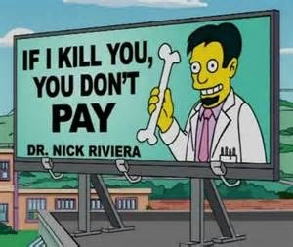
Did the Injury Result in Damages?
The successful satisfaction of all the elements mentioned resulted in a compensable injury
A plaintiff must prove that his or her injuries are of a nature that may be remedied by monetary damages
Desai B. Malpractice 101. MedEdPORTAL. 2012;8:9222. https://doi.org/10.15766/mep_2374-8265.9222

Slide 26
Damages
Two principal kinds:
Economic loss is damage that can be objectively measured
Wages lost due to the injury
Past and future medical care
Noneconomic damage is subjective and not measurable by any standard
e.g., Pain and suffering
Desai B. Malpractice 101. MedEdPORTAL. 2012;8:9222. https://doi.org/10.15766/mep_2374-8265.9222

Slide 27
Can I prevent this?
Probably not, number of pts seen is predictor of lawsuits
Carlson, Jestin N. et al. Provider and Practice Factors Associated With Emergency Physicians’ Being Named in a Malpractice Claim, Annals of Emergency Medicine , Volume 71 , Issue 2 , 157 - 164.e4
Notes:
Of the 9 independent variables, only increasing total number of years in practice (adjusted odds ratio 1.04 per year; 95% confidence interval 1.02 to 1.06) and total patients treated as the attending physician of record (adjusted odds ratio 1.09 per 1,000 visits; 95% confidence interval 1.05 to 1.12) were associated with being named in a malpractice claim (Table 1). When data were stratified by visit volume, there was a direct relationship between visit volume and malpractice risk that increased with increasing years in practice

Slide 29
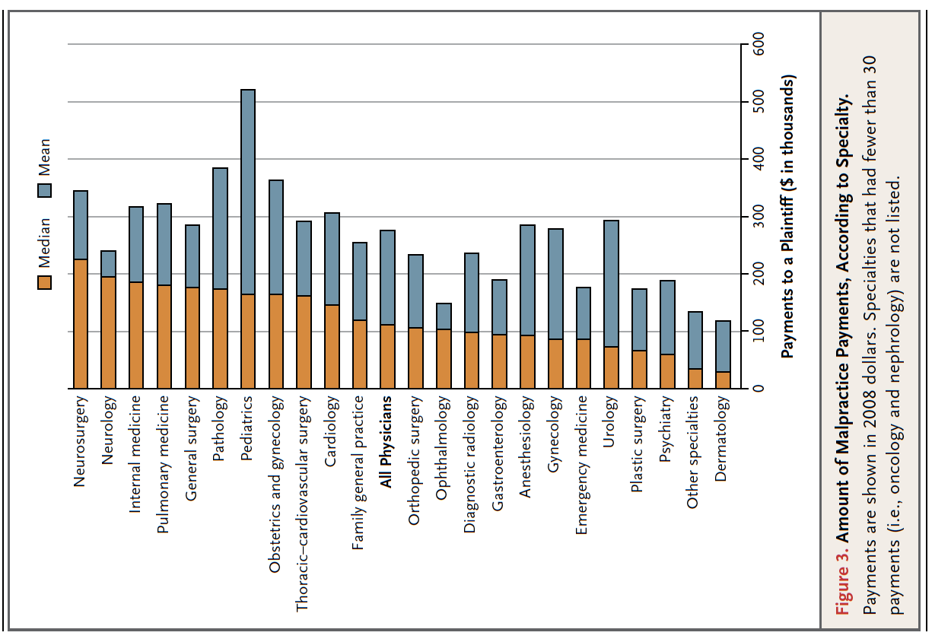
Notes:
NEJM article: Across specialties, 7.4% of physicians annually had a claim, whereas 1.6% made an indemnity payment. There was significant variation across specialties in the probability of facing a claim, ranging annually from 19.1% in neurosurgery, 18.9% in thoracic–cardiovascular surgery, and 15.3% in general surgery to 5.2% in family medicine, 3.1% in pediatrics, and 2.6% in psychiatry

Slide 30
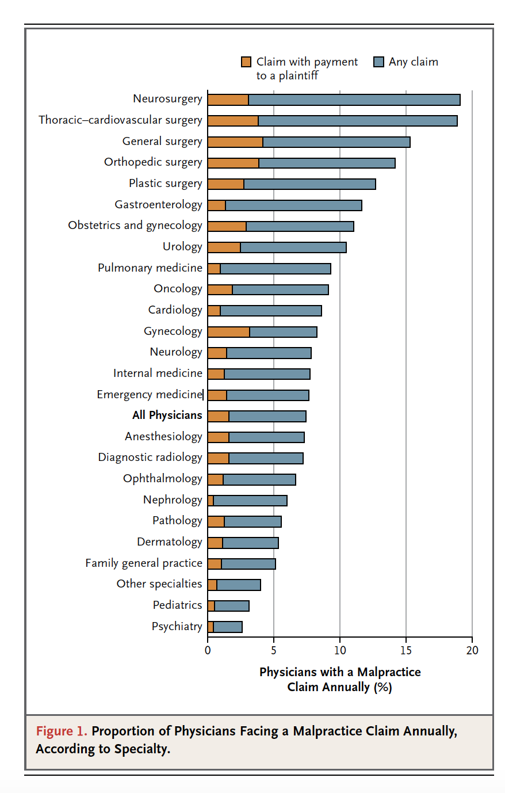

Slide 31
You Will be Sued Eventually
50% of emergency physicians will be sued at least once in their career, more than 30% twice
Enormous emotional toll
Profoundly expensive
(more than $100,000 to litigate)
Extremely time consuming
(takes >45 MONTHS to complete a suit)

Slide 32
Emergency Medicine is High Risk
Number 5 in incidence of lawsuits just behind radiology
Good news: 65% claims dropped without settlement
Only 7% go to trial

Slide 33
High Risk Factors Unique to EM
Patients are already in pain, scared and often angry
They have never seen you before and you have very little time to establish a rapport
They are often very sick

Slide 34
High Risk Factors Unique to EM
Shift work – 63% of malpractice incidents occur between 6pm and 1am on weekends and holidays
Busy and patients are already angry
Decreased staffing
Fatigue
Acuity of presentation
(unable to see PCP, change in behaviors, etc.)

Slide 35
High Risk Factors Unique to EM
Return Visits
Despite general opinion, up to 25% of initial dx is wrong
Merits a thoughtful re-eval and possible increased level of investigation
Language Barrier
You are expected to use and document that you used a translator, otherwise at significant risk for missed information

Slide 36
High Risk Factors Unique to EM
Shift Change
Customary vigilance relaxed as pt has already been evaluated
Miscommunication
Failure to re-evaluate pt and integrate new labs
Informed Consent in emergent situations

Slide 37
What do You Get Sued For?
Malfeasance (performing action which should not have been performed)
MAST trousers for pulmonary edema
Misfeasance (performing action in improper way)
Suturing complex hand lac without eval of neurovasc and tendon function beforehand
Nonfeasance (failing to perform indicated action)
Not doing septic workup on 2 week old febrile child

Slide 38
What do You Get Sued For
Consent (failure to get informed consent for invasive procedures can result in battery charges)
Restraint without evidence of pt being threat to himself or others is false imprisonment or assault and battery
Failure to report (sexual assault, child abuse, stabbings/shootings and assaults, STDs, DOAs, poisonings, animal bites)
MVCs and ETOH as well as adult/elder abuse reporting requirements vary by state

Slide 39
Now what do you REALLY get sued for?
FP’s and Pediatricians have the lowest incidence of suits
Surgeons have the highest incidence
Good communication and establishing a good relationship with patients will protect against most suits

Slide 40
Once communication and excellent care have failed, an airtight chart will prevent the plaintiff’s attorney from even taking the case

Slide 41
Questions

Slide 42
References
Zane RD. “The Legal Process” Emerg Med Clin N Am 27 (2009) 583-592
Jena AB, Seabury S, Lakdawalla D, Chandra A. “Malpractice Risk According to Physician Specialty” N Engl J Med 365;7 August 18, 2011
Kass JS, Rose RV. “Medical Malpractice Reform: Historical Approaches, Alternative Models, and Communication and Resolution Programs“ AMA J Ethics. 2016;18(3):299-310.
Carlson, Jestin N. et al. Provider and Practice Factors Associated With Emergency Physicians’ Being Named in a Malpractice Claim, Annals of Emergency Medicine , Volume 71 , Issue 2 , 157 - 164.e4
Desai B. Malpractice 101. MedEdPORTAL. 2012;8:9222. https://doi.org/10.15766/mep_2374-8265.9222
Special thanks Catherine Glazer, MD for sharing slides

