Slide 1
Arthrocentesis and Synovial Fluid Analysis

Slide 2
Indications
Suspected septic arthritis
Febrile patient with an acute flare of established arthritis
Unexplained joint, bursa or tendon sheath swelling
Suspected crystal-induced arthritis
Therapeutic injection or aspiration
Methylene blue injection or saline load test
Notes:
Indications:
Suspicion of septic arthritis
Suspicion of crystal induced arthritis
Unexplained arthritis with synovial effusion
Relative: therapeutic (decrease intra-articular pressure, injection of anesthetics/steroids)

Slide 3
Contraindications
No absolute contraindications for diagnostic arthrocentesis
Do not inject steroids into a joint that you suspect is already infected
Relative Contraindications:
Overlying cellulitis
Coagulopathy
Joint prosthesis (refer to ortho)

Slide 4
Patient education
Risks: Iatrogenic septic joint (1/3,500), damage to neurovascular structures, flushing and post-injection flare with kenalog injection
Post-procedure: activity limitations, bathing, dressing, compression, cold therapy, pain control, observation for iatrogenic infection
Notes:
Can also discuss less common risks of hypopigmentation and fat atrophy which typically occur in superficial steroid injections

Slide 5
Equipment
Syringe
Needles
Topical / local anesthetic
Test tube and culture tubes
Sterile gloves
Mask
Chlorhexadine prep
Drape
Bandage
Gauze
Elastic bandage

Slide 6
Technique
Needle size – Knee: 18-22g
Syringe – 5-50 mL

Slide 7
Site preparation
Chlorhexadine prep – 30s scrub, 30s dry.
4x5in area with 3mL applicator
Don’t shave area, avoid needle contact with hair

Slide 8
Anatomic approach
Easy access
Least obstruction by bone
Avoidance of neurovascular bundles

Slide 9
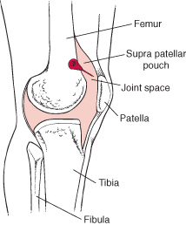
Knee: The needle is inserted just posterior to the medial portion of the patella and is directed slightly posteriorly and slightly inferiorly

Slide 10
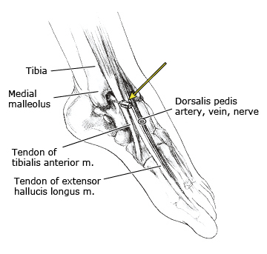
Ankle: With the leg-foot angle at 90 degrees, the needle is inserted at a point just medial to the tibalis anterior tendon and just lateral to the medial malleolus. The needle is then directly posteriorly

Slide 11
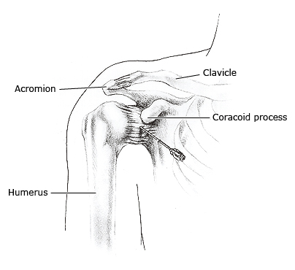
Shoulder: With the shoulder externally rotated, the needle is inserted at a point just medial to the head of the humerus and slightly inferior and lateral to the coracoid process. The needle is then directed posteriorly and slightly superiorly and laterally

Slide 12
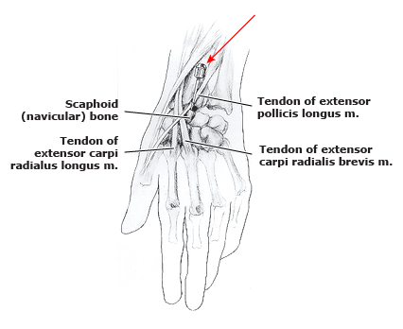
Wrist: The needle is inserted at a point just distal to the radius and just ulnar to the anatomic snuff box. It is then directed perpendicularly. If bone is hit, the needle should be pulled back and slightly redirected toward the thumb

Slide 13
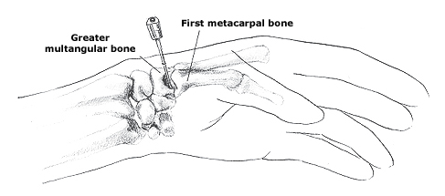
1st CMC: The thumb is flexed across the palm toward the tip of the fifth finger. The needle is inserted at the base of the metacarpal bone away from the border of the snuff box. It is then directed toward the proximal end of the fourth metacarpal.

Slide 14
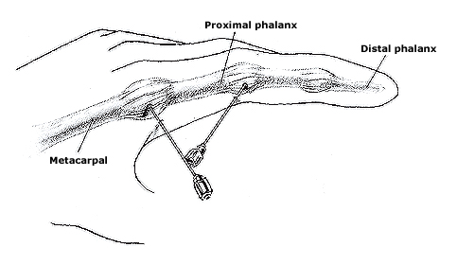
MCP and finger: With the digit straight or slightly flexed, a small and short needle is inserted on either side just under the extensor tendon mechanism. It is not necessary for the needle to be interposed between the articular surfaces

Slide 15
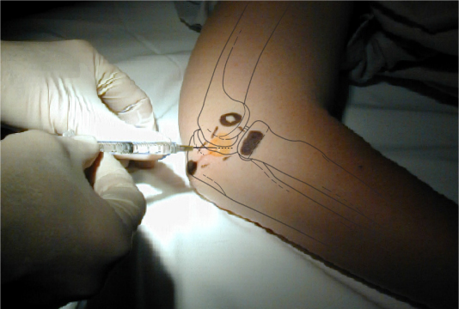
Elbow: The landmarks for injection or aspiration of the elbow joint are the radial head, lateral epicondyle, and tip of the olecranon. A needle inserted into the center of the triangle penetrates only the anconeus muscle and capsule before entering the joint. The patient is supine with the elbow flexed to 90 degrees and the hand tucked under the buttock. A triangle is made with points at the lateral epicondyle, radial head, and olecranon process. The needle is inserted in the center of the triangle, perpendicular to the skin and parallel to the radial head, 0.75 to 1 inch (about 2 to 2.5 cm) deep.

Slide 16
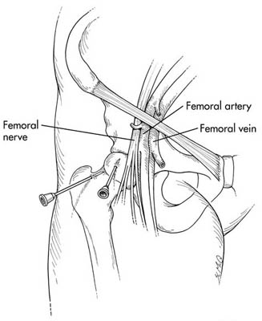
Hip: US guided

Slide 17
SYNOVIAL FLUID ANALYSIS

Slide 18
Specimen handling
Aspiration performed under aseptic conditions
Transfer fluid into sterile test tube and an aliquot into an aerobic blood culture bottle (and an anaerobic blood culture bottle if anaerobic organism is suspected)

Slide 19
Characteristics of synovial fluid
Normal
Highly viscous
Clear
Essentially acellular
Protein concentration 1/3 of plasma
Glucose concentration similar to plasma

Slide 20
Categories of joint effusions
Noninflammatory – OA, trauma, OCD
Inflammatory – RA, gout, pseudogout
Septic – bacteria, mycobacteria, fungus
Hemorrhagic – hemophilia, anticoagulation, trauma, tumor

Slide 21
Components of synovial fluid analysis
Gross appearance
Clarity
Color
Viscosity

Slide 22
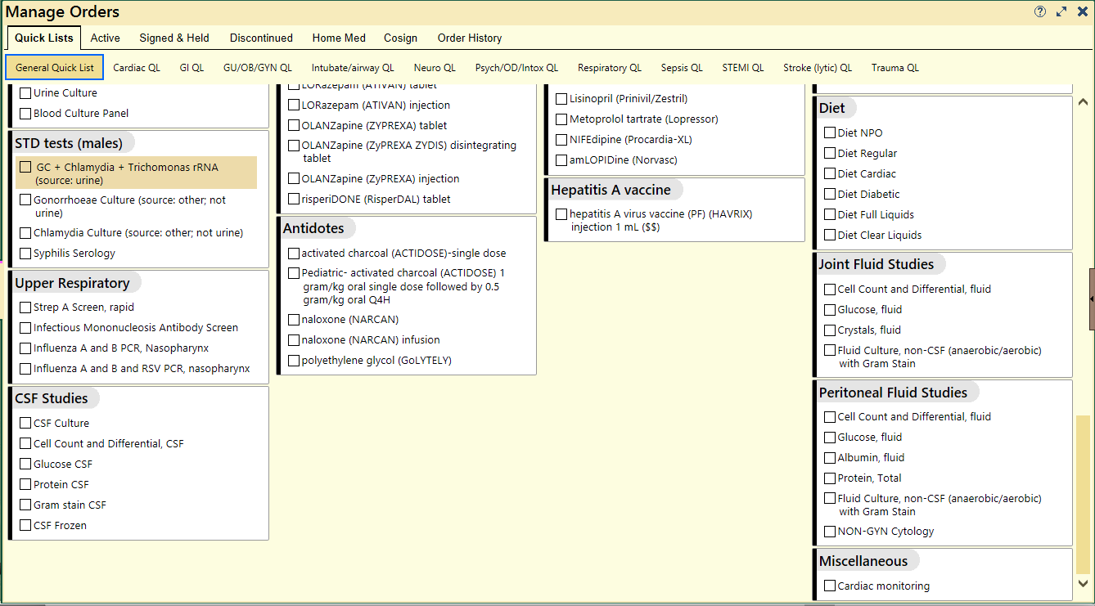
Lab studies
Notes:
Discuss ordering tests, consider replacing the picture with a screenshot from your own EMR

Slide 23
Cell count with differential
Cell count – normally nearly acellular. Bacterial infections typically with leukocyte count of 50,000-150,000 cells/mm³
Likelihood ratios for septic arthritis:
< 25,000: LR = 0.32
25,000-50,000: LR = 2.9
50,000-100,000: LR =7.7
> 100,000: LR = 28
Differential – bacterial > 75% PMNs, eosinophilia suggestive of parasitic, neoplastic or Lyme disease

Slide 24
Crystal search
Monosodium urate (MSU) - gout
Calcium pyrophosphate dihydrate (CPPD) – pseudogout

Slide 25
Glucose
Decreased in septic arthritis

Slide 26
Gram stain and culture
ID of organism
Aerobic culture +/- anaerobic culture
Suspected gonococcal, lyme or TB – must request specific testing

Slide 27
Arthrocentesis Cases

Slide 28
CASE 1
History:
A 45 y/o male history of left ankle laceration from fence 3 weeks prior presents with severe pain in the ankle unrelieved by aspirin and cold pack. Patient denies new trauma patient has history of diabetes but hasn’t followed with his doctor for a few years. Patient denies further medication. Patient has pain with active and passive dorsiflexion and plantar flexion with only 5 degrees. Laceration is well healed no erythema or signs for cellulitis. Significantly swollen ankle without deformity or bruising.
Notes:
The purpose of case one is to facilitate a discussion about indications for arthrocentesis to evaluate for septic joint

Slide 29
CASE 1
Vitals BP 123/78 HR100 RR22 Temp 37.9C

Slide 30
Case 1
Xray: No signs for Fracture or dislocation
Labs: Na136 K+ 4.0 Cl 106 HCO3 24 BUN 8 Cr1.1 Gluc 348
WBC 9.8 Hgb12.5 Hct 35 Plt 150,000 ESR 30mm/hr CRP 4mg/dL

Slide 31
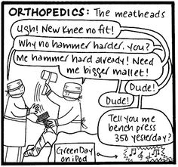
Case 1
What to do next?
Notes:
The correct answer is to perform arthrocentesis

Slide 32
Case 1
Arthrocentesis:
Cloudy, thin
Crystals: none
Synovial fluid WBC: 101,000/mm3
Neutrophils: 92%
Notes:
Allow participants to discuss results of the arthrocentesis and interpretation – The correct diagnosis is septic joint

Slide 33
Case 2
History
A 22 y/o woman presented to the Emergency Department because of progressively severe unilateral wrist pain of 24 hours duration. No preceding injury or unusual physical activity was identified. Plain radiographs of the wrist were unremarkable. A splint was applied. Ibuprofen was prescribed at 600 mg TID and she was discharged with a diagnosis of wrist sprain.
Notes:
Case 2 will allow for a discussion about gonococcal arthritis

Slide 34
Case 2
Pain Persisted overnight and patient returned with worsening symptoms
Further history revealed the absence of nausea, vomiting, diarrhea, bloody stool, swollen glands, photophobia or ocular irritation. Past medical and family histories were noncontributory.

Slide 35
Case 2
Physical Examination
The patient was a well-developed, well-nourished 22 y/o woman. She was febrile, temperature 101ºF, though hemodynamically stable. Articular examination was notable for swelling and warmth at the left wrist. The wrist joint was exquisitely tender to palpation and to manipulation. Swelling extended over the dorsal surface of the hand. The fingers were spared. Skin findings were notable for several tender bilateral palmar violaceous pustular eruptions. What tests would you perform?

Slide 36
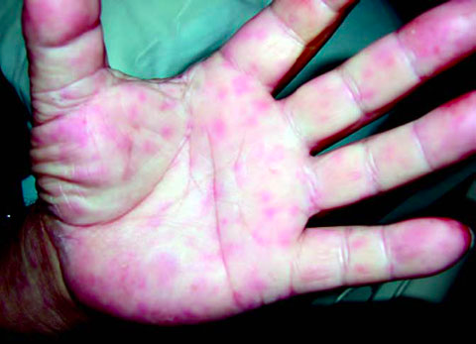
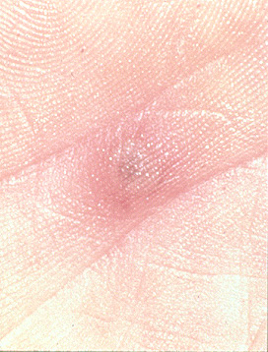
Case 2
No pain
Pain central necrosis
No Pain scaley

Slide 37
Case 3
History: 42 YO male h/o HTN presents c/o pain over entire foot progressively worsening over the past 3 days patient notes “hot swelling “over 1st MTP and minor relief with NSAIDS but patient advised not to use with other BP meds.
BP meds unknown.
Notes:
Case three will prompt participants to discuss gout and pseudogout

Slide 38
Case 3
SHx: Occasional ETOH 1-2 beer 5 times per week, Caffeine intake 3 cup coffee per day. Employed at local Deli. Denies smoking or drug use.
Physical: Obese male swollen foot with erythema at angle of hallux at 1st MTP. Mild valgus deformity.

Slide 39
Case 3
Arthrocentesis:
Opaque
Crystals: present
Synovial fluid WBC: 10,000/mm3
Neutrophils: 81%

Slide 40
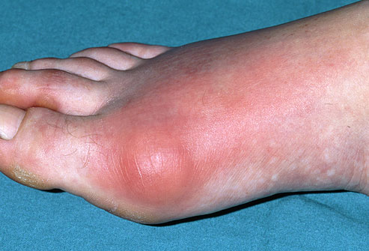
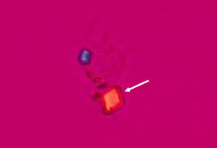
Gout

Slide 41
Case 4
History:
65 y/o female h/o RA with hot left swollen knee similar to flare ups of RA. Patient has limited ROM of knee with swelling and intact skin. Thick anterior scar. RA medication has been working to halt flares since started and patient has not missed any doses. No history of gout. Patient getting over recent “cold” but not treated with antibiotics.
Notes:
Case four is designed to allow participants to discuss atypical infections

Slide 42
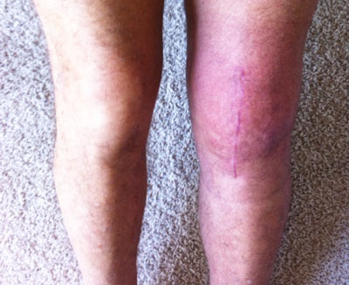
Case 4
Physical: Large effusion on knee linear scar well healed no skin breakdown no bleeding
Meds: Etanercept
Social Hx: Denies ETOH, Drugs, or Smoking Works as staff nurse in a jail for retirement job as it is mostly sit down work.

Slide 43
Case 4
Arthrocentesis:
Clear/dark yellow
Crystals: none
Synovial fluid WBC: 1500/mm3
Neutrophils: 65%

Slide 44
Case 4
Ortho resident consulted over phone and feels this is RA flare based on history in EMR, resident agrees to follow cultures recommends discharge
Patient started on empirically on Keflex and sent home from ED to follow up in 2 weeks.
Gram stain and Culture after 5 days return negative.

Slide 45
Case 4
Patient returns to ED before weekend 5 days later and continues to have pain and swelling returned the area worsening, febrile with BP 82/48 toxic appearing and x rays obtained…

Slide 46
Case 4

Slide 47
Case 4

Slide 48
Immunosuppression
Need to request special cultures for CD4<200, immunocompromised, sickle cell, iatrogenic risk
GC, P. acnes, fungal, TB

