Slide 1
Collapse During Exercise

Slide 2
Goals and Objectives
List the differential diagnosis of the collapsed athlete.
Discuss the potential complications of sickle cell trait in athletes.
Identify normal variants on EKGs of trained athletes.
Identify pathological EKG findings that suggest cardiomyopathies in athletes.
Identify pathological EKG findings that suggest primary dysrhythmias in athletes.

Slide 3
Disclosures

Slide 4
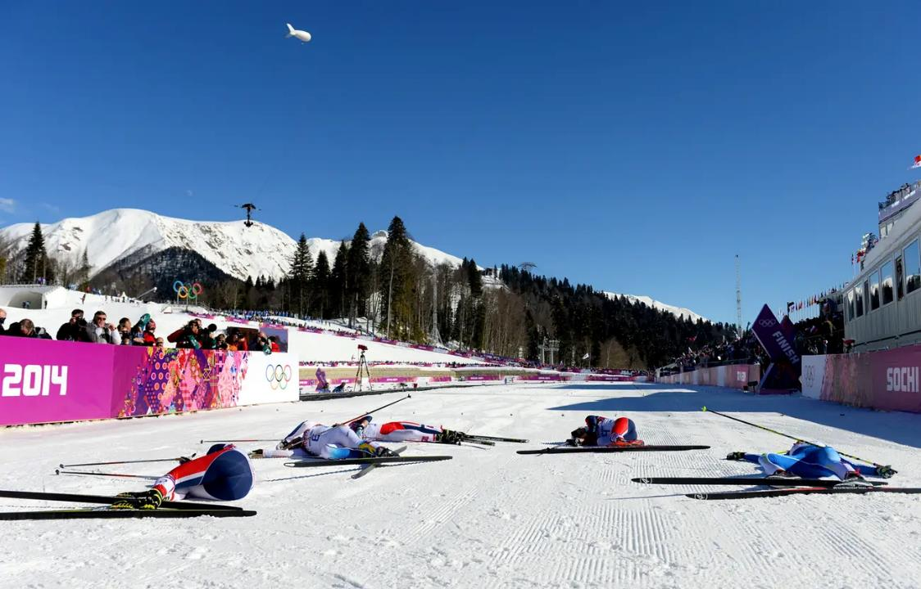
Notes:
Working the sideline of a Nordic ski race, and this is the scene at the finish line. https://www.youtube.com/watch?v=oj9xZBfdb8I&feature=emb_err_woyt
What is likely going on here? These are examples of exercise-associated collapse. In exercise-associated collapse, cardiac pre-load decreases immediately upon cessation of activity as the muscular action that was pumping blood from the vasodilated periphery back to the heart abruptly stops, resulting in postural hypotension.
What is on your differential? Cardiac arrest, dehydration, sodium disturbance, heat stroke
How do you approach workup and management of these athletes? Check for responsiveness and presence of breathing. Monitor closely for a few minutes to ensure that they are able to progressively move and stand.

Slide 5
Exercise Associated Collapse
most common reason that athletes are treated in the medical tent following an endurance event
loss of muscle pumping action + cutaneous vasodilation = postural hypotension
usually occurs after an athlete crosses the finish line

Slide 6
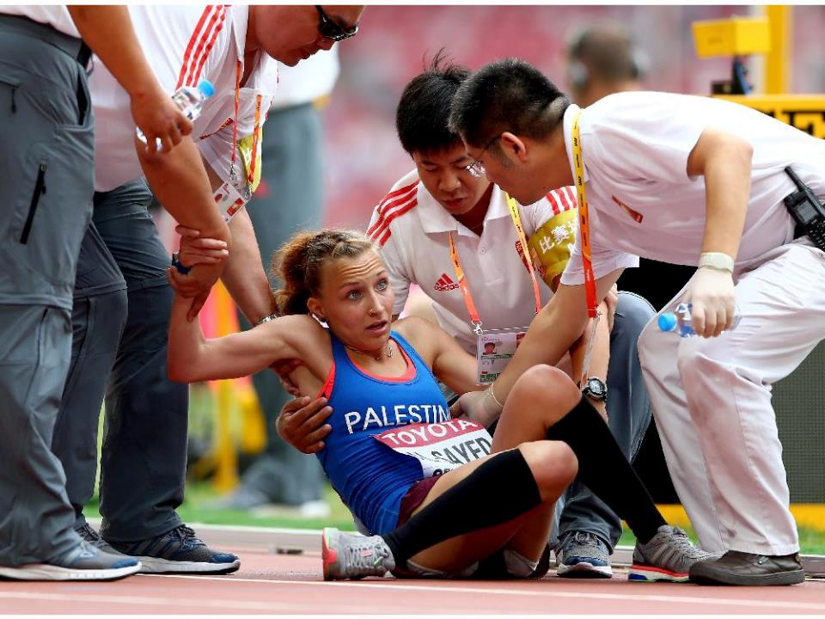
Notes:
A good example of exercise-associated collapse in endurance running, where it is very common.
-the patient is awake
-the patient is at the finish line (where exercise associated collapse [EAC] typically occurs)

Slide 7
Notes:
Marathon event coverage – 23-year-old man collapses during event. usually due to something other than EAC. Differential?
-cardiac arrest
-hypoglycemia
-exercise-associated postural hypotension/collapse
-exercise-induced anaphylaxis
-exercise associated hyponatremia
-hypernatremia
-exertional heat stroke
-heat exhaustion
-if at altitude:
-acute mountain sickness
-high altitude cerebral edema
-high altitude pulmonary edema

Slide 8
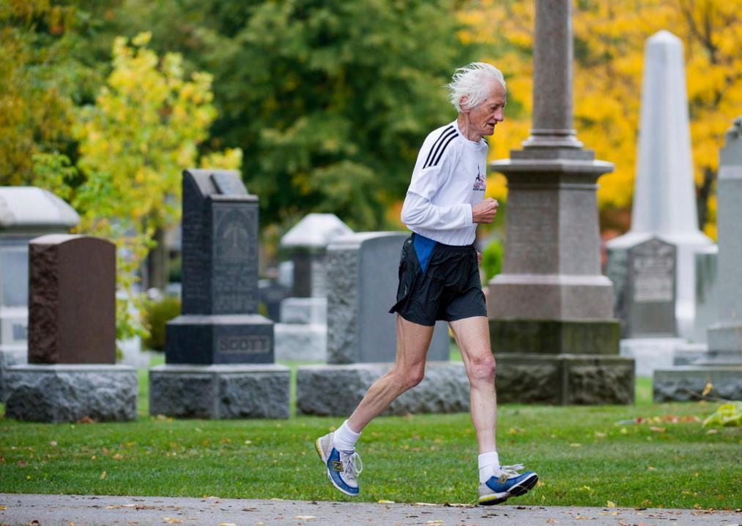
Notes:
What if this athlete collapses?
>35 years
Most commonly atherosclerotic coronary artery disease (CAD)
More than 80% of SCD in older athletes due to CAD
Regular exercise increases the risk of sudden cardiac death (SCD) from CAD acutely, but decreases the overall risk in the long term

Slide 9
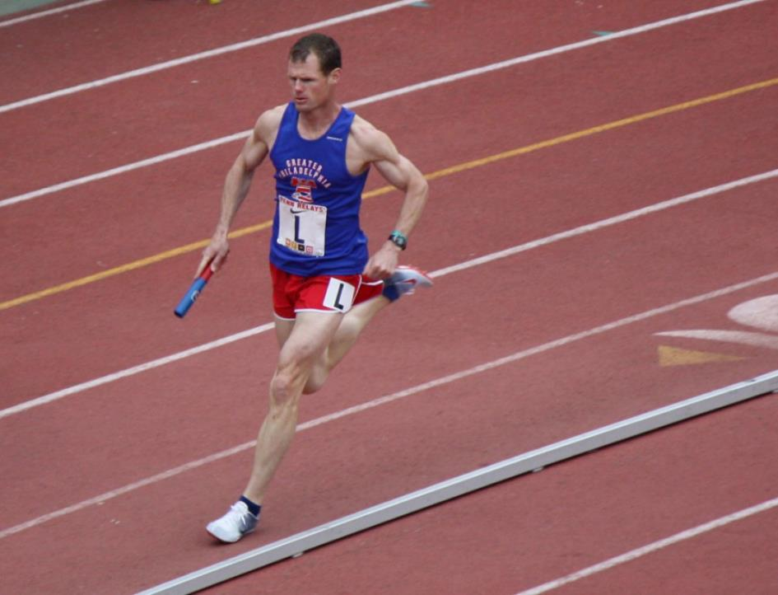
Notes:
Masters world record holding man – 42 years old. Collapses. From what?
-Still most likely to be ischemic heart disease

Slide 10
Notes:
September, 2019: A Missouri high school football player died when he went into cardiac arrest after a practice this week, according to the school district. A16-year-old sophomore and his teammates were doing conditioning exercises in the gym Wednesday, because it was too hot outside, where temps reached a high of 90 degrees. Once conditioning was over, the student-athlete suffered a medical emergency around 5:30 p.m.
Differential:
-heat stroke
-hyponatremia
-dehydration
-cardiac dysrhythmia
-structural heart disease (HCM)
-rhabdomyolysis
-SICKLE CELL TRAIT
-predisposes athletes to rhabdomyolysis and hyperkalemia resulting in collapse or death
-hypoxia, dehydration, lactic acidosis, hyperthermia can all precipitate sickling

Slide 11
Notes:
Questions about the situations in which athletes collapse?

Slide 12
Notes:
EKG findings that are normal in trained athletes’ hearts

Slide 13
Notes:
Sinus bradycardia

Slide 14
Notes:
Isolated LVH

Slide 15
Notes:
Incomplete right bundle branch block

Slide 16
Notes:
1st degree AV block or Mobitz 1 (Wenckebach)

Slide 17
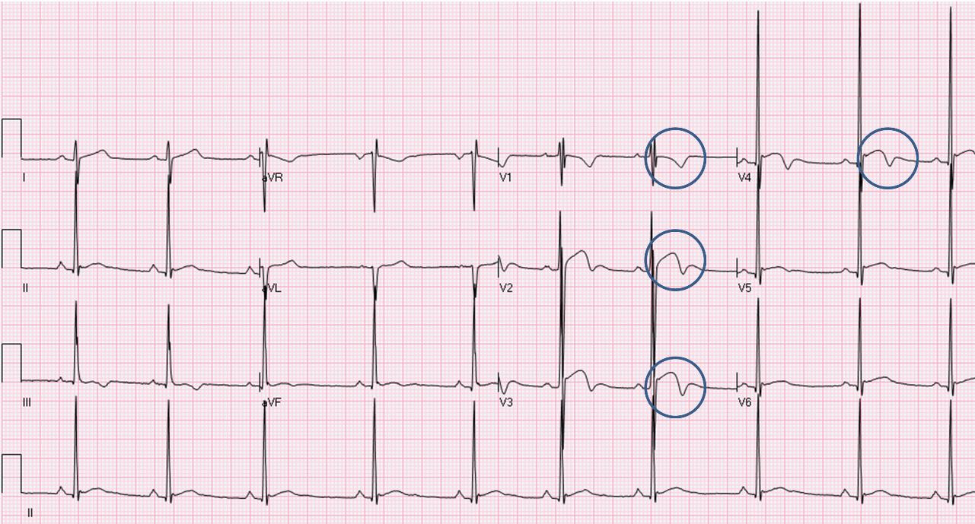
Notes:
ST elevation V1-V3 in afro-caribbean athletes
Distinguish it from Brugada syndrome: Zorzi A, et al. Differential diagnosis between early repolarization of athlete's heart and coved-type Brugada electrocardiogram. Am J Cardiol 2015;115:529-532.

Slide 18
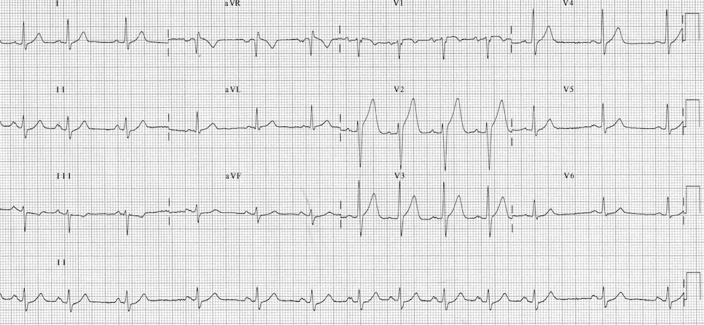
Notes:
Sinus arrhythmia

Slide 19
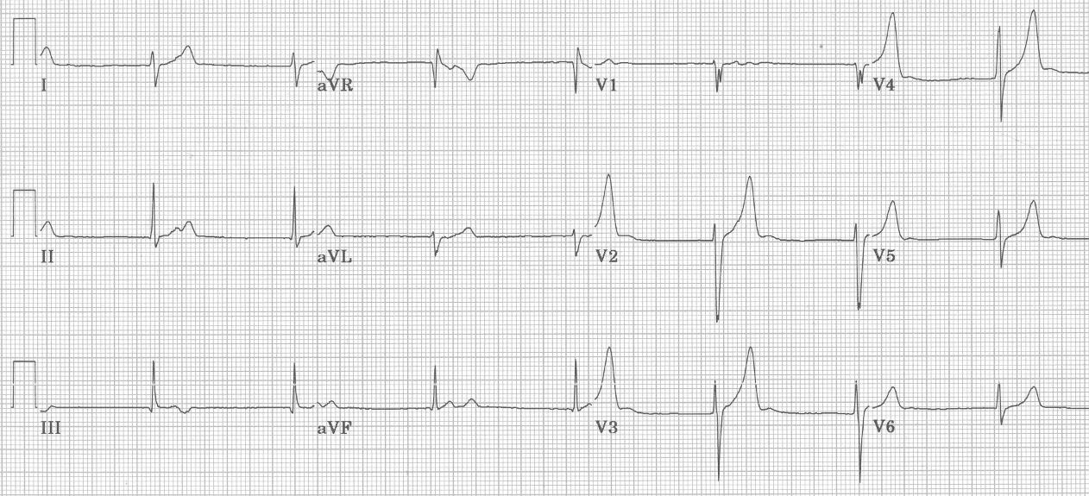
Notes:
Junctional rhythms
-sinus rate is slower than junctional escape rate

Slide 20
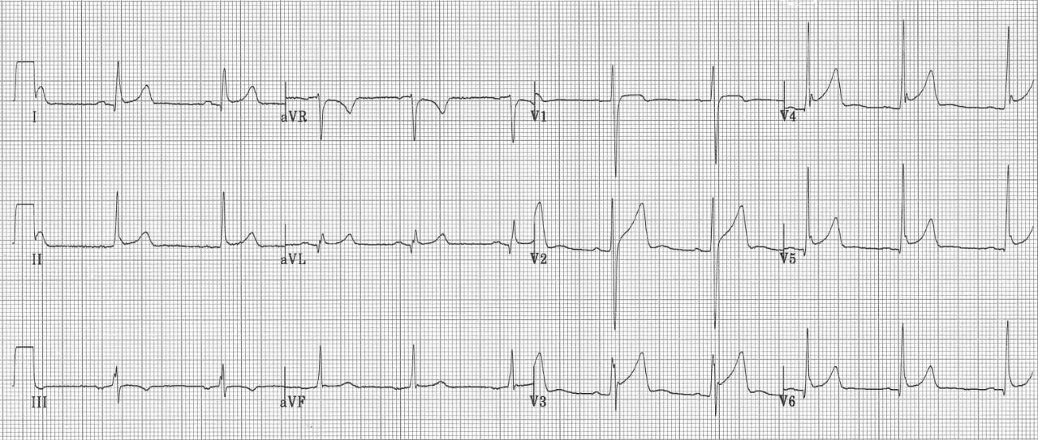
Notes:
Early repolarization

Slide 21
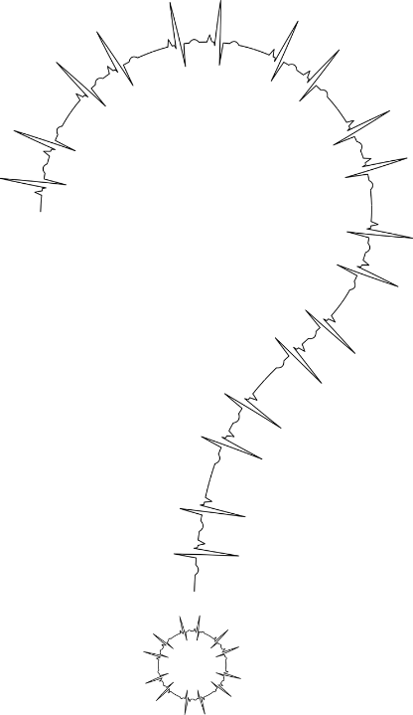
Notes:
Questions about normal variants in EKGs of trained athletes?

Slide 22
Notes:
https://www.dailymail.co.uk/video/news/video-1656926/NBA-G-League-player-Zeke-Upshaw-collapses-court.html
What do you notice here?
-This is a case of sudden cardiac death – abrupt, patient not moving or breathing
-No CPR or defibrillation!

Slide 23
Notes:
What are the causes of sudden cardiac death in young athletes?
-cardiomyopathies
-dysrhythmias

Slide 24
Dysrhythmia
?
?
Cardiomyopathy
Sudden Cardiac Death

Slide 25
?
Cardiomyopathy
Sudden Cardiac Death

Slide 26
Notes:
Hypertrophic cardiomyopathy: asymmetric ventricular or septal wall hypertrophy leading to obstruction of flow from the left ventricle, impaired cardiac filling in diastole, and increased risk for cardiac dysrhythmias including ventricular fibrillation. Frequently genetic. Accentuated by the hyperplastic effects of training.
T wave inversion, ST segment depression, pathologic Q waves, conduction delay, left axis deviation, and left atrial enlargement.

Slide 27
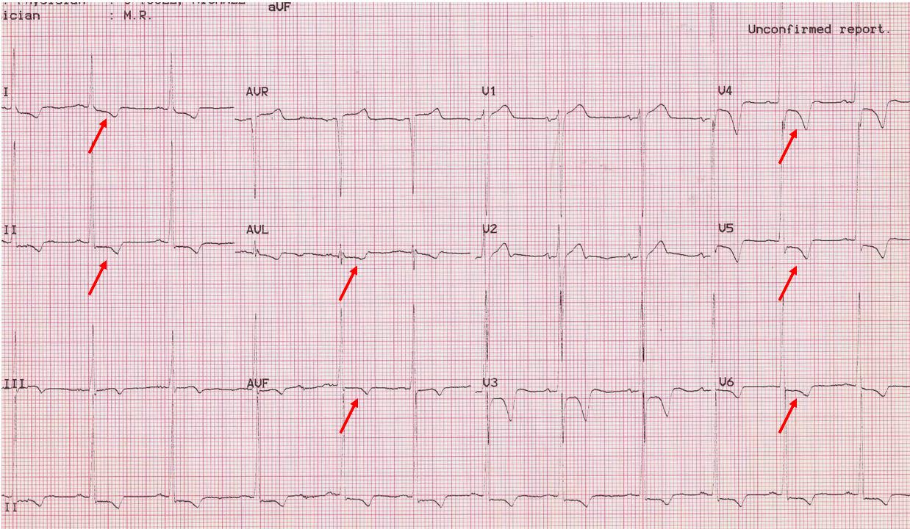
Notes:
HCM – ST Depression and T wave inversions

Slide 28
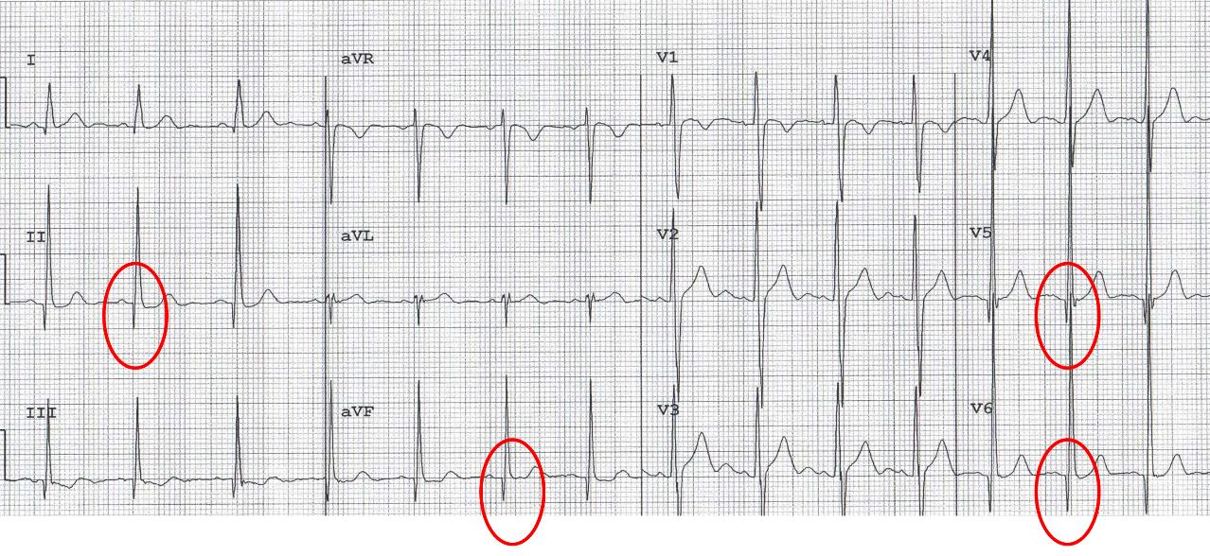
Notes:
HCM – Pathologic Q Waves - “dagger-like”

Slide 29
Notes:
HCM – Left Axis Deviation

Slide 30
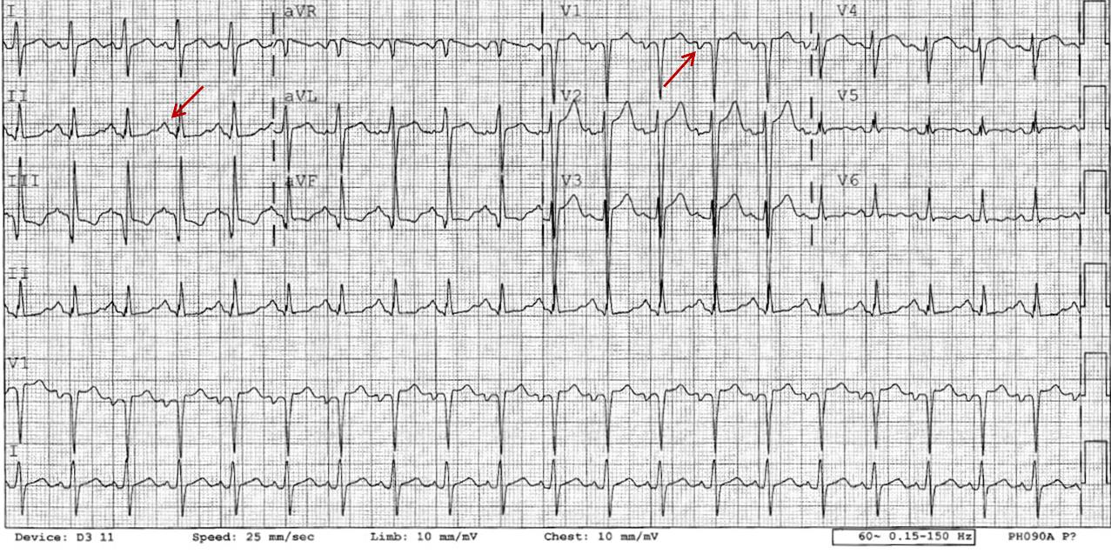
Notes:
HCM – Left Atrial Enlargement
P wave >120 ms in Lead I or II
Negative deflection of P wave >40ms and >1mm depth in V1

Slide 31
Notes:
Questions about HCM?

Slide 32
Notes:
Arrhythmogenic right ventricular cardiomyopathy (ARVC)
-fibro-fatty replacement of right ventricular myocardium, causing life-threatening ventricular arrhythmias or SCD, mostly occurring in young people and athletes
-Progressive dilation and dysfunction predominantly involve the right ventricle with involvement of the left ventricle in late stage disease.
Inverted T Waves

Slide 33
Notes:
ARVC – Epsilon Waves

Slide 34
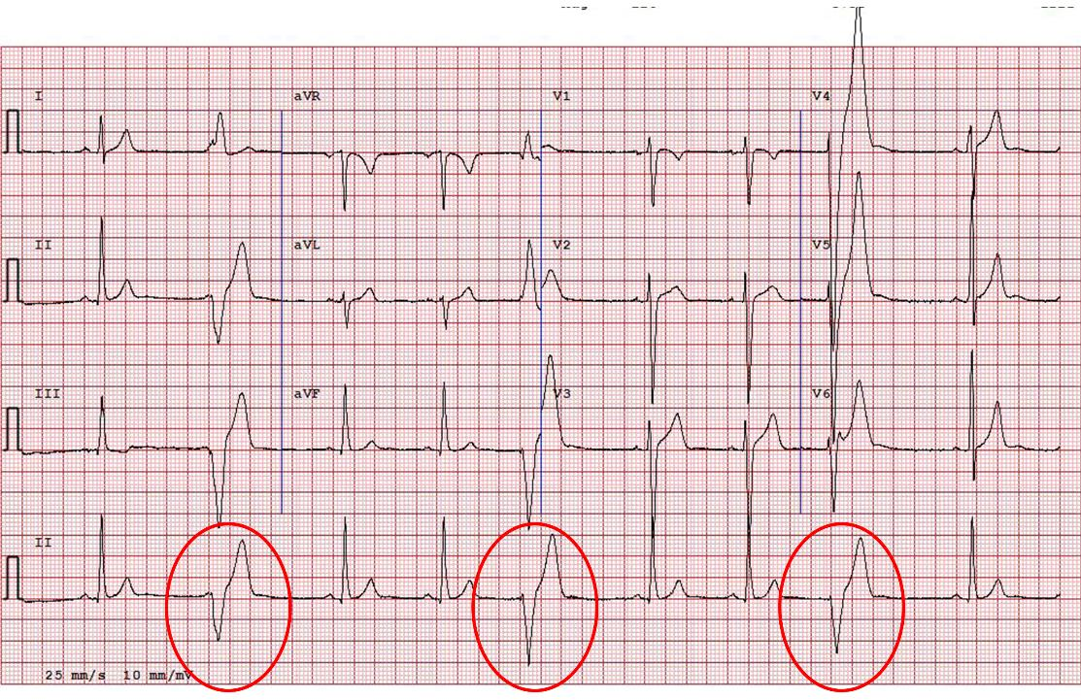
Notes:
ARVC: LBBB negative in limb leads – concerning for R ventricular wall origin → pathologic

Slide 35
Cardiomyopathy
Hypertrophic Cardiomyopathy
Arrhythmogenic right ventricular cardiomyopathy
Dilated cardiomyopathy
Sudden Cardiac Death

Slide 36
?
Dysrhythmia
Sudden Cardiac Death

Slide 37
Notes:
Long QT
>470 ms in males, >480 ms in females

Slide 38
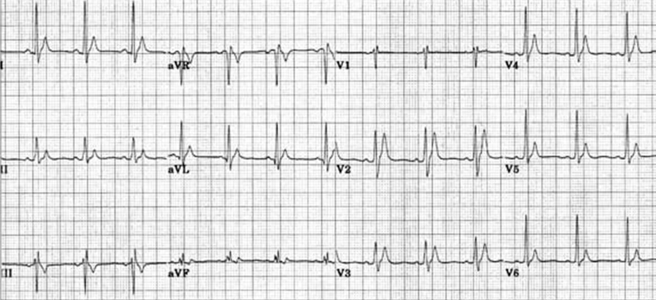
Notes:
Very rare
Short QT (Rare)
<320 ms

Slide 39
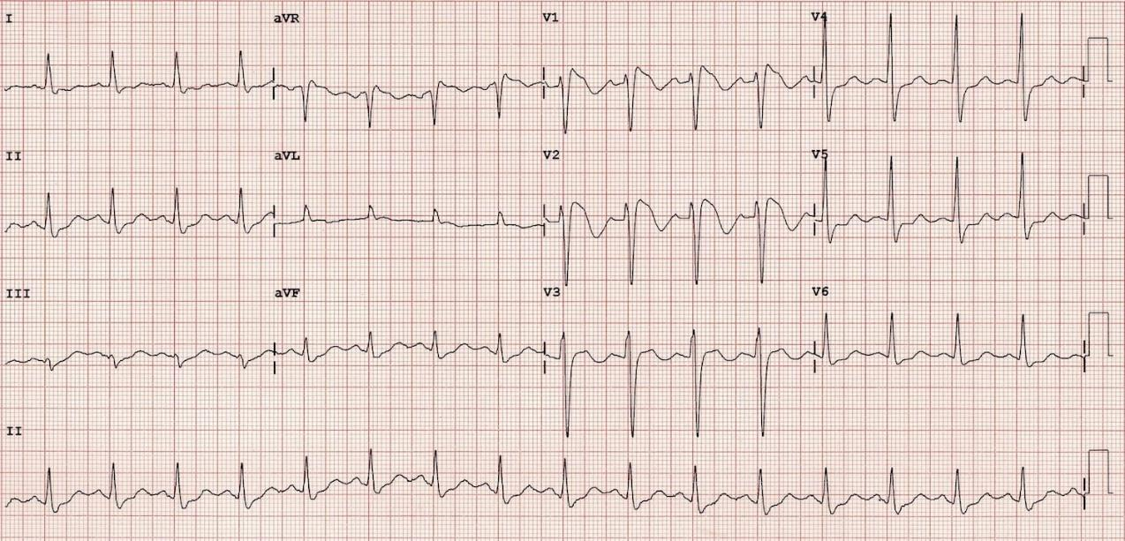
Notes:
Brugada Syndrome
“high take off“ ST segment elevation in the right precordial leads, and predisposes to ventricular fibrillation and sudden death in the absence of clinically demonstrable structural heart disease.

Slide 40
Brugada
Brugada pattern ECGs. Type 1 Brugada pattern ECG is defined as a high-take off and downsloping ST segment elevation ≥2 mm followed by a negative T wave in at least two contiguous leads (V1-V3). Type 2 and 3 Brugada pattern ECGs have a “saddleback” appearance with J-point elevation ≥2mm, ST segment elevation >1 mm in type 2 and ≤1 mm in type 3, and either a positive or biphasic T wave.

Slide 41
Notes:
How about this EKG? Normal sinus rhythm at rest. With exercise… (see next slide)

Slide 42
Notes:
Catecholinergic Polymorphic Ventricular Tachycardia
inherited arrhythmogenic disorder characterized by ventricular ectopy induced by exercise or emotional stress.
Resting EKG is normal
Exercise stress test is diagnostic

Slide 43
Notes:
Wolff-Parkinson-White (WPW)

Slide 44
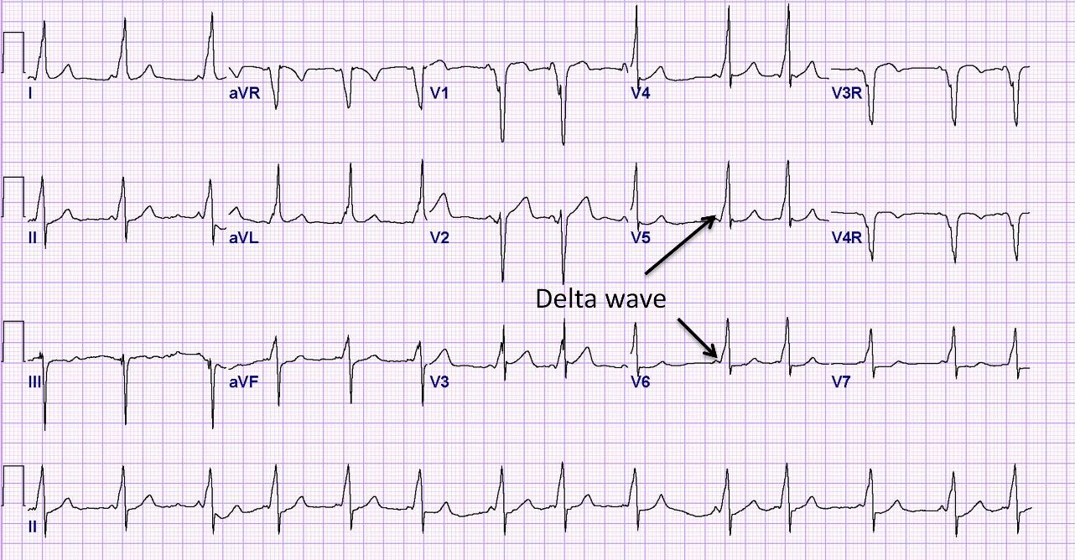
Notes:
Wolff-Parkinson-White Syndrome
short PR interval (<120 ms), the presence of a delta wave (slurring of the initial QRS), and a wide QRS (> 120 ms)

Slide 45
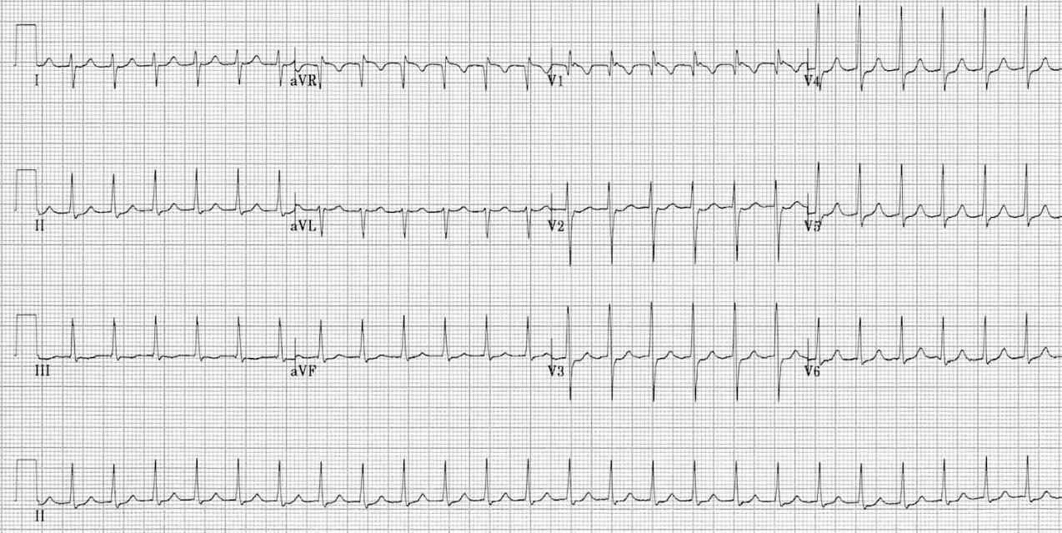
Notes:
SVT
AVRT involves an accessory atrioventricular bypass pathway where the circuit typically conducts down the AV node and up the bypass pathway, producing a narrow complex tachycardia.
AVNRT is a circuit involving a slow and fast pathway entering and exiting the AV node. The electrical circuit usually travels down the slow pathway and up the fast pathway, but can be reversed or even involve multiple slow pathways.

Slide 46
Dysrhythmia
Long QT
Short QT
Brugada Syndrome
Catecholinergic Polymorphic Ventricular Tachycardia
Wolff-Parkinson-White
Supraventricular tachycardia
Sudden Cardiac Death

Slide 47
Cardiomyopathy
Dysrhythmia
Hypertrophic Cardiomyopathy
Arrhythmogenic right ventricular cardiomyopathy
Dilated cardiomyopathy
Long QT
Short QT
Brugada Syndrome
Catecholinergic Polymorphic Ventricular Tachycardia
Wolff-Parkinson-White
Supraventricular tachycardia
Sudden Cardiac Death

Slide 48
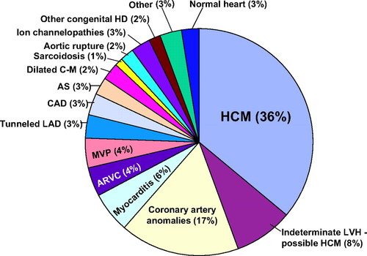
Barry J. Maron. Circulation. Recommendations and Considerations Related to Preparticipation Screening for Cardiovascular Abnormalities in Competitive Athletes: 2007 Update, Volume: 115, Issue: 12, Pages: 1643-1655, DOI: (10.1161/CIRCULATIONAHA.107.181423)
Notes:
Distribution of cardiovascular causes of sudden death in 1435 young competitive athletes. From the Minneapolis Heart Institute Foundation Registry, 1980 to 2005. ARVC indicates arrhythmogenic right ventricular cardiomyopathy; AS, aortic stenosis; CAD, coronary artery disease; C-M, cardiomyopathy; HD, heart disease; LAD, left anterior descending; LVH, left ventricular hypertrophy; and MVP, mitral valve prolapse.

Slide 49
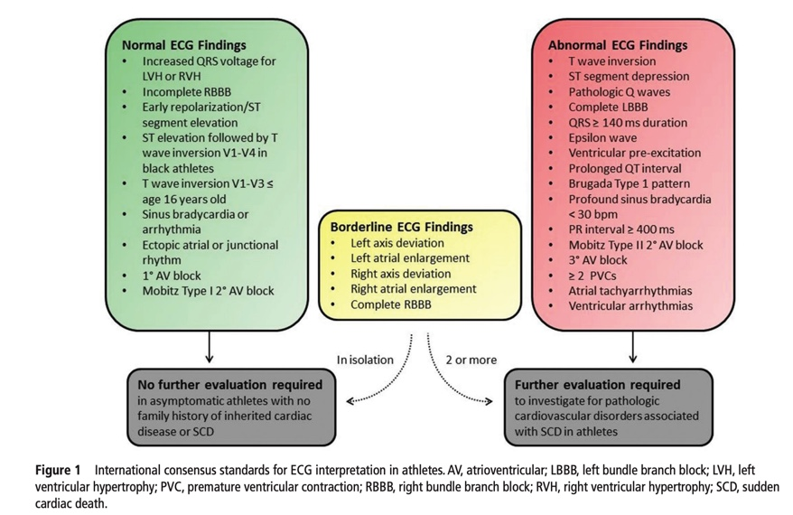
Drezner JA, et al. Br J Sports Med 2017;1:1–28. doi:10.1136/bjsports-2016-097331
Notes:
Algorithm for interpreting EKGs in athletes

Slide 51
References
Dale B. Speedy, Timothy B. Noakes & Lucy-May Holtzhausen (2003) Exercise-Associated Collapse, The Physician and Sportsmedicine, 31:3, 23-29, DOI: 10.1080/00913847.2003.11440566
https://www.insider.com/jessie-diggins-cross-country-skiing-winter-olympics-2018-2
Terry GC, Kyle JM, Ellis JM Jr, Cantwell J, Courson R, Medlin R. Sudden Cardiac Arrest in Athletic Medicine. J Athl Train. 2001;36(2):205-209.
https://learning.bmj.com/learning/course-intro/.html?courseId=10042239
Litfl.com
WikiSM: Exercise-associated collapse, Sudden Cardiac Death
Drezner JA, et al. Br J Sports Med 2017;1:1–28. doi:10.1136/bjsports-2016-097331
Maron BJ. Recommendations and Considerations Related to Preparticipation Screening for Cardiovascular Abnormalities in Competitive Athletes: 2007 Update. Circulation. Volume 115, Issue 12, 27 March 2007, Pages 1643-1655. https://doi.org/10.1161/CIRCULATIONAHA.107.181423
Zorzi A, et al. Differential diagnosis between early repolarization of athlete's heart and coved-type Brugada electrocardiogram. Am J Cardiol 2015;115:529-532.

