Slide 1
Evaluation of the Shoulder and Elbow in the Emergency Dept.

Slide 2
Objectives
Review MSK anatomy
Review common x-ray views
How to perform physical examination
Identifying common pathologies and how to treat them
Practice with board-style questions

Slide 3
Anatomy

Slide 6
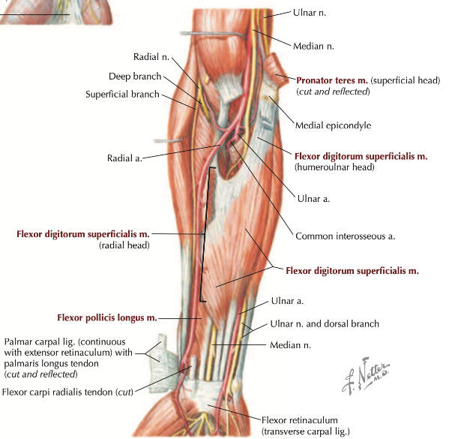

Slide 8
Radiology
Notes:
https://www.startradiology.com/internships/general-surgery/shoulder/x-shoulder/
https://www.startradiology.com/internships/general-surgery/elbow/x-elbow/index.html

Slide 9
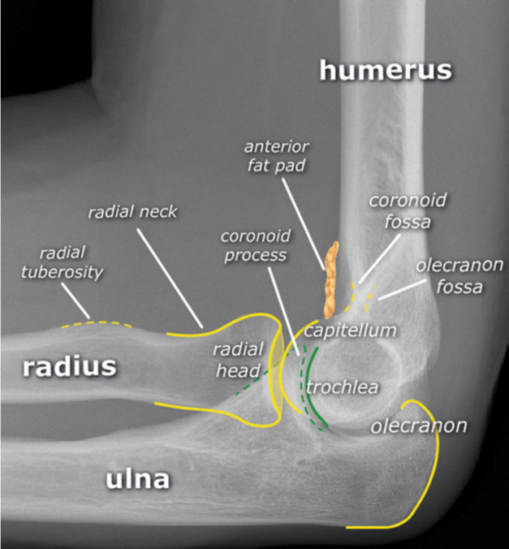
Lateral view
Notes:
Lateral view

Slide 10
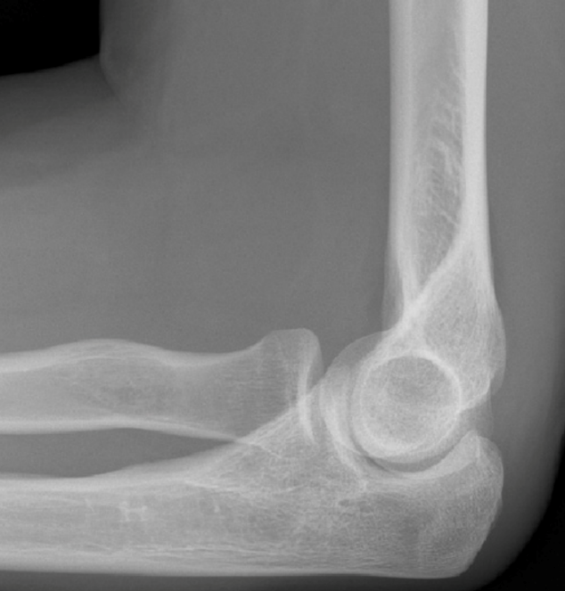
Notes:
Lateral view
Radiocapitellar line runs through the central radius and passes the central capitellum on a normal image.
Anterior humeral line runs along the front of the humerus and passes the anterior 1/3 of the capitellum.
When one of the above lines is abnormal, a fracture should be suspected.

Slide 11
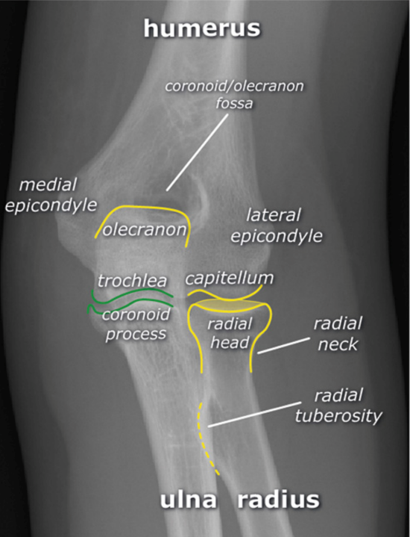
AP view
Notes:
AP view

Slide 12
Ossification centers of the elbow
Notes:
Cartilage is invisible on X-rays. As young children mature, 6 ossification centers develop. The sequence of development of the ossification centers is fixed:
Memory aid: CRIpTOE (p is just a placeholder to help make the mnemonic easier to remember).

Slide 13
Physical Examination
Elbow and Shoulder Exam

Slide 14
Elbow
Inspection- symmetry, edema, deformity, ecchymoses
Palpation- medial/lateral epicondyles, radial head, antecubital fossa, biceps tendon, olecranon, cubital tunnel
ROM- flexion, extension, pronation, supination
Strength- same as above with resistance
NV- “thumbs up” and “OK” sign (median n.), resisted wrist and fingers extension (radial n.), resisted abduction of fingers (ulnar n.); sensation over tip of 2nd digit (median n.), dorsum thumb-index webspace (radial n.), and tip of 5th digit (ulnar n.)
Reflexes- biceps (C5), brachioradialis (C6), triceps (C7)

Slide 15
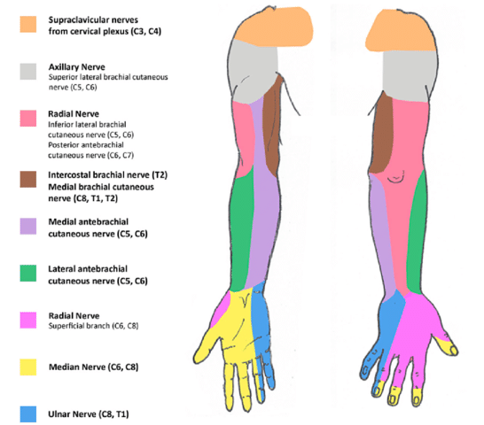

Slide 16
Pathologies

Slide 17
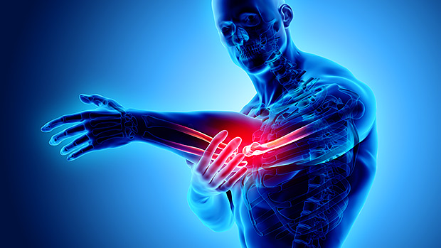
Elbow Pathologies

Slide 18
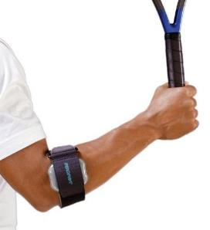
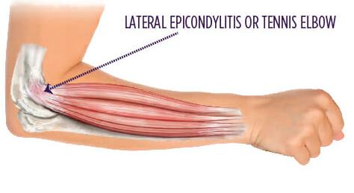
Lateral Epicondylitis or “Tennis Elbow”
Overuse syndrome affecting the wrist extensors, digit extensors, and forearm supinators
Clinical diagnosis: tenderness over the lateral epicondyle and pain with resisted wrist extension, digit extension, and forearm supination
Tx: rest, NSAIDs, immobilization (rigid brace or counterforce forearm brace), PT, referral

Slide 19
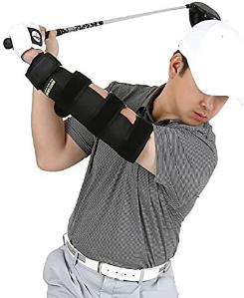
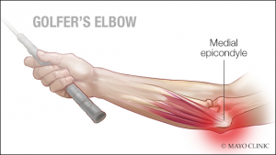
Medial Epicondylitis or “Golfer’s Elbow”
Overuse syndrome affecting the wrist flexors and forearm pronators
Clinical diagnosis: tenderness over the medial epicondyle and pain with resisted wrist flexion and forearm pronation
r/o Ulnar neuropathy → requires ortho f/u
Tx: rest, NSAIDs, bracing, PT, referral

Slide 20
A 40-year-old man presents with lateral forearm pain. On physical exam, pain is exacerbated with wrist extension and is located on the radial aspect of the forearm. What is the most likely diagnosis?
De Quervain tendinopathy
Lateral epicondylitis
Medial epicondylitis
Median nerve compression
Notes:
Answer: B

Slide 21
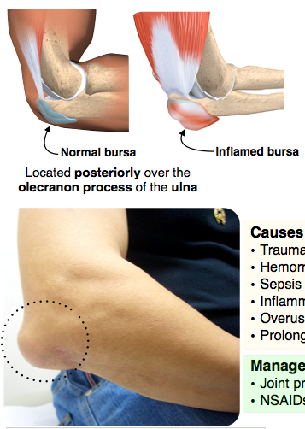
Olecranon Bursitis
Caused by trauma, hemorrhage, infection, arthritis, gout, overuse, prolonged pressure (student elbow)
Exam: swelling, pain, full passive ROM, decreased active ROM
Aspiration indicated to r/o infection and microcrystalline disorder
Tx: Ice, NSAIDs, joint protection

Slide 22
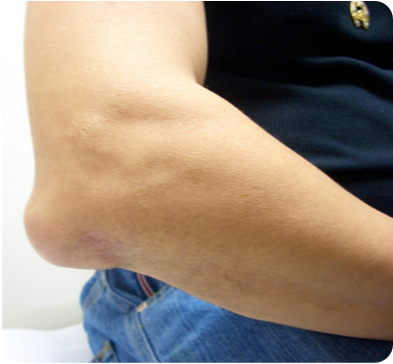
A 21-year-old male college student with no past medical history presents to the emergency department for elbow pain. He states that while studying for final exams, he has noticed that his elbow has become more swollen over the last week. His vital signs include a temperature of 37°C, a heart rate of 70 bpm, and a blood pressure of 115/75 mm Hg. On exam, you note the swelling above. You are able to fully extend the elbow with only minimal discomfort. What is the most appropriate next step in management?
Apply sugar tong splint
Discharge with NSAIDs and changes in study habits
Obtain an ultrasound of the elbow
Perform an arthrocentesis
Notes:
Answer: B

Slide 23
Elbow Dislocation
Mechanism: FOOSH
90% posterolateral
Patient presents with the elbow in 45º flexion, olecranon is prominent
“Terrible triad:” elbow dislocation, radial head fx, and coronoid fx → emergent ortho consult for unstable joint
Assess the brachial a., ulnar n., and median n.
Angiography to r/o vascular compromise, XR Elbow to r/o fractures
Emergency ortho consult for complex dislocations:
irreducible dislocations, neurovascular compromise, postreduction instability, associated fractures, and open dislocations

Slide 24
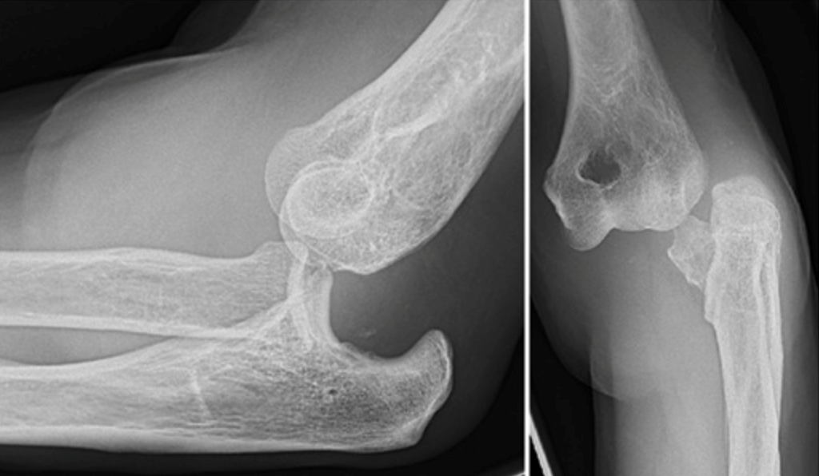
Notes:
Posterior elbow dislocation

Slide 25
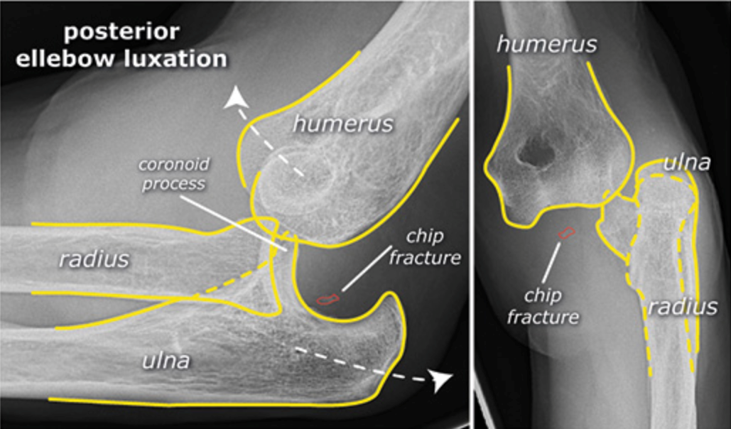
Notes:
Posterior elbow dislocation

Slide 26
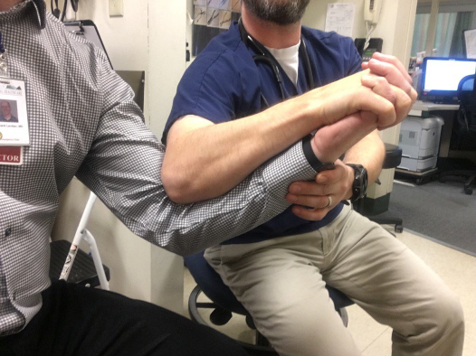
Treatment of Simple Elbow Dislocations
NSAIDs, opiates, benzos, intra-articular anesthetic injection, procedural sedation for analgesia and anti-spasmodic
Most effective pain relief is reduction of dislocation

Slide 27
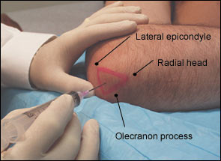
Intra-articular anesthetic Injection
Patient supine with elbow flexed 45$º$, hand in neutral position resting on thigh
Injected from lateral approach to avoid ulnar n.
Needle inserted into soft tissue in the triangle (see diagram) towards the medial epicondyle
Aspirate and then inject slowly; easy flow suggests proper positioning of needle
If hitting bone, pull back and redirect at different angle

Slide 28
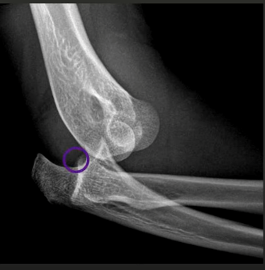
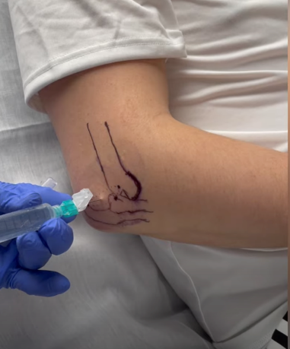
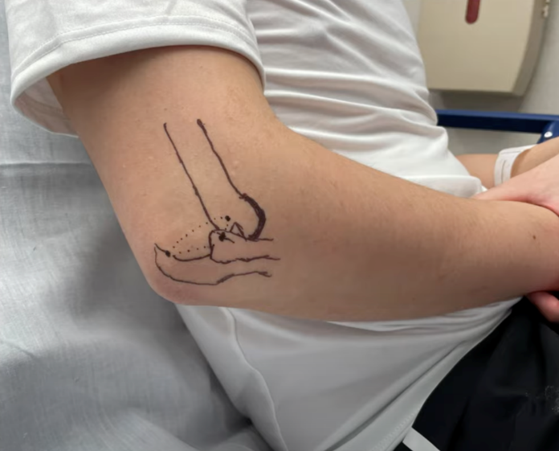
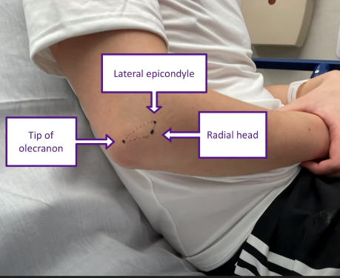
Intra-articular anesthetic injection

Slide 29
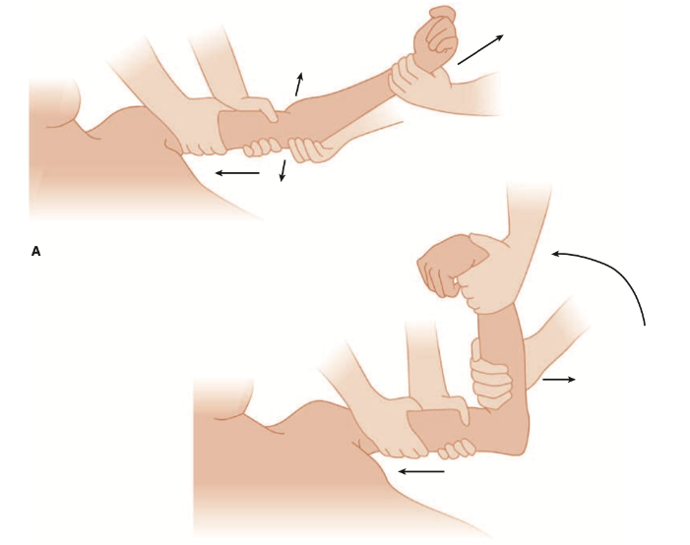
Traction and Flexion Reduction Method
Notes:
Position the forearm supine. While an assistant applies a stabilizing countertraction force on the upper arm, use one hand to apply a longitudinal traction on the wrist and forearm. With the other hand, manipulate the elbow to correct any medial or lateral displacement. Then apply slow and steady downward pressure to the proximal forearm with the other hand to help disengage the coronoid process from the olecranon fossa. Continue distal traction and flex the elbow.

Slide 30
Olecranon Manipulation Reduction Method (prone vs. supine)
Notes:
Position the patient prone with the arm abducted and the elbow slightly flexed. The patient may also be supine with the arm adducted across the torso and the elbow slightly flexed. Have an assistant apply longitudinal traction on the wrist and forearm. Then, grasp the elbow, positioning both thumbs on the olecranon, and apply firm pressure against the olecranon to push it up and over the trochlea and back into anatomic position. Apply countertraction with the fingers against the distal humerus.

Slide 31
Single Person Reduction Method
Notes:
A single-person reduction technique with the patient in a seated position. Place an elbow in the patient’s antecubital fossa, then grasp the patient’s hand or wrist. Flex the patient’s forearm while leveraging a force into the antecubital fossa to bring the olecranon back into anatomic position.

Slide 32
Hanging Arm Reduction Method
Notes:
A modification of the Stimson hanging technique used in shoulder reductionss. Place the patient prone with the elbow flexed over the edge of the stretcher. Support the humerus proximal to the elbow with a folded blanket or pillow. Suspend 5-lb weights from the wrist. The patient’s elbow should reduce over a period of several minutes. Gentle manipulation may be applied to the olecranon to aid reduction.

Slide 33
Post reduction care
Postreduction XR to confirm successful reduction and documentation
Posterior long arm splint
forearm and wrist in neutral position, elbow flexed at slightly less than 90º
Sling for comfort
Avoid lifting objects >5 lbs
Pain management: NSAIDS, acetaminophen, narcotics
Follow-up with Orthopedics or Sports Medicine within 3-5 days

Slide 34
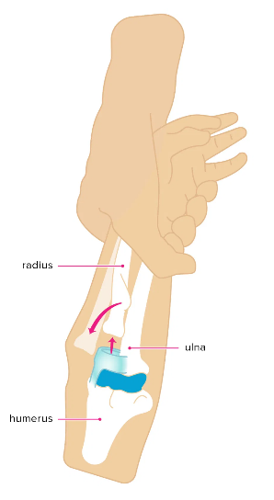
Radial Head Subluxation aka Nursemaid’s elbow
Child 1-4 years-old with Hx of being pulled up by wrist
Exam: arm held close to body, flexed and pronated; no focal tenderness or swelling; normal x-ray
Tx: closed reduction by hyperpronation method vs. supination/flexion method
Relief is immediate and child should begin to move affected extremity within 5-10 min

Slide 35
Radial Head Subluxation Reduction Hyperpronation vs. Supination-Flexion
Notes:
Hyperpronation method - apply pressure to the radial head and hyperpronating the forearm
Supination/flexion method - supinate and fully flex the elbow simultaneously while applying pressure to the radial head and pulling with gentle traction

Slide 36
Radial Head Dislocation
Mechanism: FOOSH, commonly in infancy or childhood
Congenital radial head dislocation 2/2 abnormal capitellum development- asymptomatic in infants, delayed presentation into adolescence after start using the affected limb more
Exam: child with unwillingness to use the affected arm
XR helpful to diagnose – radiocapitellar line
r/o associated ulna fracture – Monteggia fracture-dislocation
Tx: closed reduction → distal axial tension with pressure to radial head
if fail, then refer to ortho for open reduction

Slide 37
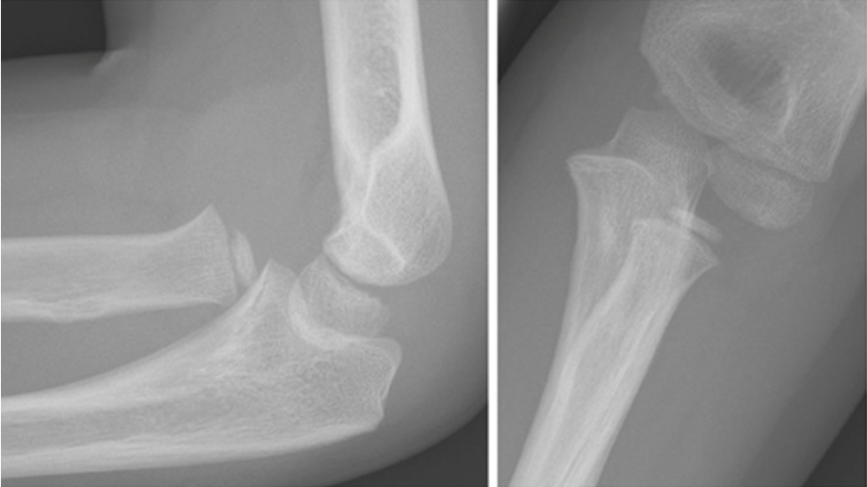
Notes:
Radial head dislocation aka Nursemaid’s elbow

Slide 38
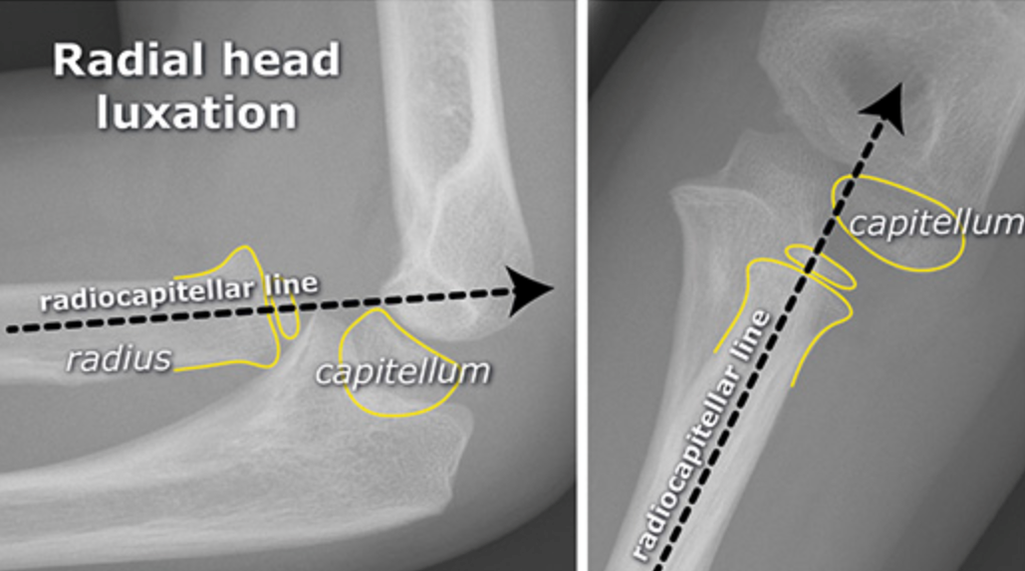
Notes:
Radial head dislocation aka Nursemaid’s elbow
Abnormal in both views- the radiocapitellar line no longer runs through the central capitellum

Slide 39
A 2-year-old girl presents to the ED reluctant to move her left arm. The patient's father states that he had grabbed his daughter by her wrist to pull her up from the floor. On exam, there is no swelling or deformity. Which of the following maneuvers can be attempted to correct the injury?
Full elbow flexion followed by pronation
Hypersupination of the forearm
Pronation followed by elbow flexion
Simultaneous supination and elbow flexion
Notes:
Answer: D

Slide 40
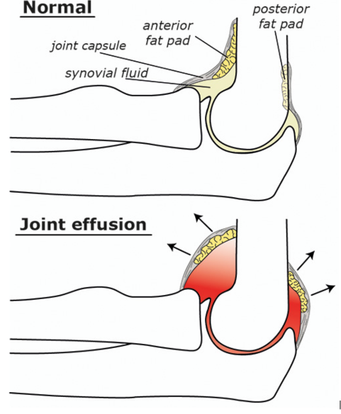
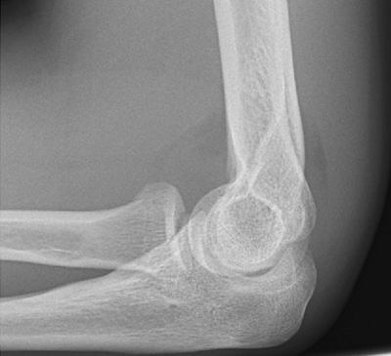
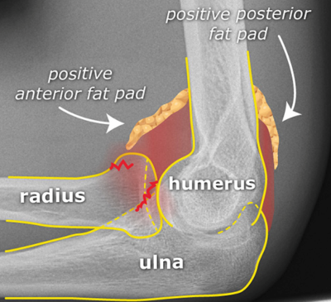
Distal Humerus Fractures
Traumatic hemarthrosis displaces fat from the olecranon fossa posteriorly (posterior fat pad) and anteriorly (“sail sign”)
May be absent in severe trauma that disrupts the joint capsule and allows intra-articular fluid extravasation
Notes:
In some nondisplaced fractures, the fracture line may not be seen, with the fat pad sign being the only evidence of injury. Treatment is initiated as though a fracture were identified.
Routine ED care of nondisplaced distal humerus fractures with normal neurovascular function includes immobilization, ice, elevation, analgesics, and orthopedic referral.
Displaced fractures or those with neurovascular compromise require immediate orthopedic consultation.

Slide 41
Extension-Type Supracondylar Fractures
Mechanism: FOOSH with the elbow in full extension
Exam: prominent olecranon and a depression proximal to the elbow (may be mistaken for a posterior elbow dislocation)
Nondisplaced fractures: immobilization (long arm posterior splint keeping the elbow at 90º), ice, elevation, analgesics, and referral
Displaced fractures must be reduced and require urgent ortho consult
Emergency ortho consult:
Neurovascular compromise, open fracture, or irreducible fracture

Slide 42
Flexion-Type Supracondylar Fractures
Mechanism: direct anterior force against a flexed elbow, resulting in anterior displacement of the distal fragment (often open fractures)
Nondisplaced: immobilization (long arm posterior splint with the elbow flexed at 90º), ice, elevation, analgesics, and referral
Displaced fractures must be reduced and require urgent ortho consult
Emergency ortho consult:
Neurovascular compromise, open fracture, or irreducible fracture

Slide 43
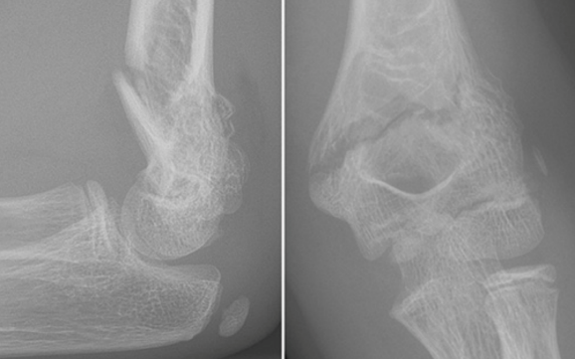
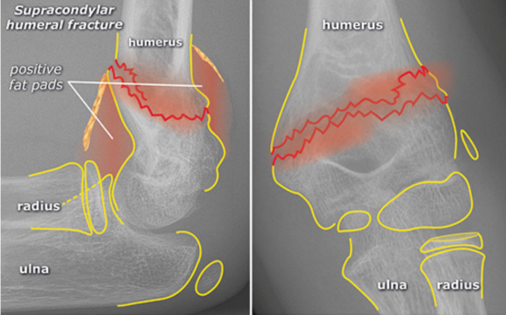

Slide 44
Complications of Supracondylar Fractures
High incidence of anterior interosseous n. (median n. branch) injury
Can only be identified through motor testing by making the “OK” sign
Volkmann’s ischemic contracture: compartment syndrome of forearm
Signs: refusal to open the hand, pain with passive extension of the fingers, and forearm pain out of proportion to exam
Other complications include radial n., ulnar n. (iatrogenic), and brachial a. injuries

Slide 45
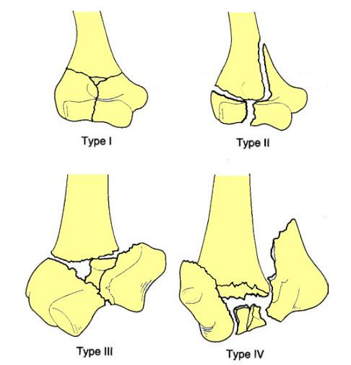
Intercondylar Fractures
Mechanism: force against the post elbow that drives the olecranon against the humeral articular surface and separating the condyles
All intercondylar fractures involve the articular surface
CT imaging is useful for identifying comminuted fractures
Nondisplaced: immobilization (long arm posterior splint with the elbow flexed at 90º), ice, elevation, analgesics, and referral
Urgent ortho consult for displaced, rotated, or comminuted fractures
Notes:
Riseborough and Radin classification:
Type I: No displacement of the fragments.
Type II: T-shaped intercondylar fractures with the trochlear and capitellar fragments separated but not appreciably rotated in the frontal plane.
Type III: T-shaped intercondylar fractures with separation of the fragments and significant rotatory deformity.
Type IV: T-shaped intercondylar fractures with severe comminution of the articular surface and wide separation of the humeral condyles.

Slide 46
Epicondyle Fractures
Lateral epicondyle fx are uncommon and usually avulsion fx 2/2 direct blow
Tx: immobilization (long arm posterior splint with the elbow flexed at 90º, forearm in supination instead of neutral), ice, elevation, analgesics, and referral
Medial epicondyle fx occur with posterior elbow dislocation, repeated valgus stress such as throwing a baseball (Little League elbow), or a direct blow
Tx: immobilization (long arm posterior splint with the elbow flexed at 90º, forearm in pronation instead of neutral), ice, elevation, analgesics, and referral
Emergent ortho consult:
High-energy injuries, open fractures, unstable joints, significant fragment displacement, an intra-articular fragment, or ulnar neuropathy

Slide 47
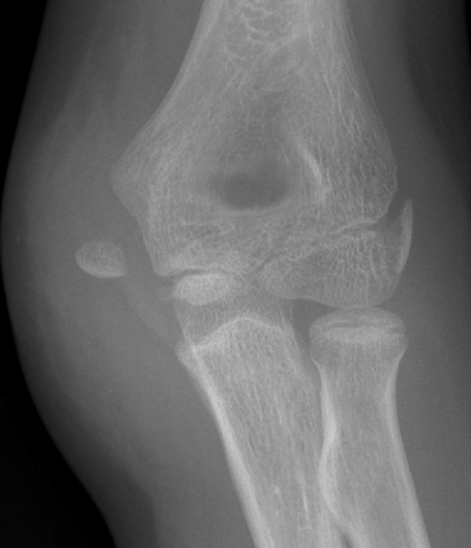
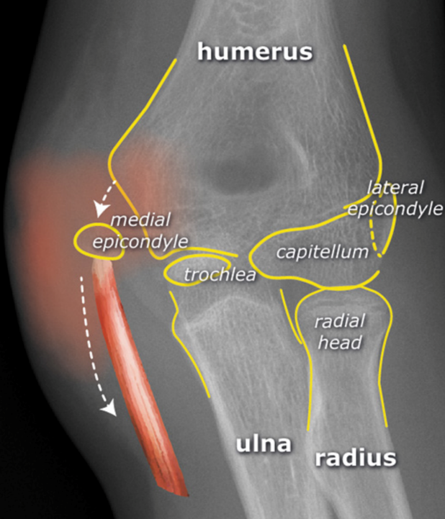

Slide 48
Condyle Fractures
Lateral condyle fx are from either a direct blow or FOOSH
Medial condyle fx are uncommon and from either FOOSH or excessive valgus stress
The trochlea ossification center does not appear until age 9 to 10 years old, so it is often missed on XR
Tx: immobilization (long arm posterior splint), ice, elevation, analgesics, and referral
Emergent ortho consult for displaced fx or neurovascular compromise

Slide 49
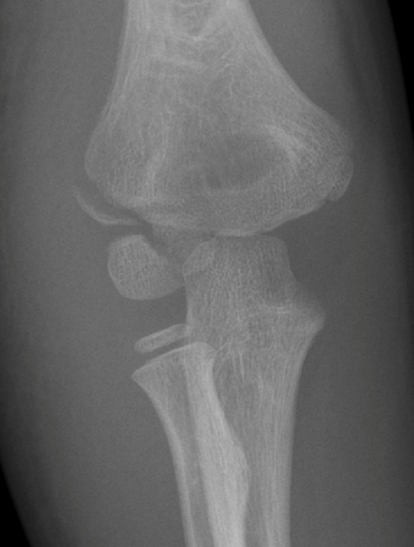
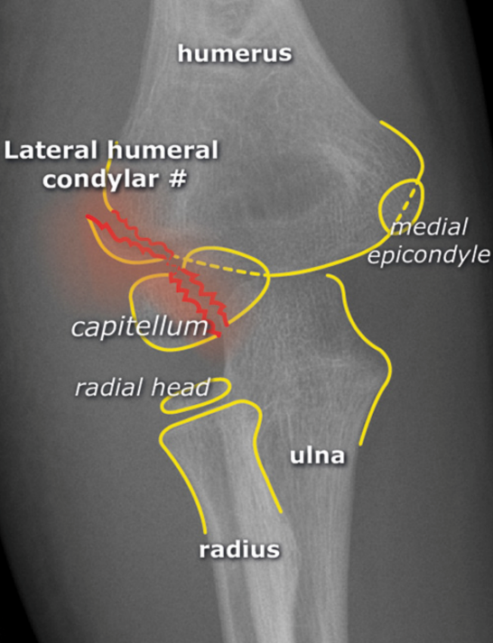

Slide 50
Trochlea and Capitellum Fractures
Isolated trochlea fractures are rare and are often associated with other elbow injuries, such as posterior elbow dislocations
suspect injury to the medial (ulnar) collateral ligament
Isolated capitellum fractures are also rare and are usually associated with radial head fractures
no tendinous or ligamentous attachments, so many fractures are nondisplaced
Tx: Immobilization (long arm posterior splint), ice, elevation, analgesics, and referral
Complications are common and include limited flexion and extension, elbow joint instability, avascular necrosis, nonunion, and arthritis

Slide 51
Coronoid Fractures
Mechanism: isolated fx can occur 2/2 elbow hyperextension but usually associated with posterior elbow dislocations
Exam: pain, swelling, and tenderness over the antecubital fossa
CT is often needed to make the diagnosis
Tx: Immobilization (long arm posterior splint with the elbow flexed and the forearm in supination), ice, elevation, analgesics, and referral
Displaced fractures or those with joint instability require ORIF and frequently have poor outcomes

Slide 52
Olecranon Fractures
Mechanism: direct trauma or fall with forced hyperextension of the elbow
Associated injuries are common, including open fractures, dislocations, other fractures (especially of the radial head), and ulnar nerve injury
Exam: pain, swelling, tenderness, and occasionally crepitus over the post elbow
elbow extension can be compromised → test extension against resistance
Tx: immobilization (long arm posterior splint with the elbow flexed and forearm neutral), ice, elevation, analgesics, and referral to ortho within 24 hr
Stable, nondisplaced fractures with intact extensor function can be treated conservatively. All other olecranon fractures require surgical repair.

Slide 53
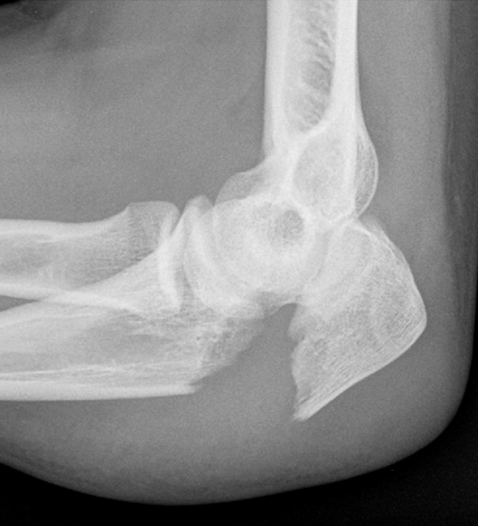
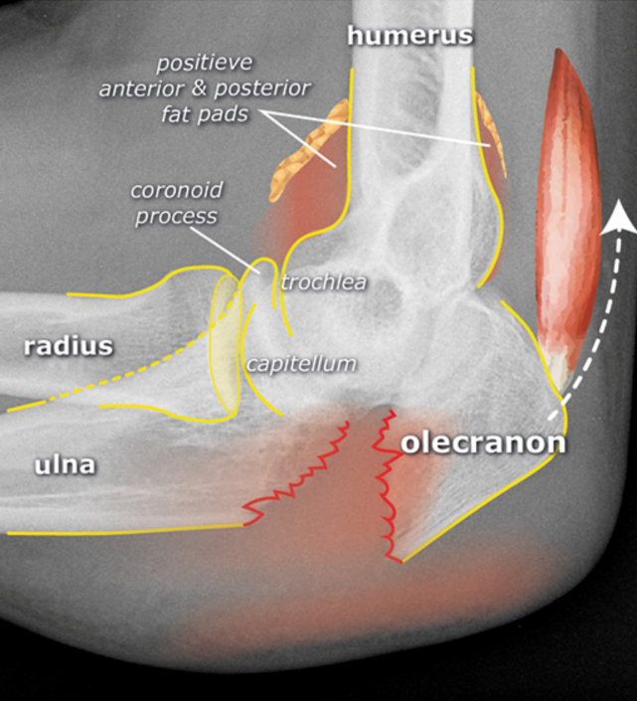

Slide 54
Forearm Pathologies

Slide 55
Radial Head Fractures (most common fractures of the elbow)
Mechanism: FOOSH
Associated injuries are common and may include capitellum fx, olecranon fx, coronoid fx, medial collateral ligament injury, medial epicondyle avulsion fx, elbow dislocation, and Essex-Lopresti lesion
Exam: tenderness and swelling in the lateral elbow, especially with pronation and supination of the forearm
Tx: sling, ice, elevation, analgesics, early ROM, and referral
Consider aspiration of the joint hematoma to improve pain and facilitate early mobilization
Notes:
The Essex-Lopresti lesion: disruption of the triangular fibrocartilage complex of the wrist and the interosseous membrane between the radius and ulna, causing dissociation of the distal radioulnar joint.
Failure to recognize this injury can result in proximal migration of the radius → emergency ortho consult

Slide 56
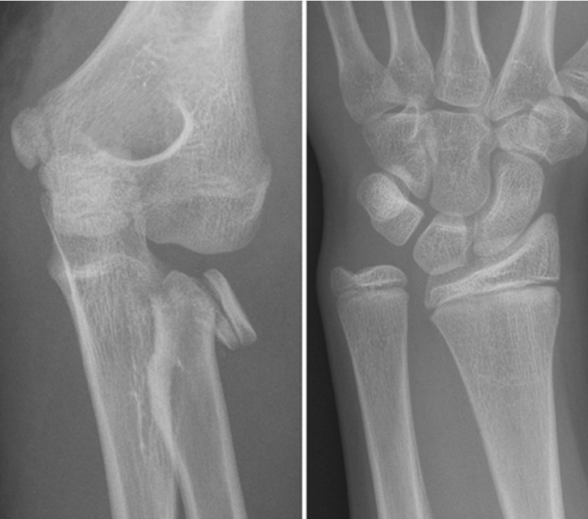
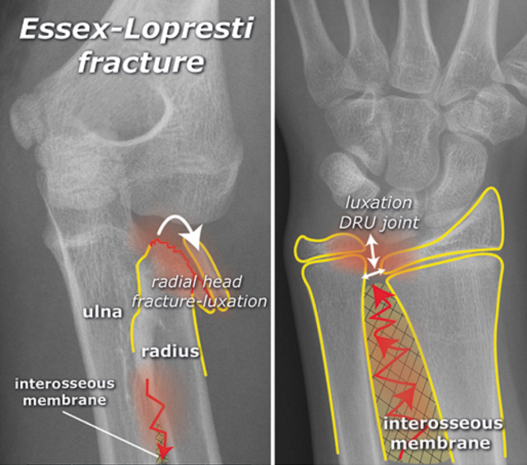
Learning point: in a comminuted fracture of the radial head, the wrist joint should always be imaged to exclude an Essex-Lopresti fracture.

Slide 57
Notes:
Mason Classification of Radial Head fractures
Type I: fracture without dislocation.
Type II: partial intra-articular fracture with dislocation of > 2mm.
Type III: comminuted fracture of the entire radial head.
Type IV: fracture with dislocation of the elbow joint.

Slide 58
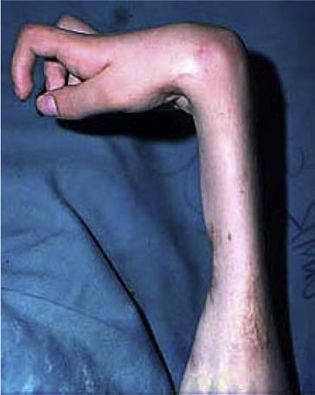
Fractures of both Radius and Ulna
Mechanism: often from vehicular trauma, falls from a height, or a direct blow
Moderate forces → transverse or mildly oblique fractures
High-impact forces → comminuted and segmental fractures
Nerve injuries can occur with severe open fractures but are uncommon with closed injuries
Excellent collateral circulation of the forearm, so vascular compromise is generally not a major concern
Note the degree of angulation, displacement, and shortening on XR
Recognizing the development of a compartment syndrome is particularly important to prevent Volkmann’s ischemic contractures of the forearm

Slide 59
Ulna Fractures
Mechanism: a direct blow to the forearm
A fracture resulting from the natural response to raise the forearm in defense of a strike is referred to as a nightstick fracture
Nondisplaced tx: immobilized (sugar-tong splint), ice, elevation, analgesics, and referral
Fractures with >50% displacement, with >10% angulation, or that involve the proximal third of the ulna → urgent ortho consult
Monteggia’s Fracture-Dislocation: fracture of the proximal third of the ulna with a radial head dislocation → urgent ortho consult
Missing this can lead to chronic pain, limited ROM, and possible future radial head excision as treatment

Slide 60
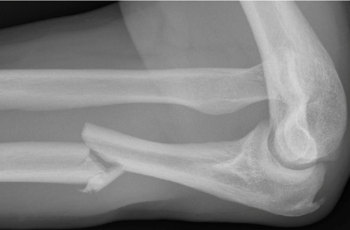
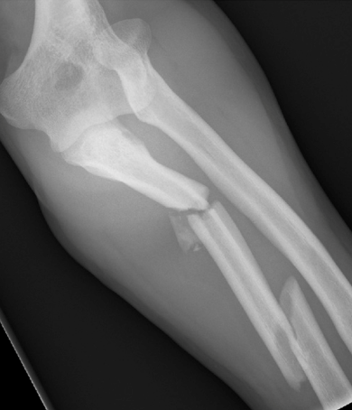
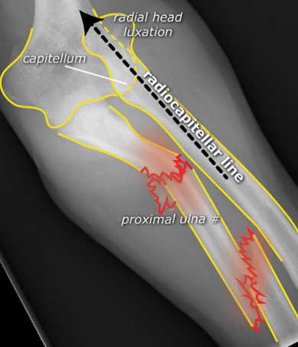
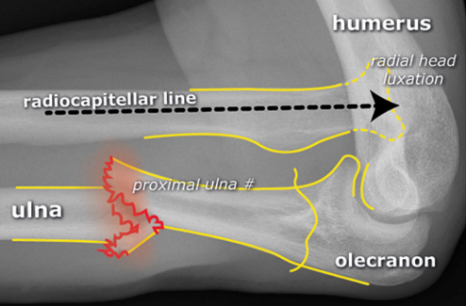
Monteggia’s Fracture-Dislocation: always check the position of the radial head in the presence of a proximal/mid-shaft ulnar fracture

Slide 61
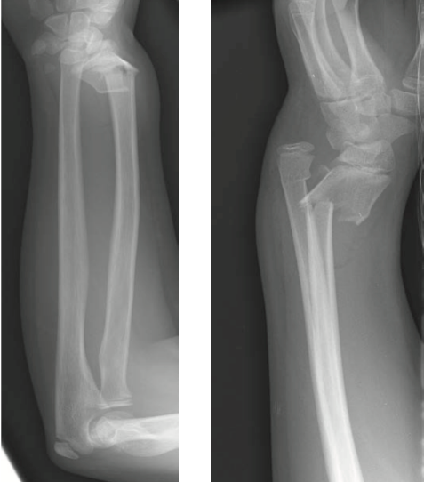
Radius Fractures
Classified as Proximal 2/3 fracture (less common) or Distal 1/3 fracture
Nondisplaced → conservative tx w/ cast
Displaced → emergency ortho consult
Galeazzi’s Fracture-Dislocation: distal 1/3 fracture + dislocation of distal radioulnar joint
Mechanism: FOOSH, forced pronation, direct blow
Emergency ortho consult

Slide 62
Which of the following radiographic signs supports the diagnosis of a Galeazzi fracture?
Distal radioulnar joint dislocation
Midshaft ulna fracture
Radial head dislocation
Radial head fracture
Notes:
Answer: A

Slide 63
Board Review Questions

Slide 64
A 50-year-old man presents to the Emergency Department with severe swelling and pain of his left forearm. He sustained a puncture wound to this area three days ago while working on a construction site. He has a diminished left radial pulse and severe pain with passive extension of his fingers. Which muscle in the deep volar compartment is at risk for ischemia?
Flexor carpi ulnaris
Flexor digitorum profundus
Palmaris longus
Supinator
Notes:
Answer: B

Slide 65
A 17-year-old man presents to the emergency department after being struck in the arm by a baseball. On physical examination, he has ecchymosis and swelling over the right medial epicondyle. He is most likely to have decreased sensation of which of the following dermatomes?
C7
C8
T1
T2
Notes:
Answer: B

Slide 66
Lateral epicondylitis involves inflammation at the attachment of which of the following muscles?
Extensor carpi radialis brevis
Flexor carpi radialis
Pronator teres
Triceps
Notes:
Answer: A

Slide 67
A 35-year-old man with no medical problems presents with 1 week of right elbow pain. He reports a 3-month history of intermittent right elbow pain, but it typically went away with ibuprofen and ice packs. He is an avid daily climber and has not been able to climb for a few days due to the pain. Which physical exam finding is most consistent with the likely diagnosis?
Nontender egg-size swelling at olecranon with normal range of motion
Normal-appearing elbow with pain medially elicited by resisted pronation
Swollen, warm, exquisitely tender elbow with painful range of motion
Visible deformity of elbow with no range of motion possible
Notes:
Answer: B

Slide 68
A 45-year-old man presents to the ED with pain and swelling of his right elbow. He does not recall any specific trauma. On exam, the patient has full passive range of motion with no pain. The elbow is slightly warm to touch. Which of the following is the most appropriate management for this patient?
Aspirate fluid for cell count and culture
Ice and NSAIDs
Incision and drainage
Posterior mold splint
Notes:
Answer: B

Slide 69
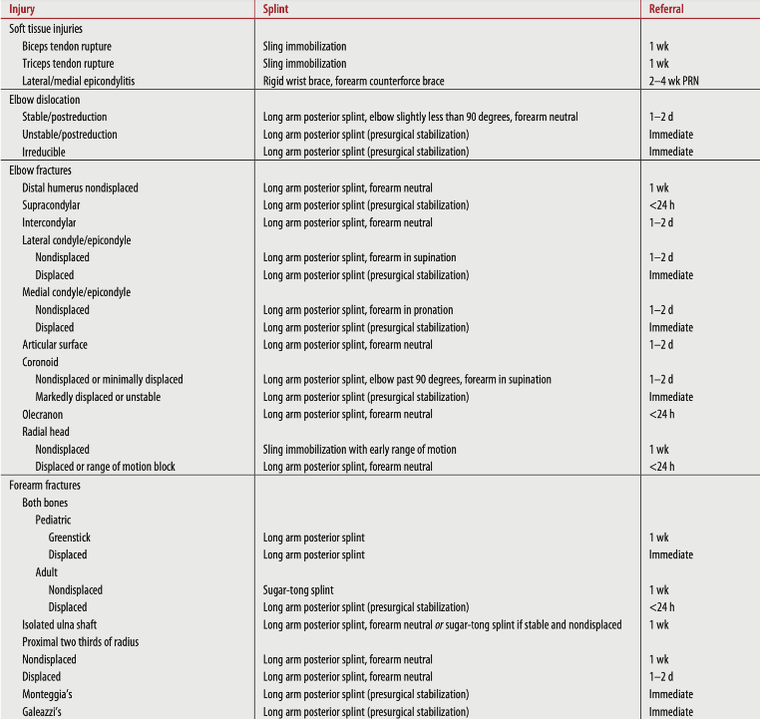

Slide 70
References
Netter’s Clinical Anatomy, 4th edition
Startradiology.com
Radiopaedia.org
Tintinalli’s Emergency Medicine A Comprehensive Study Guide, 9th edition
Rosh Review

