Slide 1
Evaluation of the Shoulder in the Emergency Dept.

Slide 2
Objectives
Review MSK anatomy
Review common x-ray views
How to perform physical examination
Identifying common pathologies and how to treat them
Practice with board-style questions

Slide 3
Anatomy

Slide 5
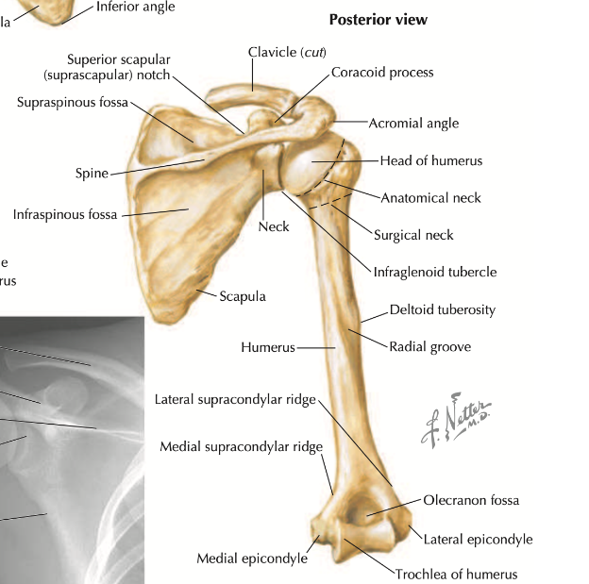
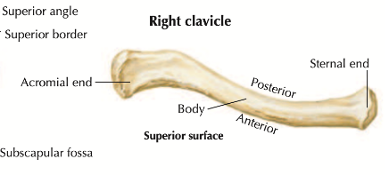

Slide 7
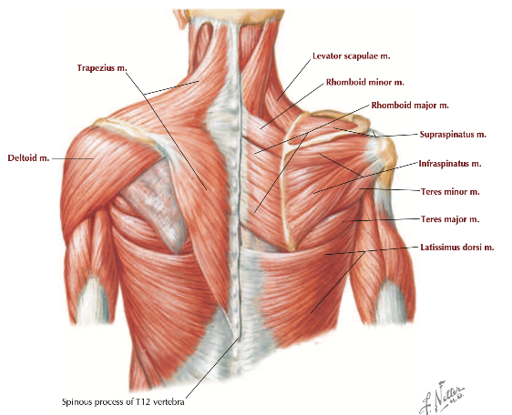

Slide 10
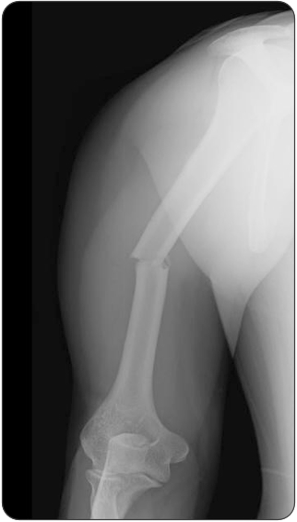
A 43-year-old man presents after being struck by a motor vehicle on his right side and falling onto his left arm. His trauma evaluation is negative except for pain in the mid-right arm. A radiograph is seen above. Secondary injury to which of the following is the most common complication?
Axillary artery
Brachial artery
Median nerve
Radial nerve
Notes:
Answer: D

Slide 11
Radiology
Notes:
https://www.startradiology.com/internships/general-surgery/shoulder/x-shoulder/
https://www.startradiology.com/internships/general-surgery/elbow/x-elbow/index.html

Slide 12
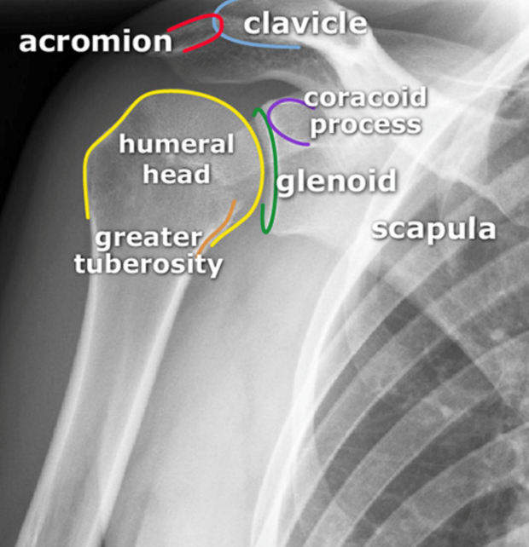
AP internal rotation
Notes:
AP internal rotation

Slide 13
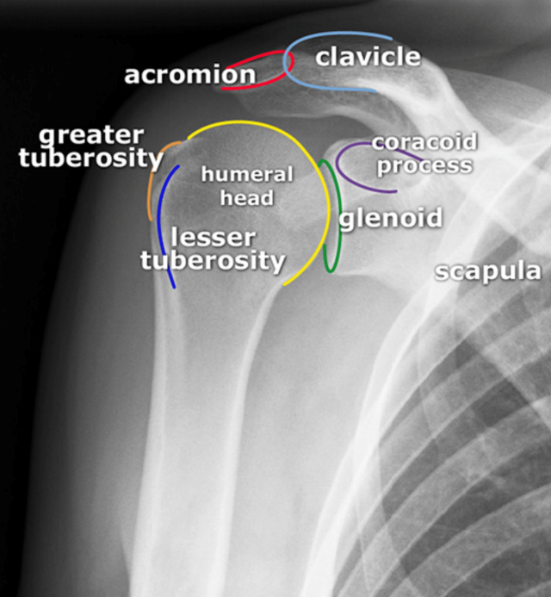
AP external rotation
Notes:
AP external rotation

Slide 14
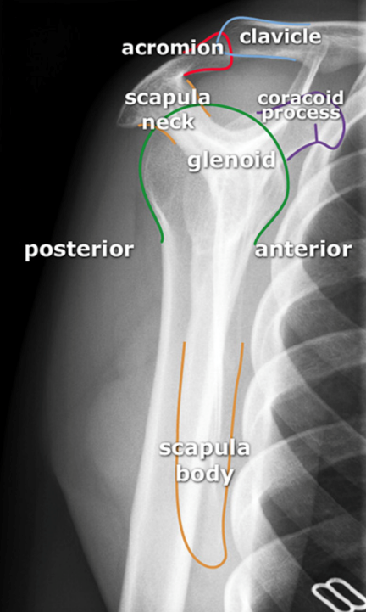
Y-view
Notes:
Y-view/ Lateral scapular view

Slide 15
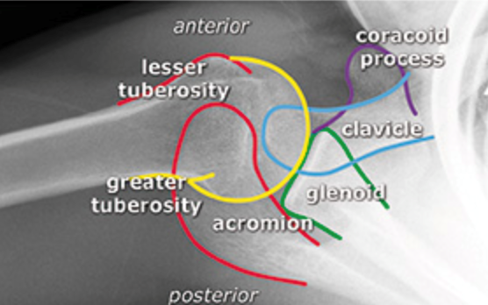
Axillary view
Notes:
Axillary view

Slide 16
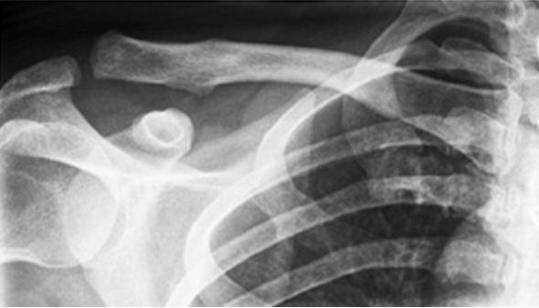
Notes:
AC joint
The bottom of the acromion should align with the bottom of the distal clavicle. If not, be alert for an AC dislocation.

Slide 17
Physical Examination
Shoulder Exam

Slide 18
Shoulder
Inspection- symmetry, edema, deformity, ecchymoses
Palpation- clavicle, AC joint, SC joint, prox. humerus, acromion, scapula
ROM- abduction (160-180º), flexion (160-180º), ext. rotation with elbows bent 90º (45-90º), int. rotation with Apley scratch test (T7/T9 or inf. edge of scapula)
Strength- empty can test (supraspinatus), belly press test or lift off test (subscapularis), ext/int rotation with elbows bent 90º (infraspinatus and teres minor), drop arm sign (severe tear)
Neurovascular- radial pulse, sensation over lateral deltoid (axillary n.) and lateral forearm (musculocutaneous n.)

Slide 19
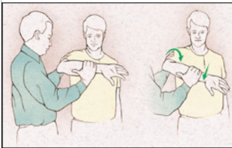
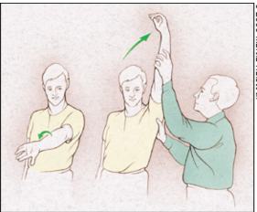
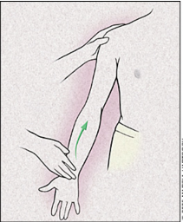
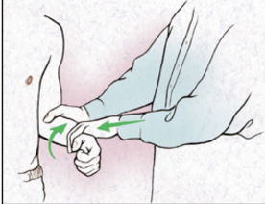
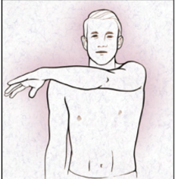
Special testing
Hawkins test- supraspinatus impingement vs. bursitis
Neer test- supraspinatus impingement vs. bursitis
Speed’s test- biceps tendon injury
Yergason’s test- biceps tendon injury
Cross body adduction test- AC joint injury
Notes:
Woodward TW, Best TM. The painful shoulder: part I. Clinical evaluation. Am Fam Physician. 2000 May 15;61(10):3079-88. PMID: 10839557.

Slide 20
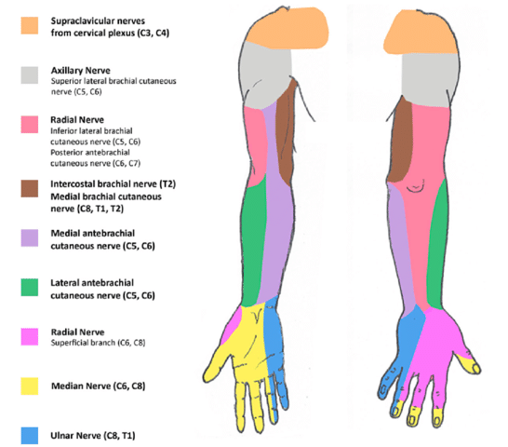

Slide 21
Pathologies

Slide 22
Shoulder Pathologies

Slide 23
Sternoclavicular Sprain
Traumatic
Pain and swelling localized to SC joint
Pain exacerbated by arm motion and lying supine
Treat with ice, sling, and analgesics
Nontraumatic
Suspect septic arthritis, especially in IVDU
Effusion visible with US → joint aspiration

Slide 24
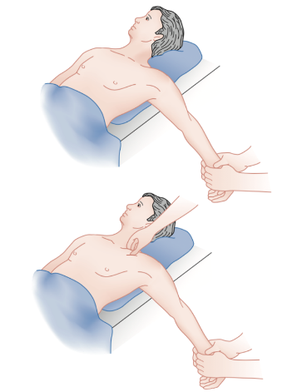
Anterior Sternoclavicular dislocation
Medial clavicle is prominent and palpable anterior to the sternum
May discharge without reduction, if uncomplicated
May attempt reduction if <10 days of injury
Usually unstable and re-dislocates ~50%
Treat with ice, sling, analgesics, and referral
Residual cosmetic deformity
Rarely symptomatic

Slide 25
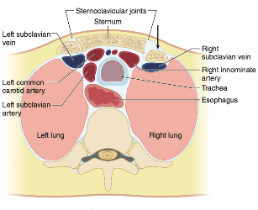
Posterior Sternoclavicular dislocation *may be life-threatening*
Medial clavicle less visible and may not be palpable
Complications include impingement of superior mediastinal contents
Stridor, dysphagia, SOB
CXR → r/o PTX, HemoPTX, pneumomediastinum
CT is imaging of choice, consider w/ contrast to assess mediastinal structures
Closed reduction requires ortho consult
Open reduction performed in OR with ortho, vascular, +/- trauma

Slide 26
A towel clamp may be placed percutaneously on the medial end of the clavicle and a very careful reduction maneuver with an anteriorly directed force is attempted

Slide 27
Clavicle Fractures
Swelling, deformity, tenderness, crepitus
Arm is slumped inward and downward, decreased ROM
Often diagnosed with shoulder X-Rays
If clinically suspect and XR negative → 45º cephalad tilt view XR or CT
Emergent ortho consult if:
open fracture
neurovascular injury
persistent skin tenting

Slide 28
Proximal Third Clavicle Fractures
Often high mechanism injury
R/o intrathoracic trauma w/ CT
May need emergent trauma/ortho/vascular surgery consultation if positive
If uncomplicated, then DC
Treat with ice, sling, analgesics, and referral within 1-2 weeks

Slide 29
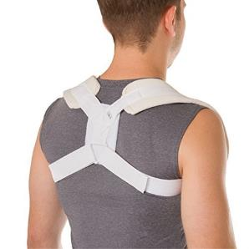
Middle Third Clavicle Fractures
Risk factors for nonunion → require operative fixation w/in days
Initial shortening >2cm
Comminuted fracture
Displaced fracture >100%
Significant trauma
Female
Elderly
Athletes, professional impact, cosmetic concerns
Otherwise, conservative treatment may be appropriate
Treat with ice, immobilize 4-8 weeks, analgesics, and referral within 1-2 weeks
WBAT, encourage daily ROM of elbow and shoulder as pain allows

Slide 30
Distal Third Clavicle Fractures
Type I- distal to coracoclavicular ligaments with ligaments intact
Conservative treatment
Type IIa- proximal to coracoclavicular ligaments with ligaments intact
Operative management to avoid nonunion
Type IIb- between coracoclavicular ligaments with ligaments torn
Operative management to avoid nonunion
Type III- intra-articular through AC joint
Conservative treatment

Slide 31
Scapula Fractures
Localized tenderness, worse with arm movement
Arm held in adduction
Usually due to high-impact trauma → assess ipsilateral lung, ribs, shoulder, spine, and pelvis
XR scapular series: AP, lateral, and axillary → CT scan
Surgical intervention for:
significant or displaced articular fractures of the glenoid
angulated glenoid neck fractures
acromial fractures associated with a rotator cuff tear
some coracoid fractures
Otherwise, treat with ice, sling, analgesics, early ROM, and referral

Slide 32
Acromioclavicular Joint Injuries, 6 types
Look for tenderness and deformities (compare both sides)
ROM limited
Cross body adduction test POSITIVE
AC XR + axillary view +/- stress XR
Emergent ortho consult if:
open fracture
neurovascular injury
persistent skin tenting

Slide 33
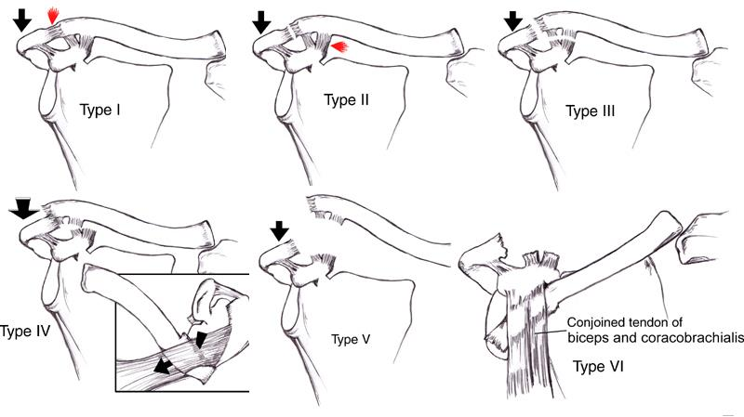
Type I and II: treat with ice, immobilization, analgesics, early ROM, and referral within 1-2 weeks
Type III: possible surgical intervention, may have trial of conservative treatment first
Type IV, V, VI: definite surgical intervention

Slide 34
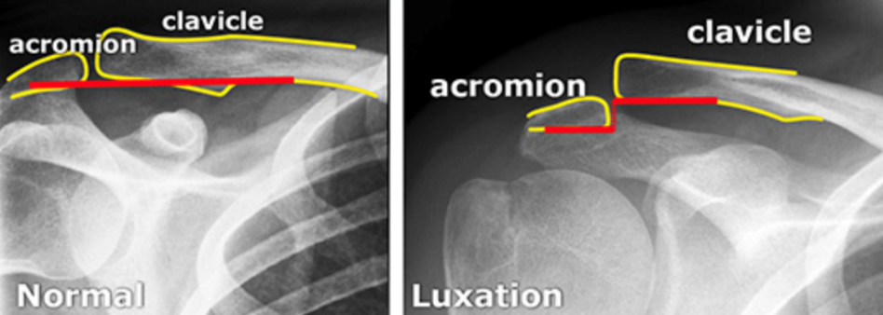

Slide 35
Anterior Glenohumeral Dislocation
Mechanism: Abduction, extension, and external rotation with force
Arm is held in abduction, externally rotated, shoulder is “squared off,” humeral head may be palpated anteriorly
Perform neurovascular exam (axillary n. most common injury)
Prereduction XR for first time dislocation or if fracture suspected
XR may be omitted if patient has hx of multiple recurrent dislocations
If associated with prox humeral fracture → ortho consult

Slide 36
Complications of Glenohumeral Dislocation
Recurrence
First-time dislocation → ortho referral (early surgical repair may decrease recurrence)
Rotator cuff tears
Hill-Sachs deformity (humeral head bony defects)
Bankart lesion (glenoid labral defects)
Neurovascular injuries
Absent radial pulse, axillary hematoma, bruising of lat chest wall, axillary bruit
Loss of sensation over upper arm, weakness with abduction and ext rotation

Slide 37
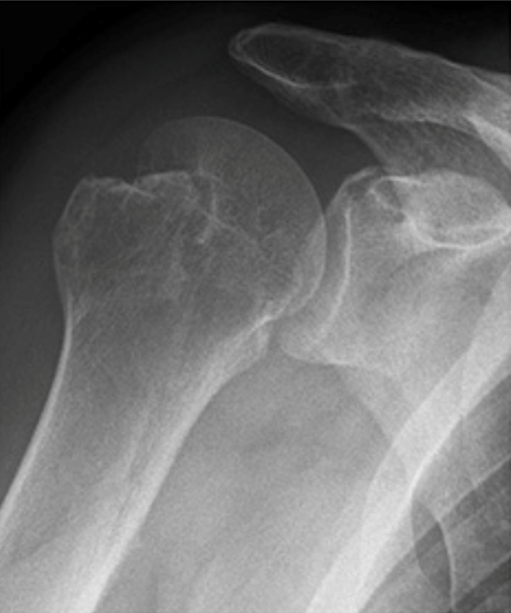
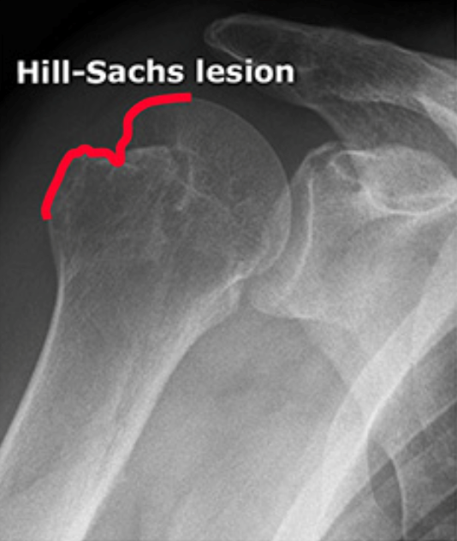
Notes:
Hill-Sachs lesion: humeral head bony defects

Slide 38
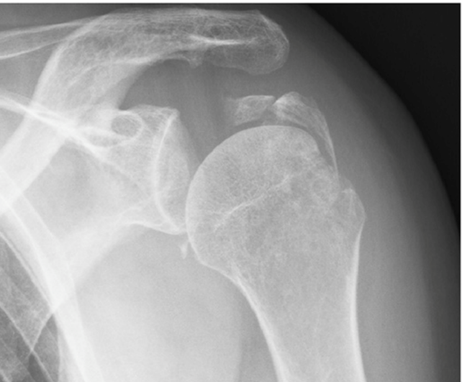
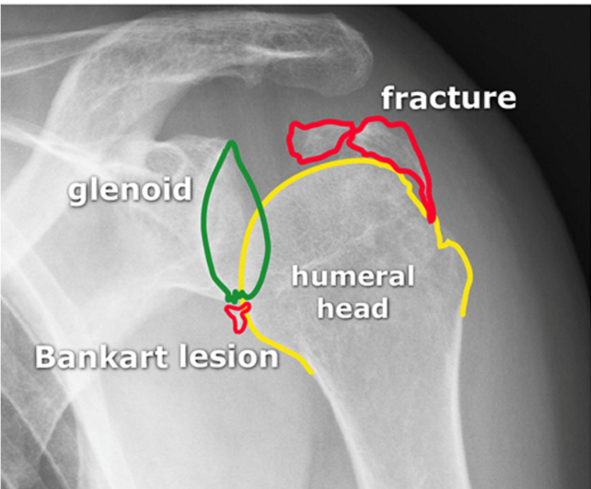
Notes:
Bankart lesion: glenoid labral defects

Slide 39
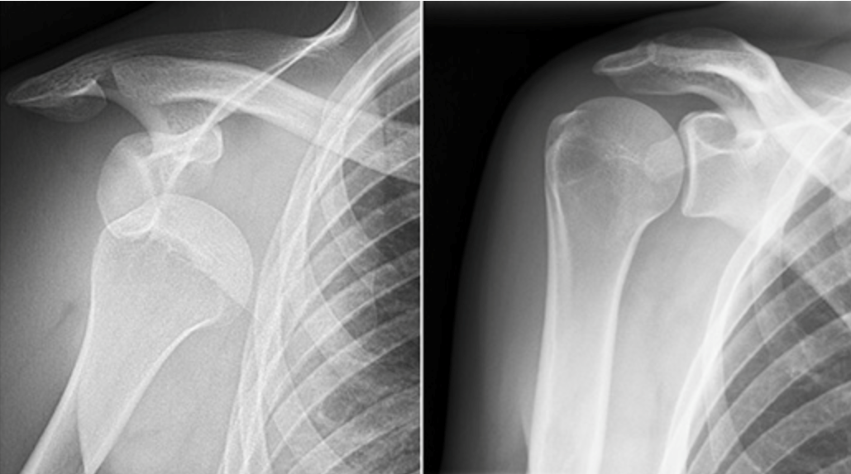
Notes:
Anterior dislocation AP view
Pathologic on left, normal on right

Slide 40
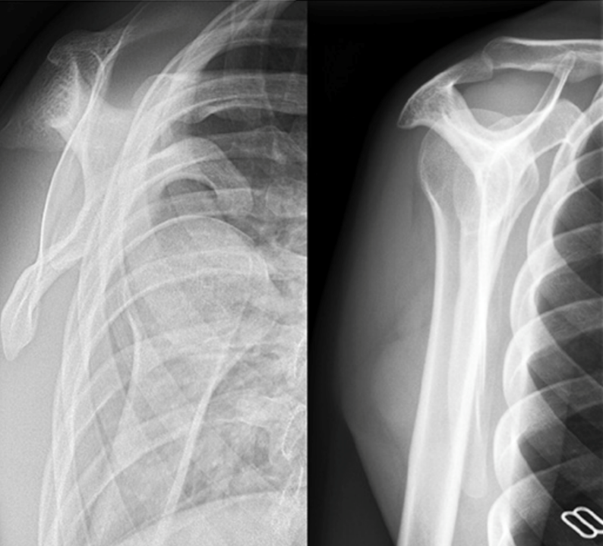
Notes:
Anterior dislocation Y-view
Pathologic on left, normal on right

Slide 41
Treatment of Glenohumeral Dislocations
NSAIDs, opiates, benzos, intra-articular anesthetic injection, procedural sedation for analgesia and anti-spasmodic
Most effective pain relief is reduction of dislocation
May reduce without meds if performed slowly and atraumatically

Slide 42
Intra-articular anesthetic injection
Use 10-20 cc of 50:50 mix of saline and local anesthetic
Palpate the lateral aspect of the acromion
2 cm inferior to this should be a hollow
Insert 25g needle 2 cm deep into the hollow, perpendicular to skin
Aspirate per usual, then inject 10-20 cc of the 50:50 mix
Lateral approach
Posterior approach

Slide 43
Common Shoulder Reduction Techniques

Slide 44
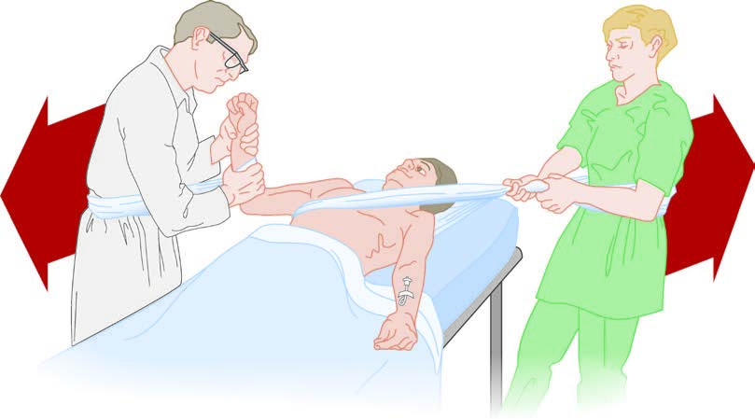
Traction/Counter-traction aka Modified Hippocratic Technique
Notes:
The patient is supine with the arm abducted and elbow flexed at 90 degrees. A sheet is tied and placed across the thorax of the patient and then around the waist of the assistant. Another sheet is tied and placed around the forearm of the patient at the elbow and the waist of the physician. Gradually apply traction to the proximal forearm as the assistant provides countertraction. Gentle internal and external rotation or outward pressure on the proximal humerus may aid reduction.

Slide 45
FARES Technique (Fast, Reliable and Safe)
1
2
3
4
Notes:
Place the patient in a supine position and hold the patient’s wrist with gentle traction in a neutral position. Gently move the limb anteriorly and posteriorly in small oscillating movements on the outstretched arm and start abducting the limb slowly while continuing to apply traction. Once the limb is abducted 90 degrees, the limb is externally rotated. Continue to slowly abduct the limb past this position. Reduction is usually achieved once the limb is abducted to 120 degrees.

Slide 46
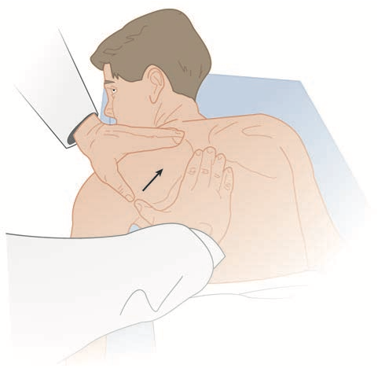
Scapular Manipulation Technique
Notes:
The patient is positioned with weights in the same manner as the Stimson technique. After adequate sedation, the physician pushes the tip of the scapula medially using the thumbs, while stabilizing the superior aspect with the cephalad hand.

Slide 47
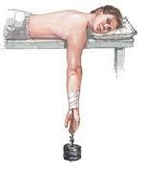
Stimson Technique
Notes:
Place the patient prone with the dislocated extremity hanging over the side of the stretcher and a 10-lb weight attached to the wrist. Inject intra-articular lidocaine. Complete muscle relaxation is required. Reduction occurs in 20 to 30 minutes.

Slide 48
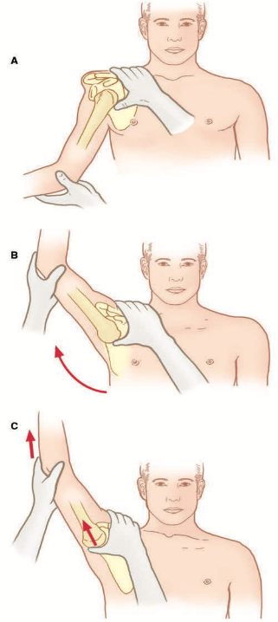
Milch Technique
Notes:
The maneuvers for the Milch technique are external rotation, arm abduction to 180 degrees with simultaneous pressure on the humeral head, and in-line longitudinal traction with continued pressure on the humeral head.

Slide 49
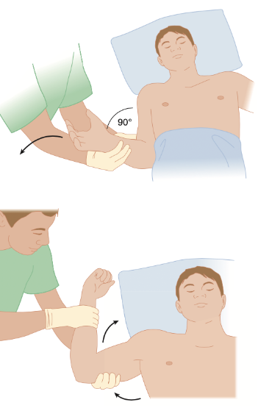
External Rotation Technique (Kocher’s Technique)
Notes:
Place the patient supine with the affected arm adducted to the patient’s side. With the elbow at 90 degrees of flexion, slowly externally rotate the arm. No longitudinal traction is applied. Perform the movement slowly to allow time for spasm and pain to resolve. Reduction is usually complete before reaching the coronal plane and is often not noted either by the patient or physician. If needed, the elbow may be brought anteriorly and internally rotated to the opposite shoulder.

Slide 50
Cunningham Technique
Notes:
Seat the patient comfortably, as upright as possible, with shoulders relaxed. Supporting the affected arm, slowly and gently move the humerus into full adduction with the elbow in flexion. Have the hand of the affected extremity resting against the physician’s shoulder. Gently massage the trapezius and deltoids, which helps to relax the patient. Then, gently massage the biceps at the mid-humeral level. Ask the patient to elevate and shrug or retract the shoulders (attempting to touch the scapulae together) and continue the biceps massage. The goal is to wait for the patient to relax fully and have the humeral head slip back into place.

Slide 51
SPASO technique

Slide 52
DAVOS technique

Slide 53
Post reduction care
Postreduction XR to confirm successful reduction and documentation
Sling vs. Sling and Swathe vs. Shoulder Immobilizer
Non-weight bearing (NWB)
Pain management: NSAIDS, acetaminophen, narcotics
Follow-up with Orthopedics or Sports Medicine within 1-2 days if complicated by bony/ST injury or 1 week if uncomplicated
Instruct patient to remove sling several times daily for ROM exercises (move the elbow, gentle pendulum exercises) to prevent stiffness

Slide 54
The shoulder is most vulnerable to an anterior glenohumeral dislocation in which of the following positions?
Abduction and external rotation
Abduction and internal rotation
Adduction and external rotation
Adduction and internal rotation
Notes:
Answer: A

Slide 55
Which of the following is the most common complication associated with an anterior shoulder dislocation?
Axillary nerve injury
Bankart lesion
Greater tuberosity fracture
Hill-Sachs defect
Notes:
Answer: D

Slide 56
Posterior Glenohumeral Dislocation
Mechanism: Forceful internal rotation and adduction or a direct blow to the anterior shoulder
Prominence of the posterior shoulder may, or may not, be present
Anterior flattening of the normal shoulder contour
Patient will be unable to externally rotate or abduct the affected arm
Y-view XR +/- Axillary XR diagnostic
Neurovascular and rotator cuff tears are less common
Notes:
Reduction of a posterior dislocation is performed with the patient supine. Apply traction to the adducted arm in the long axis of the humerus. Have an assistant gently push the humeral head anteriorly into the glenoid fossa.

Slide 57
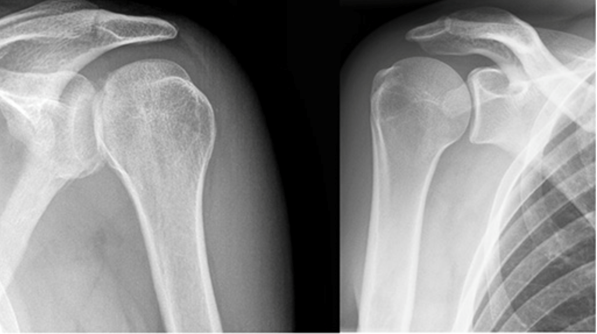
Notes:
Posterior dislocation AP view
Pathologic on left, normal on right

Slide 58
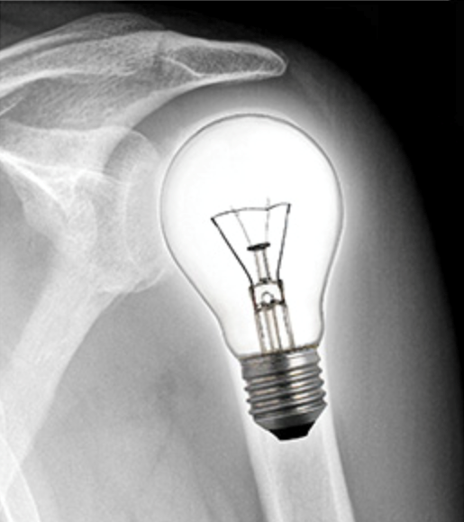
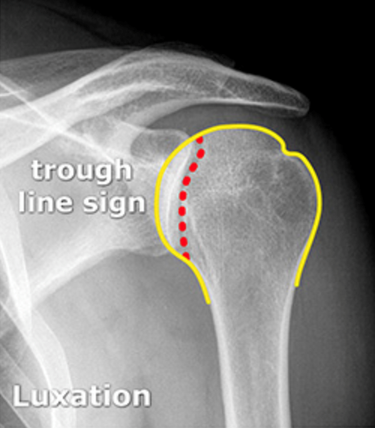
Notes:
Posterior dislocation, lightbulb sign and trough line sign

Slide 59
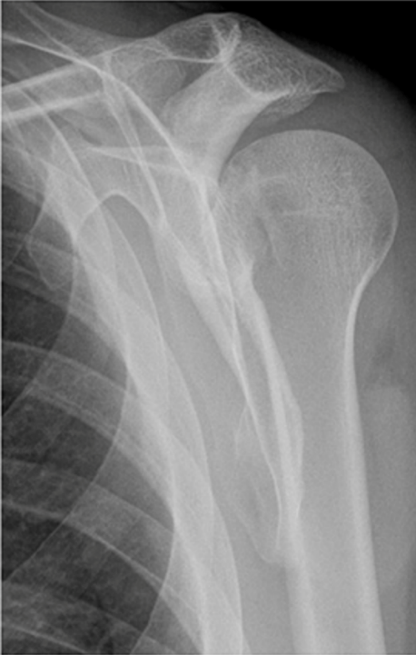
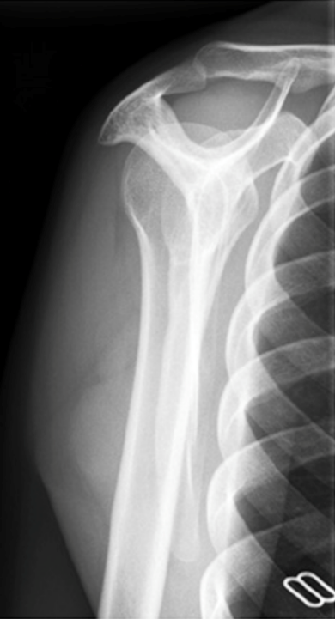
Notes:
Posterior dislocation Y view
Pathologic on left, normal on right

Slide 60
Inferior Glenohumeral Dislocation
Mechanism: hyperabduction force
Humerus fully abducted, the elbow flexed, and the patient’s hand on or behind the head
The humeral head can be palpated on the lateral chest wall
Associated with significant soft tissue trauma or fracture
When the humeral head is buttonholed through the inferior capsule, the dislocation is irreducible, and operative reduction is required

Slide 61
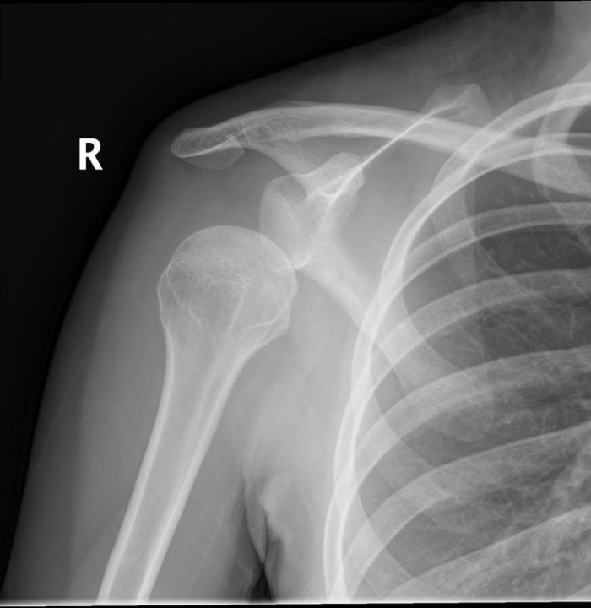
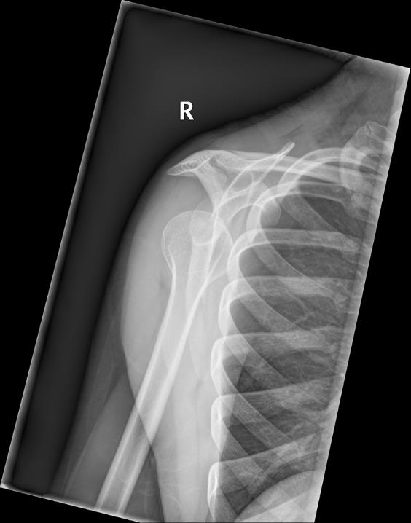

Slide 62
Luxatio Erecta (Inferior Dislocations)
Notes:
Reduction consists of traction in an upward and outward direction in line with the humerus. Have the assistant apply countertraction.

Slide 63
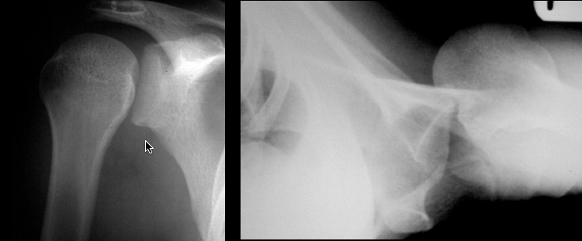
A 17-year-old woman presents after a witnessed generalized tonic-clonic seizure. She complains of pain in her right shoulder and difficulty moving her right arm. You order a shoulder radiograph and obtain the image above. You are told that the patient could not tolerate all three views of the shoulder. Which of the following is the most likely diagnosis?
Acromioclavicular separation
Anterior shoulder dislocation
Hill-sachs deformity
Posterior shoulder dislocation
Notes:
Answer: D

Slide 64
Subacromial Impingement Syndrome
Stage 1: reversible edema and hemorrhage about the rotator cuff
patients complain of a dull ache over the anterolateral shoulder that is aggravated by activity and improved by rest
Stage 2: tendinitis of the rotator cuff creates fibrosis and thickening of the tendons and bursa
patients complain of a recurrent or chronic aching pain with daily activities, pain with vigorous activity, and night pain
Stage 3: rotator cuff tears, rupture of the long head of the biceps, and subacromial spurs.
patients have progressive symptoms and disability, and they often require surgical decompression of the subacromial space

Slide 65
Subacromial Impingement Syndrome
Mechanism: Repetitive overhead use of the arm or movement of the shoulder above the horizontal
Exam may reveal anterolateral shoulder pain that radiates to lateral mid-humerus, atrophy of shoulder muscles, catching and crepitus (fibrosis), but full active and passive ROM
Neer and Hawkins tests
Tx: rest, activity and posture modification (scapular retraction), analgesics (NSAIDs), ice, ROM exercises, stretching and strengthening, corticosteroid injections, follow up
Notes:
Relative rest and activity modification. Advise the patient to avoid the aggravating activity and minimize all overhead activities. Although brief periods of support with a sling may help, avoid complete immobilization and prescribe range-of-motion exercises three to four times daily to minimize the chance of developing adhesive capsulitis.
Anti-inflammatories and analgesics. NSAIDs for 7 to 21 days are key, with short-term (3 days) opioid analgesics added if needed for severe pain. Acetaminophen may aid in lesser pain syndromes.
Cryotherapy. Apply ice to the affected shoulder for 10 to 15 minutes three to four times daily for analgesic effects and potential reduction of inflammation and edema. This is a cornerstone of treatment and should be used liberally.
Range-of-motion exercises. Two simple exercises can help the patient maintain glenohumeral motion. Pendulum swings are done with the patient slightly bent at the waist with the arm hanging freely in front of the body. The arms should be swung in gentle arcs of motion in both a clockwise and counterclockwise direction to the level of pain tolerance for 5 to 10 minutes three to four times daily. The size of the arcs should increase daily as symptoms allow. Also, the patient should stand sideways an arm’s length from a wall and walk the fingers up the wall to the level of pain tolerance, repeating the exercise three to four times daily.
Stretching and strengthening. Stretching and strengthening exercises are best carried out under the supervision of a physical therapist. Training should include movements that support scapular retraction, which helps open the subacromial space.
Corticosteroid injections. Although local corticosteroid injections into the subacromial space relieve pain, adverse effects include muscular atrophy, weakness, and further tissue degeneration. Injection directly into the tendon can lead to necrosis and rupture. Injection is not an emergency procedure and is best left to the primary care physician or orthopedist.
Follow-up. Ensure reassessment within 7 to 14 days with an orthopedist and/or a rehabilitation expert for consideration of additional therapies.

Slide 66
Subacromial Impingement Syndrome

Slide 67
Rotator Cuff Tears
Acute
Mechanism: trauma, extreme hyperabduction or hyperextension, FOOSH, lifting heavy object or catching heavy object +/- glenohumeral dislocation
Exam: sudden tearing sensation in the shoulder with severe pain, inability to abduct or externally rotate the arm against even minimal resistance, and asymmetry due to local swelling
Chronic (more common)
Mechanism: sports with overhead activities (swimming, tennis, baseball), laborers, extension of subacromial impingement syndrome
Exam: gradual and progressive pain at lateral upper arm, worse with arm elevation, external rotation, and lifting; disuse atrophy, weakness and crepitus with ROM is often present

Slide 68
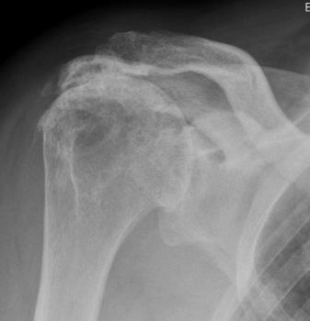
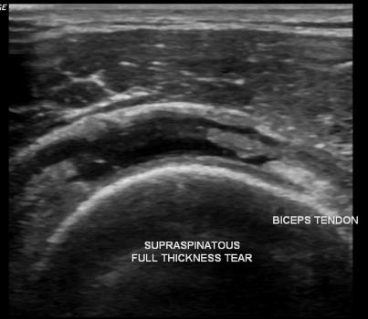
Rotator Cuff Tears
Partial Tear (more common) vs. Full-thickness Tear
Tx: rest, activity modification, analgesics (NSAIDs), ice, ROM exercises, stretching and strengthening, corticosteroid injections, follow up within 1 week
Less responsive to conservative treatment over time
Full-thickness → OR
Neurovascular → OR

Slide 69
Calcific Tendinosis
chronic repetitive microtrauma, age, tissue hypoxia → calcium crystal deposition → painful spontaneous resorption
Pre-calcific: mild pain at rest or at night
Calcific: pain with abduction or “catching” sensation
Resorptive: incapacitating pain for 1-2 weeks
Post-calcific: variable pain and shoulder dysfunction for several months

Slide 70
Calcific Tendinosis
Exam: patient may hold the arm adducted, max tenderness over the prox humerus, limited active and passive ROM, crepitus, muscle atrophy
Shoulder XR: localize deposits and any signs of impingement
Tx: analgesics, NSAIDs, ice, sling for brief periods, progressive ROM exercises, PT if chronic, corticosteroid injection, oral steroids, platelet-rich plasma, electrical nerve stimulation, and US-guided needle lavage
rest the shoulder in abduction on the back of a chair as often as is tolerable
sleep with a pillow beneath the axilla in order to prevent restriction of motion
Progression of symptoms, constant pain interfering with daily activities, or no improvement with conservative therapy → arthroscopy in OR

Slide 71
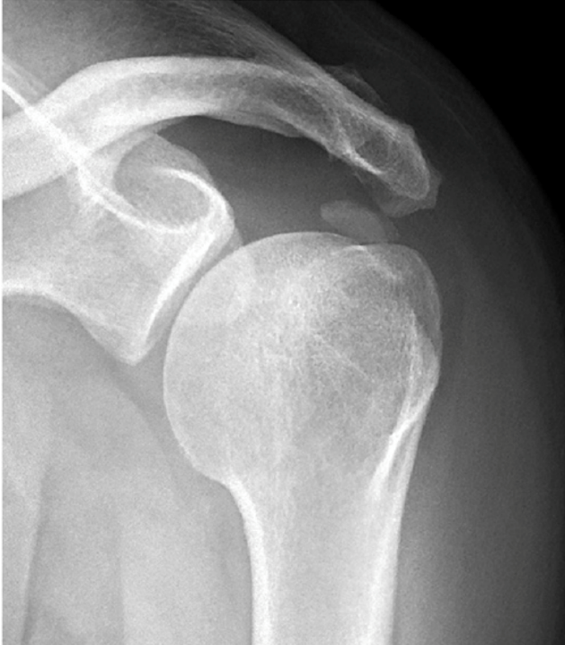
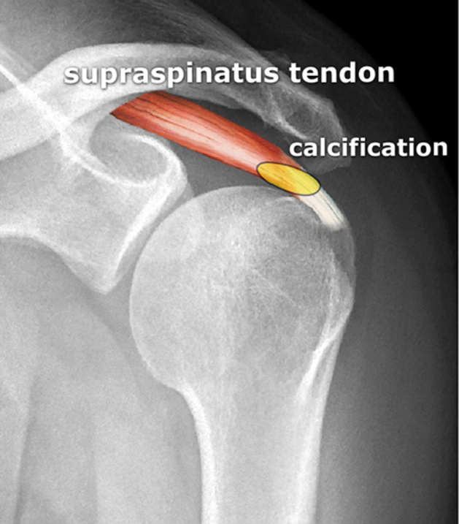

Slide 72
Adhesive Capsulitis aka Frozen Shoulder Syndrome
Primary: diabetes, thyroid disease, postmenopausal, pulmonary neoplasm, and autoimmune disorders
Secondary: prolonged immobilization after trauma, surgery, stroke, impingement syndrome or bicipital tendinitis
Stage 1 (months 2-3): acute synovial inflammation with limitation of ROM
Stage 2 (months 3-9): decreased shoulder motion and chronic pain from capsular thickening/scarring
Stage 3 (months 9-15): less pain and increased ROM, but a more fibrotic thick capsule
Stage 4 (months >15): progressive improvement in ROM with significant improvement in pain

Slide 73
Adhesive Capsulitis aka Frozen Shoulder Syndrome
Exam: limited active and passive ROM, pain is diffuse, poorly localized, often extends down the upper arm, worse at night and at rest +/- muscle atrophy
US may demonstrate increased vascular flow, thickening of rotator cuff structures, and bulging of the supraspinatus tendon
Tx: analgesics, NSAIDs, ice, no immobilization, progressive ROM exercises, PT is crucial, corticosteroid injection
If symptoms persist >6 months: refer to ortho for closed manipulation under general anesthesia, arthroscopic capsular release, or open capsular release in OR

Slide 74
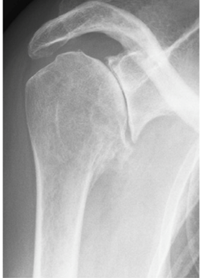
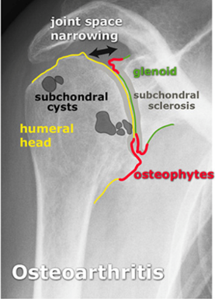
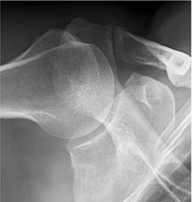
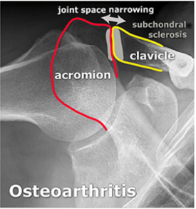
Osteoarthritis (OA)
Gradual and progressive pain, worse with motion, better with rest
Usually concurrent with degenerative disease of the AC joint
Secondary OA (more common): prev. fracture, recurrent dislocations, or an underlying disorder
Tx: analgesics, NSAIDs, gentle ROM exercise

Slide 75
Thoracic Outlet Syndrome
Compression of the brachial plexus (medial trunk) and blood vessels (subclavian a./v.) proximal to the shoulder
Pain that radiates through the shoulder to the medial forearm and 4^{th/}5th digits, numbness and tingling of the fingers and a weak grip
Elevated arm stress test and Adson’s test
XR → prior clavicular fracture with malunion or cervical rib band; CTA → arterial lesions; US → upper extremity venous thrombosis
Tx: activity modification, education, postural exercises, NSAIDs, PT, referral to PCP to dx neurogenic vs. arterial vs. venous TOS
Notes:
Elevated arm stress test (EAST): raise hands above head, then open and close fist for 3 min. Positive test: unable to complete, paresthesia, claudication.
Adson’s test: palpate both radial pulses while patient turns head from side to side. Loss of pulse is a positive test.

Slide 76
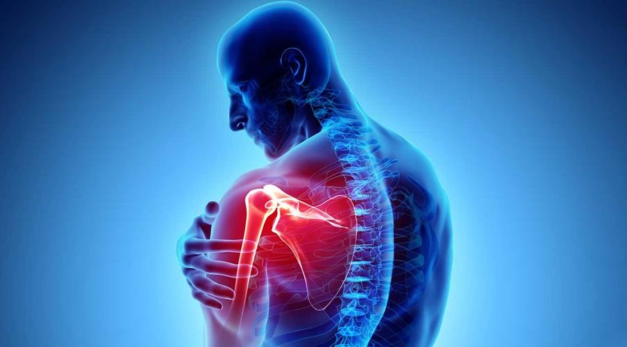
Arm Pathologies

Slide 77
Proximal Humerus Fractures
Pain, swelling, and tenderness around the shoulder
ROM often significantly limited, and arm is held in adduction
Crepitus and ecchymosis may be present
Neurovascular exam: axillary n. (sensation over deltoid m.) and suprascapular n. (supraspinatus and infraspinatus → shoulder abduction)
Axillary a. injury may be suggested by weak distal pulses, paresthesia, pallor, pulselessness, or an expanding hematoma

Slide 78
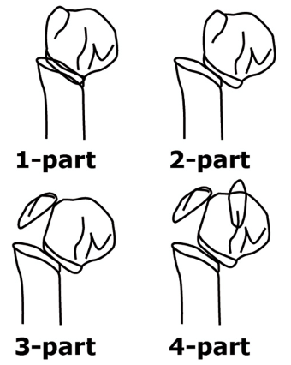
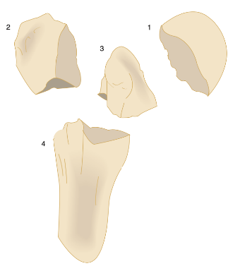
Neer classification system
1-part: fragment is not displaced, is displaced <1 cm, or is not angulated >45º
Tx: immobilization, ice, analgesics, ortho referral, and early mobilization
2-part, 3-part, 4-part: 2, 3, or 4 fragments that are displaced >1cm or angulated > 45º
Tx: Ortho consult in the ED
1. Articular surface
2. Greater tubercle
3. Lesser tubercle
4. Diaphysis/shaft
Notes:
Anatomic neck or the articular surface → compromise of the blood supply to the articular segment
If ischemic necrosis of the articular segment, a humeral head prosthesis may be required
Significantly angulated surgical neck fractures → neurovascular damage (brachial plexus)
Significant displacement of a greater tuberosity fracture → rotator cuff tear → OR
Fracture of the lesser tuberosity → potential posterior shoulder dislocation

Slide 80
Humeral Shaft Fractures
Transverse Fx: direct blow that produces a bending force
Oblique Fx: bending AND torsion forces, sometimes with comminution
Spiral Fx: indirect mechanism (FOOSH) that produces a torsion force

Slide 81
Humeral Shaft Fractures
Exam: Localized tenderness, swelling, pain, and abnormal mobility or crepitus +/- arm shortening
r/o injury to the brachial a. and v., or the radial, ulnar, or median n.
Neurovascular injuries → emergency ortho consultation
<20º of angulation in the sagittal plane, <30º of varus or valgus angulation, and shortened <2-3 cm → non-operative management
Tx: immobilization (sugar-tong, hanging cast, simple sling and swathe), ice, analgesia, and referral

Slide 82
Disorders of the Biceps Tendon
Tendinitis (inflamm.) and Tendinosis (collagen tears): associated with SLAP (superior labrum anterior to posterior) lesions 2/2 repetitive overhead arm motion
Intense pain at the anterior aspect of the shoulder at rest, at night, and with rotation
Subluxation of the biceps tendon from the bicipital groove is painful and occurs medially or laterally, while complete dislocation is seen only medially and is associated with a subscapularis tear
Partial or complete rupture is almost always proximal and is due to micro-tears and other age-related degenerative changes vs. mild trauma
Audible snap or pop followed by severe pain and deformity

Slide 83
Disorders of the Biceps Tendon
Exam: forearm supination (long head of the biceps) with resistance reproduces pain, palpable subluxation or popping sensation
US reliably detects biceps tendon dislocation and complete tears
Tx: rest, ice, sling PRN, analgesics, NSAIDs, elevation, early mobilization, intra-articular or bicipital groove inject. with US
Ortho: debridement, tenotomy, or tenodesis
TENDON
Notes:
Speed’s test identifies tear or tendinitis of the long head of the biceps; flex the shoulder to 90 degrees with the patient’s arm (elbow) fully extended and supinated. Provide downward resistance against shoulder flexion. Pain localized to the bicipital groove indicates a positive test.
The uppercut test is performed with the shoulder held in a neutral position, elbow flexed to 90 degrees, and the forearm supinated, as the patient forms a fist. The patient is instructed to simulate a boxing “uppercut” punch resisted by the examiner who places a hand over the patient’s fist. Pain or a painful pop over the anterior portion of the involved shoulder indicates a positive test.
The test most likely to indicate a SLAP lesion is the active compression test. To perform the test, have the standing patient flex his or her shoulder to 90 degrees, and then adduct 10 to 15 degrees medially and internally rotate so the thumb points to the floor, with elbow extended. The examiner applies a uniform downward force to the arm. This is repeated in full supination. A positive response is indicated by eliciting pain on the first maneuver, which is significantly diminished or absent on the second maneuver

Slide 84
Proximal Biceps Tendon Rupture
Mechanism: sudden or prolonged contraction against resistance, especially with a history of chronic biceps tendinopathy
Exam of the ant shoulder may reveal swelling, ecchymosis, tenderness, and often crepitus over the bicipital groove
Obtain XR Shoulder to r/o avulsion fracture
Tx: sling, ice, analgesics, and referral to ortho
Nonsurgical treatment if patient is older, less active, injury is at nondominant arm, patient can tolerate not having full arm function

Slide 85
Distal Biceps Tendon Rupture
Mechanism: sudden eccentric (extension) load applied to a flexed elbow
Exam of the antecubital fossa may reveal swelling, ecchymosis, and tenderness
Obtain XR Elbow to r/o avulsion fracture
Tx: sling, ice, analgesics, and referral to ortho
Nonsurgical treatment if patient is older, less active, injury is at nondominant arm, patient can tolerate not having full arm function

Slide 86
Distal Biceps Tendon Rupture tests
Notes:
Biceps squeeze test: patient seated and the forearm at 60 to 80 degrees of flexion, place one hand on the muscle belly of the biceps and the other hand on the myotendinous junction, and squeeze with both hands. The squeeze should result in forearm supination. Lack of supination is considered a positive test, indicating rupture of the distal biceps tendon.
Hook test: flex the patient’s elbow to 90 degrees. During active supination, if the biceps tendon is intact, the examiner can “hook” the index finger under a cord-like structure in the antecubital fossa.

Slide 87
Triceps Tendon Rupture
Mechanism: fall on an outstretched hand causing a forceful flexion of an extended elbow or a direct blow to the olecranon
Exam of the elbow may reveal posterior swelling, ecchymosis, and tenderness just proximal to the olecranon
Obtain XR Elbow to r/o avulsion fractures
Tx: sling, ice, analgesics, ortho referral
Notes:
Modified Thompson test: the upper extremity is positioned such that the arm is supported and the forearm is hanging in a relaxed position with 90 degrees of flexion. Squeezing the triceps muscle should produce extension of the forearm, unless a complete rupture is present.

Slide 88
Board Review Questions

Slide 89
An 82-year-old woman with osteoporosis falls against her kitchen table. She presents with acute right shoulder pain, proximal right upper extremity edema, and near-absent active shoulder joint range of motion. Which of the following is the most appropriate next step in management?
Obtain a scapular-Y radiograph
Passive range of motion measurement
Perform a distal neurovascular examination
Perform a Hawkins testing
Notes:
Answer: C

Slide 90
A 49-year-old man presents to the ED with right shoulder pain after falling from his bicycle while riding at a high speed. His exam is unremarkable except that his right arm is locked in abduction over his head, as seen in the image above. Which of the following is the likely diagnosis?
Anterior shoulder dislocation
Inferior shoulder dislocation
Posterior shoulder dislocation
Sternoclavicular joint dislocation
Superior shoulder dislocation
Notes:
Answer: B

Slide 91
A 20-year-old patient presents with traumatic shoulder pain with a noted deformity. An X-ray is shown above. Which of the following is the most likely diagnosis?
Acromioclavicular joint separation
Anterior glenohumeral dislocation
Inferior glenohumeral dislocation
Posterior glenohumeral dislocation
Notes:
Answer: D

Slide 92
Which of the following is the most common nerve injury associated with anterior shoulder reduction?
Axillary nerve injury
Brachial plexus injury
Musculocutaneous nerve injury
Radial nerve injury
Notes:
Answer: A

Slide 93
A 33-year-old man presents with right-sided neck and shoulder pain. On exam, which of the following maneuvers would be most predictive of a rotator cuff injury?
Pain in shoulder while actively abducting the arm beyond 90 degrees
Pain in shoulder with forced internal rotation with the arm parallel to floor and elbow flexed at 90 degrees
Pain with passive elevation of the arm above the head
Reproducible right arm pain with downward pressure on the head while the neck is extended and leaning toward the right
Notes:
Answer: A

Slide 95
References
Netter’s Clinical Anatomy, 4th edition
Startradiology.com
Radiopaedia.org
Tintinalli’s Emergency Medicine A Comprehensive Study Guide, 9th edition
Rosh Review

