Slide 1
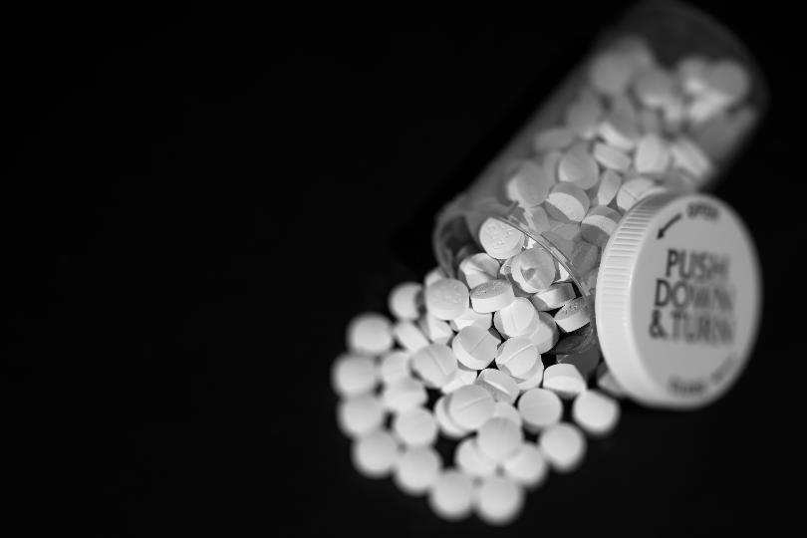
Module #1 Introduction
Module Primary Author
Lucinda Lai
Authoring Group
Steven L. Bernstein, Kathryn Hawk, Lindsey Jennings, Lucinda Lai, Alexis LaPietra, Ryan McCormack, Lewis S. Nelson, and Reuben Strayer
Funding for this initiative was made possible (in part) by grant no. 1H79FG000021-01 from SAMHSA. The views expressed in written conference materials or publications and by speakers and moderators do not necessarily reflect the official policies of the Department of Health and Human Services; nor does mention of trade names, commercial practices, or organizations imply endorsement by the U.S. Government.

Slide 2
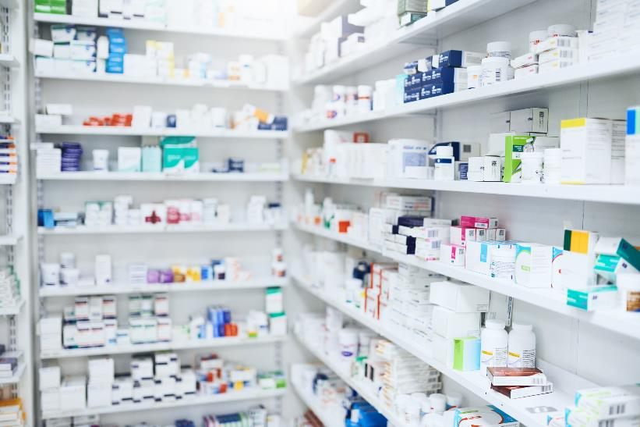
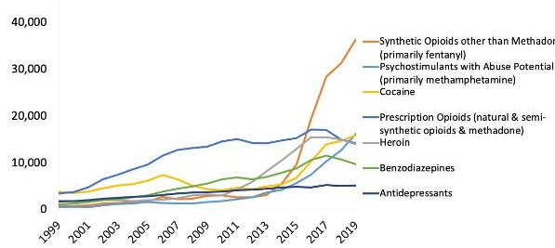
Record 72,000 Drug Overdose Deaths in 2019
CDC, 2020
2
Notes:
Speaker Notes:
The death toll from drug overdoses continues to rise, reaching a record high of 72,000 deaths in the U.S. in 2019 (CDC, 2020).
As context:
~58,000 deaths during the entire Vietnam War
~50,000 AIDS-related deaths in 1995 in the worst year of the AIDS.
~36,000 motor vehicle deaths in 2019.
~24,000 deaths due to homicides in 1991.
Most recent sudden increase (gold line) is mostly due to illicit Fentanyl and its analogues
Overdose is now the leading cause of death for Americans under 50 years old (Katz, NYTimes 2017, https://www.nytimes.com/interactive/2017/09/02/upshot/fentanyl-drug-overdose-deaths.html)

Slide 3
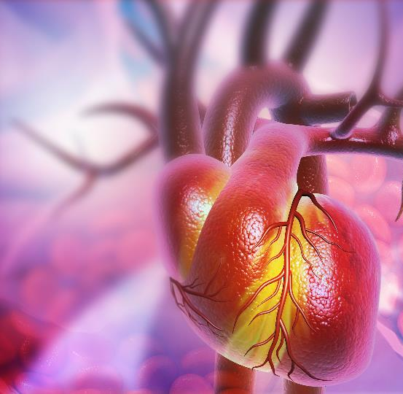
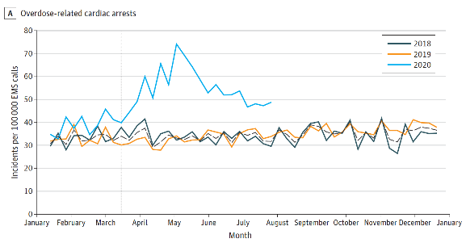
Overdose-Related Cardiac Arrests Rise During COVID-19 Pandemic
Friedman, 2020
3
Notes:
Speaker Notes:
A retrospective analysis of a national EMS database by Friedman (2020) revealed that the number of overdose-related cardiac arrests rose sharply during April 2020 and reached a peak in May, when lockdowns began to really take hold across the U.S.
Peak OD-related cardiac arrest rates in May 2020 were more than double the baseline in 2018 and 2019.
Many of the trends predicted by public health experts at the outset of the pandemic, such as an increased proportion of individuals using substances alone, increased toxification of the drug supply, and reduced access to treatment, may explain the increased lethality of each overdose incident.

Slide 4
The Treatment Gap
More than 21 million people needed SUD treatment in 2018.
Only 1 in 9 received any type of specialty SUD treatment.
Although this number is increasing, only a minority of providers are currently waivered to prescribe medication for opioid use disorder.
SAMHSA, 2019
Notes:
Speaker Notes:
SUDs are chronic conditions that affect over 21 million adults in America and are amongst the top causes of morbidity, mortality and economic costs.
Significant treatment gaps continue to exist for the timely treatment of SUDs: Of the 21.2 million American people aged 12 or older who needed treatment for a substance use disorder in 2018, only 1 in 9 (11.1%) received addiction treatment within the past 12 months.
Why are so many people left untreated? Lack of knowledge about evidence-based treatment modalities, the pervasive stigma surrounding addiction, and lack of a feeling of self-efficacy on the part of clinicians to intervene may all contribute to the missed opportunities to save lives.
Medication for opioid use disorder (MOUD) can help decrease the treatment gap and lower mortality for individuals with Opioid Use Disorder.
According to the Substance Abuse and Mental Health Services Administration (SAMHSA), fewer than 4% of licensed physicians were approved to prescribe buprenorphine in 2017.

Slide 5
Objectives
Describe the epidemiology and public health impact of substance use disorders.
Explain the neurobiology of addiction.
Address stigma as a barrier to treatment.
Discuss screening and intervention efforts that can be started in the emergency department.
5

Slide 6
Terminology
Substance use disorder (SUD) is the appropriate medical term for “addiction” (ie, compulsive drug use despite harmful consequences) characterized by:
Loss of control over ability to limit use
Failure to meet work, social, or family obligations
Emergence of a negative emotional state (such as dysphoria, anxiety, and irritability) when access to the substance is prevented
May also involve physical dependence on the drug (tolerance and withdrawal)
Physical dependence can develop with chronic use of many substances, including prescription drugs taken as instructed. When the body adapts to the drug, more of it is required to achieve a certain effect (tolerance). In addition, drug-specific physical or mental symptoms can arise with abrupt cessation of the substance (withdrawal).
SUD is diagnosed based on DSM-5 criteria, and each SUD can be further classified as its own disorder:
Opioid use disorder
Alcohol use disorder
Stimulant use disorder
Tobacco use disorder
ASAM, 2011; NIDA, 2014
Notes:
Key point: There is broad consensus by experts that Substance Use Disorder is a chronic, relapsing, remitting medical condition that affects behavior and decision making.
It is important to emphasize that substance use disorder is a chronic brain disease, not a moral failing.
References:
ASAM: American Society of Addiction Medicine
NIDA: National Institute on Drug Abuse

Slide 7
What if we treated other diseases the way we treat SUD?
7
Notes:
Let’s consider a thought experiment…

Slide 8
What if…
You go to the hospital with chest pain, are found to be having a heart attack, and you were…
Told it’s “your fault” because of your “choices”?
Denied treatment because you “did it to yourself”?
Handed a list of cardiologists and catheterization labs to call?
Only given aspirin if you agree to go to counseling?
Kicked out of the hospital for having more chest pain?
8

Slide 9
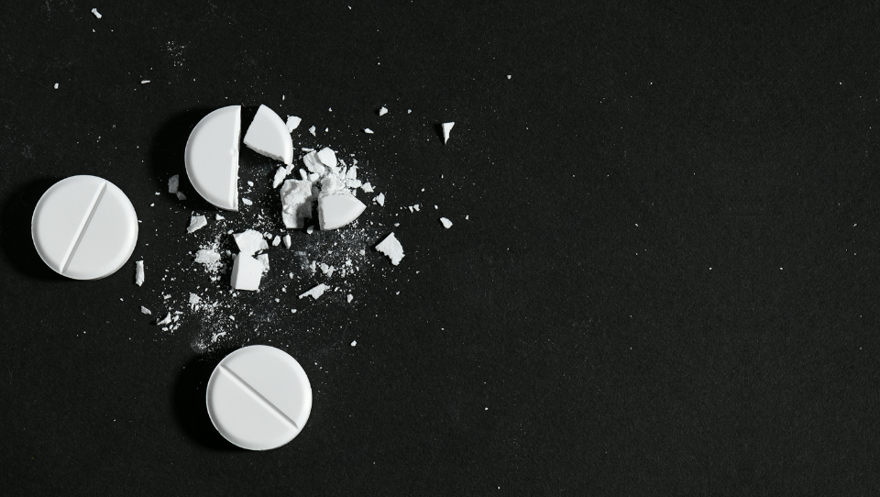
What if we treated SUD the way we treat other diseases?
9

Slide 10
What if…
The only prerequisite for treatment was having SUD?
A system existed to offer treatment on demand?
Care was triaged based on who needs it the most?
Patients didn’t get “fired” for having symptoms of the disease (eg, relapse)?
Patients were encouraged to start medications?
Patients were offered a menu of treatment options?
10

Slide 11
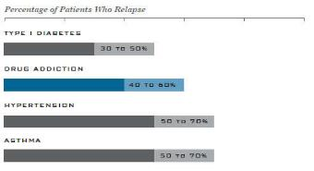
Similar to Other Chronic Illnesses
No easy cure for SUD
Similar relapse and recurrence rates compared to other chronic illnesses
Similar treatment outcomes
Goal of medical management is the prevention of acute and chronic complications
Adherence and engagement with treatment are crucial
Relapse Rates of SUD vs. other Chronic Illnesses
NIDA, 2012; McClellan, 2000
11
Notes:
Speaker Notes:
Substance use disorder meets the definition of a chronic illness, with features of heritability, influences from the environment and behavior, responsiveness to appropriate treatment, has a biologic/physiologic basis, is ongoing and long-term, and can involve recurrences. Furthermore, if not treated adequately, then can become progressive and result in substantial morbidity and mortality.
Stigma against SUD and medication-assisted treatment kills people. It kills people in the same way that if we had a stigma against insulin, and the only way to treat diabetes was through a strict diet and weight loss, people would die.

Slide 12
A Treatable Disease
NIDA, 2012; McClellan, 2000

Slide 13
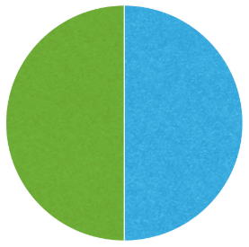
Vulnerability to developing SUD
Social influence
Biochemical
Parents
Siblings
Friends
Adverse childhood experiences Psychiatric disorders
Stressors
Lack of positive experiences
Opioid receptors
Dopamine and other transmitters
Intracellular signals
Genetics
~50%
Environment
~50%
Behavioral
Availability
Novelty seeking
Harm avoidance
Impulsivity
Psychiatric disorders
Illicit sources
Prescription
Family and friends
Anokhin et al., 2015; Milivojevic et al., 2012; Reed et al., 2014; Volkow et al., 2016
Notes:
Speaker Notes:
Substance Use Disorder is a chronic brain disease with strong genetic, neurodevelopmental, and sociocultural components.

Slide 14
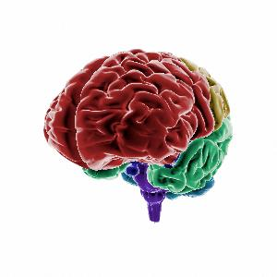
Neurobiology of Addiction
Positive reinforcement
Negative reinforcement
Cells in the brainstem release dopamine in the nucleus accumbens
Cells in the amygdala are stimulated
Liking and wanting
Anxiety, fear, distress
Seek out and do more
Avoid thing that cause do thing that relieve fear
Attention, thinking, and judgement use the prefrontal cortex.
Volkow et al., 2016; Wise and Koob, 2014
14
Notes:
Speaker Notes:
Drugs such as opioids act on fundamental reward circuitry in the brain.
Opioids stimulate release of dopamine (the basic neurotransmitter of reward) from the nucleus accumbens to an even greater extent than natural rewards such as food and sex, leading to supraphysiologic feelings of pleasure and gratification, learning of cues and behaviors that led to the experience, and motivation to repeat the behavior in the future.
Repeated use overrides impulse inhibition (in the dorsal striatal circuit).
Opioids decrease stimulation of the brain’s stress system (centered in the amygdala), producing relief from uncomfortable feelings like fear and anxiety, which again strengthens the motivation to use again in the future.
Repeated use sensitizes the brain to stressful stimuli and dysphoria when the stimulant is no longer present.
Repeated use also leads to dysregulation of executive function in the prefrontal cortex, leading to subjective feelings of preoccupation with and anticipation of the next “hit”.

Slide 15
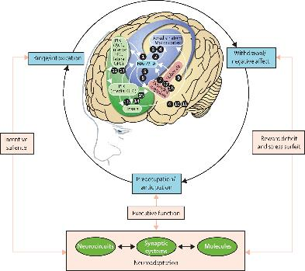
Cycle of Behaviors
HHS, 2016
15
Notes:
These neurobiological changes are associated with 3 types of behavior in a repeating cycle.
In the binge/intoxication stage, the neurons in the basal ganglia contribute to the rewarding effects of consuming an intoxicating substance through the release of dopamine and the brain’s endogenous opioid peptides.
During the withdrawal/negative affect stage of the addiction cycle, the stress neurotransmitters in the extended amygdala are activated and contribute to a general loss of reward sensitivity. These stress neurotransmitters include corticotropin-releasing factor, norepinephrine, and dynorphin.
In the preoccupation/anticipation stage, neurons in the “Go” circuits of the prefrontal cortex (the system that helps people make decisions, particularly those that require significant attention and planning) stimulate the habit systems of the dorsal striatum through connections that use glutamate, the main excitatory neurotransmitter in the brain. This process leads to decreased executive function.
treatment kills people. It kills people in the same way that if we had a stigma against insulin, and the only way to treat diabetes was through a strict diet and weight loss, people would die.

Slide 16
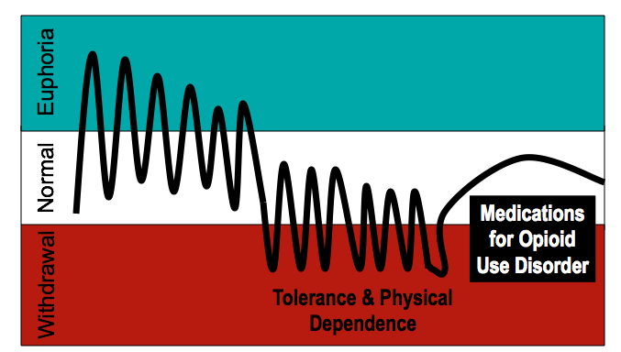
A Model of Opioid Use Over Time
Euphoria
Normal
Medications for Opioid Use Disorder
Withdrawal
Tolerance & Physical Dependence
Initial use
Repeated use
Alford, 2015
Notes:
Speaker Notes:
Initial use of opioids lead to euphoric states.
Over time, however, repeated use of opioids leads to the development of tolerance and physical dependence and more frequent dips into states of withdrawal.
Medications for Opioid Use Disorder (i.e. buprenorphine and methadone) act on the same receptors but don’t produce the dramatic high’s and low’s of illicit opioid use, so patients are better able to achieve a steady state of normalcy.

Slide 17
Stigmatizing Language
The term substance “abuse” is no longer used in the DSM-5.
The word “abuse” is moralistic and associated with behaviors like sexual assault and intimate partner violence.
Professionals are more likely to view a patient as deserving of punishment if that patient is described as a “substance abuser” rather than “a person with a substance use disorder.”
Wakeman, 2013; Kelly & Westerhoff, 2010
17
Notes:
Stigma prevents people with SUD from seeking treatment. Stigma can also lead medical professionals to perceive SUD to be a moral failing rather than a treatable chronic disease.

Slide 18
Say THIS:
NOT That:
Person with a substance use disorder
Person living in recovery
Person living with an addiction
Person arrested for drug violation
Chooses not to at this point
Medication is a treatment tool
Had a setback
Maintained recovery
Positive drug screen
Addict, junkie, druggie
Ex-addict
Battling/suffering from addiction
Drug offender
Noncompliant/bombed out
Medication is a crutch
Relapsed
Stayed clean
Dirty drug screen
National Council for Behavioral Health, 2016
18
Notes:
Speaker Notes:
Routine vocabulary of health care professional frames illness and shapes medical judgments. When these terms enter the public arena, they convey social norms and attitudes. Physicians should strive to use language that accurately reflects science, promotes evidence-based treatment, and demonstrates respect for patients. This includes using person-centric language both when speaking to patients and when speaking to other medical professionals (e.g. in the hospital elevator).

Slide 19
Interventions from the ED
Emergency departments are a key access point to the health care system for patients with SUDs.
Most effective techniques to enhance patient motivation to enter treatment are based on the principles of Motivational Interviewing, a collaborative conversation style for strengthening a person’s own commitment to change.
Patients who are treated with respect and understanding and are offered effective treatment in the emergency department are more likely to continue with that treatment and enter recovery programs.
Bernstein & D’Onofrio, 2013; D'Onofrio et al., 2017;
Miller & Rollnick, 2013

Slide 20
SBIRT
Screening
Brief Intervention
Referral to Treatment
Bernstein, 2013
20
Notes:
ED’s can be the optimal setting for screening and intervention because of the high prevalence of SUD in our patient population and the unique opportunity to leverage patients’ motivation to change when presenting in moments of crisis
Multiple studies have shown SBIRT to be effective in ED populations in reducing alcohol consumption, smoking (in selected subgroups), marijuana use, and negative consequences such as drinking and driving.
Screening: Quickly assess the severity of substance use and determine the appropriate level of treatment.
Brief Intervention: Increase insight and awareness of substance use by using motivational interviewing techniques toward behavior change.
Referral to Treatment: Provide patients identified as needing more extensive treatment with access to specialty care.

Slide 21
5 Principles of Motivational Interviewing
Express empathy.
Develop discrepancy between patients’ stated goals and values vs their current substance use behavior.
Avoid argumentation and direct confrontation.
Roll with patients’ resistance instead of fighting it.
Support self-efficacy and patients’ belief that they can change.
Miller & Rollnick, 2013
21

Slide 22
Key Points
We can make a difference.
Emergency physicians work at the frontline of the SUD epidemic, and we should feel empowered to save lives by linking patients to treatment.
Words matter.
Language can either perpetuate or reduce stigma. Physicians should strive to use language that accurately reflects science, promotes evidence-based treatment, and demonstrates respect for patients.
Treatment works.
SUD is a preventable and treatable chronic illness. Treatment outcomes for SUD are similar to those of other chronic illnesses, such as type 2 diabetes, hypertension, and asthma.
Botticelli & Koh, 2016
McLellan, 2000
22

Slide 23
References
Agerwala SM and McCance-Katz EF. 2012. Integrating Screening, Brief Intervention, and Referral to Treatment (SBIRT) into Clinical Practice Settings: A Brief Review. J Psychoactive Drugs 44(4):307–317.
Alford DP. 2015. Opioids: Research to practice [PowerPoint slides]. Chief Resident Immersion Training. https://www.bumc.bu.edu/care/ (Accessed 11/2019).
American Society of Addiction Medicine (ASAM). Definition of Addiction. 2011: https://www.asam.org/resources/definition-of-addiction (Accessed 11/2017).
Anokhin AP, Grant JD, Mulligan RC, and Heath AC. 2015. The genetics of impulsivity: evidence for the heritability of delay discounting. Biological Psychiatry 77(10):887‒894.
Bernstein SL, D’Onofrio G. A promising approach for emergency departments to care for patients with substance use and behavioral disorders. Health Aff (Millwood). 2013 Dec;32(12):2122-8.
Botticelli and Koh. The Changing Language of Addiction. JAMA 2016; 316 (13): 1361.
Centers for Disease Control and Prevention. Wide-ranging OnLine Data for Epidemiologic Research (WONDER) http://wonder.cdc.gov/mcd.html. (Accessed 12/2020).
D’Onofrio G, Chawarski MC, O’Connor PG, et al. Emergency department-initiated buprenorphine for opioid dependence with continuation in primary care: outcomes during and after intervention. J Gen Int Med 2017; 34: 660-666.
Grayken Center for Addiction at Boston Medical Center. Words Matter: My Pledge. 2019: https://www.bmc.org/sites/default/files/Patient_Care/Specialty_Care/Addiction-Medicine/LANDING/files/Words-Matter-Pledge.pdf (Accessed 11/2019).
Jones CM, Campopiano M, Baldwin G, & McCance-Katz E. 2015. National and State Treatment Need and Capacity for Opioid Agonist Medication-Assisted Treatment. Am J Public Health 105(8):e55-63.
Kelly JF, Westerhoff CM. Int J Drug Policy. 2010;21(3):202---207
McLellan AT, Lewis DC, O’Brien CP, & Kleber HD. (2000). Drug dependence, a chronic medical illness: implications for treatment, insurance, and outcomes evaluation. JAMA, 284(13), 1689-1695.
Milivojevic D, Milovanovic SD, Jovanovic M, et al. 2012. Temperament and character modify risk of drug addiction and influence choice of drugs. American Journal on Addictions 21(5):462‒467.

Slide 24
References
Miller WM and Rollnick S. 2013. Motivational Interviewing: Helping People Change. Guilford Press: New York.
National Council for Behavioral Health. Language Matters. 2019: https://www.thenationalcouncil.org/surgeon-general-toolkit/language-matters/ (Accessed 11/2019).
National Institute on Drug Abuse. Drugs, Brains, and Behavior: The Science of Addiction. 2018: https://www.drugabuse.gov/publications/drugs-brains-behavior-science-addiction/drug-abuse-addiction (Accessed 11/2019).
National Institute on Drug Abuse. Principles of Drug Addiction Treatment. 2012: https://www.drugabuse.gov/sites/default/files/podat_1.pdf (Accessed 11/2019).
National Institute on Drug Abuse. 2014: https://www.drugabuse.gov/publications/media-guide/science-drug-abuse-addiction-basics (Accessed 11/2017).
Reed B, Butelman ER, Yuferov V, et al. 2014. Genetics of opiate addiction. Current Psychiatry Reports 16(11):504‒516.
Substance Abuse and Mental Health Services Administration. 2019. Key substance use and mental health indicators in the United States: Results from the 2018 National Survey on Drug Use and Health (HHS Publication No. PEP19-5068, NSDUH Series H-54). Rockville, MD: Center for Behavioral Health Statistics and Quality, Substance Abuse and Mental Health Services Administration. Retrieved from https://www.samhsa.gov/data/
U.S. Department of Health and Human Services (HHS), Office of the Surgeon General, Facing Addiction in America: The Surgeon General’s Report on Alcohol, Drugs, and Health. Washington, DC: HHS, November 2016.
Volkow ND, Koob GF, and McLellan AT. 2016. Neurobiologic advances from the brain disease model of addiction. N Engl J Med 374(4):363‒371.
Volkow ND and McLellan AT. 2016. Opioid abuse in chronic pain: Misconceptions and mitigation strategies. N Engl J Med 374(13):1253‒1263.
Volkow ND and Morales M. 2015. The brain on drugs: From reward to addiction. Cell (4):712-25.
Wakeman SE. Am J Public Health. 2013 April; 103(4): e1–e2.
Wise RA and Koob GF. 2014. The development and maintenance of drug addiction. Neuropsychopharmacology 39(2):254‒262.
Zgierska A & Fleming MF. 2014. Medical and surgical complications of Addiction. In Ries, R.K.; Fiellin DA; Miller SC; and Saitz R (eds.) Principles of Addiction Medicine, Fifth Edition. Copyright 2014, American Society of Addiction Medicine, Chevy Chase, MD.

