Slide 1
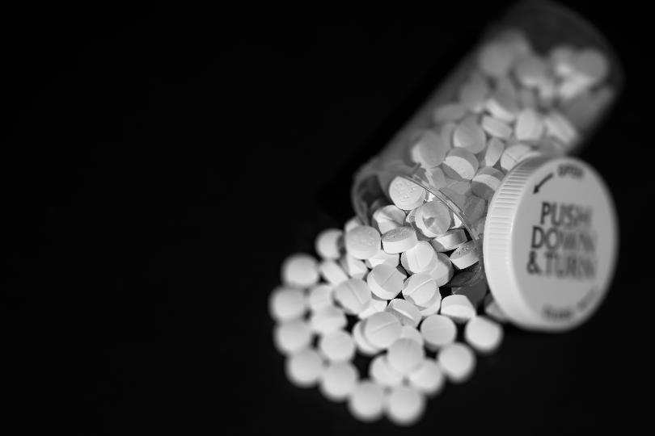
Module #2 Introduction to Opioids and Opioid Use Disorder
Module Primary Author
Kathryn Hawk
Authoring Group
Steven L. Bernstein, Kathryn Hawk, Lindsey Jennings, Lucinda Lai, Alexis LaPietra, Ryan McCormack, Lewis S. Nelson, and Reuben Strayer
Funding for this initiative was made possible (in part) by grant no. 1H79FG000021-01 from SAMHSA. The views expressed in written conference materials or publications and by speakers and moderators do not necessarily reflect the official policies of the Department of Health and Human Services; nor does mention of trade names, commercial practices, or organizations imply endorsement by the U.S. Government.

Slide 2
Learning Objectives
Describe the Opioid Epidemic.
Explain Opioid Use Disorder (OUD).
Discuss medications for the treatment of OUD.
2

Slide 3
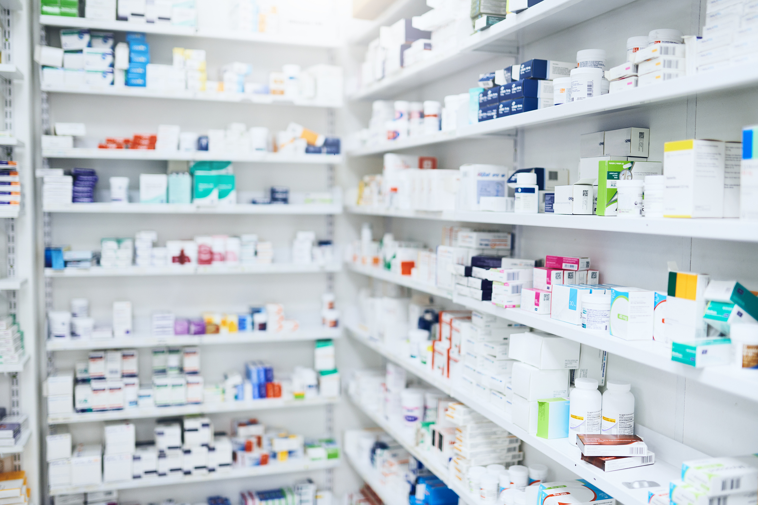
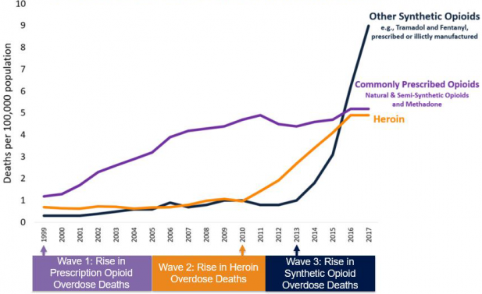
Three Waves of the Rise in Opioid Overdose Deaths
National Vital Statistics System Mortality File
3

Slide 4
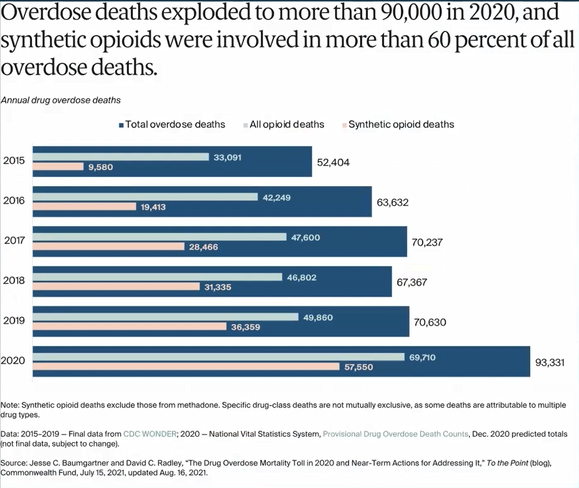

Slide 5
The Treatment Gap for Substance Use Disorders
Approximately 22 million individuals aged 12 or older needed substance use treatment in 2015.
Only 10% of those diagnosed with SUDs received any type of specialty treatment.
Jones et al., 2015;
SAMHSA, 2017
Notes:
Speaker Notes:
Key Point: Significant treatment gaps continue to exist for the timely treatment of SUDs
MAT can help decrease this gap and consequently mortality for individuals with Opioid Use Disorder

Slide 6
Addiction Is About Behavior and Loss of Control
Opioid Use Disorder: DSM-5 Criteria
Nonmedical opioid use: Taking opioids differently than how they are prescribed
Route
Frequency
Individual
Indication

Slide 7
DSM-5 Criteria for SUDs
Loss of control
More than intended
Amount used
Time spent
Unable to cut down
Giving up activities
Craving
Physiology
Tolerance
Withdrawal
Consequences
Unfulfilled obligations
Work
School
Home
Interpersonal problems
Dangerous situations
Medical problems
Formerly dependence
Formerly abuse
A substance use disorder is defined by meeting two or more of the above criteria in the past year resulting in distress or impairment.
Tolerance and withdrawal alone do not necessarily imply a disorder.
Severity is rated by the number of symptoms present:
2 to 3 = mild
4 to 5 = moderate
6 or more = severe
APA, 2013
7
Notes:
Speaker Notes:
Key Point: For a DSM diagnosis of SUD, the individual has to meet criteria in the following areas:
Loss of control of use;
Physiologic changes, and
Continued use despite negative consequences, with several specific diagnostic criteria in each category as shown above
A disorder is not diagnosed if only tolerance and withdrawal are present, without distress or impairment, since this can occur with many medications used as prescribed
Non-medical opioid use – taking a medication in manner that is inconsistent with how it is prescribed (person, frequency, route (PO vs IV), indication (euphoria)
Abuse 🡪 Outdated term. Considered stigmatizing.

Slide 8
Range of Treatment Goals
Minimization of harms from ongoing use
Sustained recovery with abstinence from all substances
FDA-approved treatment medications for OUD (MOUD) include:
Buprenorphine: partial agonist at the mu-receptor
Methadone: agonist at the mu-receptor
Naltrexone/Naloxone: antagonists at the mu-receptor
8
Notes:
Speaker Notes:
MAT has also been shown using validated rating scales to improve quality of life in multiple domains, beginning early in treatment
This study shows an ~30% improvement across various Life domains for individuals who remain in treatment for ~6months or more
Individuals begin to see an improvement in Physical health, social relationships and subjective feelings – almost immediately. Self-ratings related to leisure activities improve after being in treatment for several months - It takes time.
Reference
Ponizovsky AM and Grinshpoon A. 2007. Quality of life among heroin users on buprenorphine versus methadone maintenance. American Journal of Drug and Alcohol Abuse 33 631-642.

Slide 9
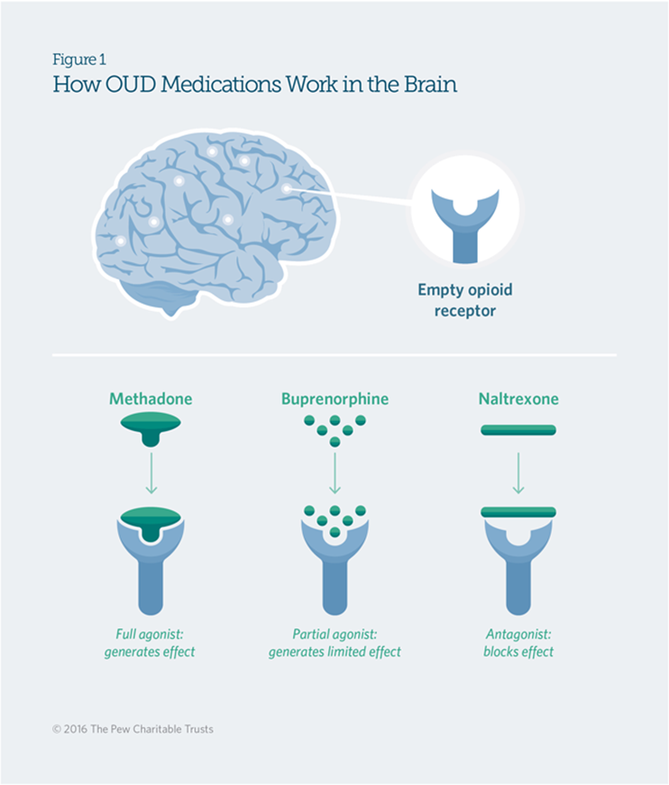
How OUD Medications Work in the Brain
FDA-approved medications for the treatment of Opioid Use Disorder:
Methadone
Buprenorphine
Naltrexone
The Pew Charitable Trusts, 2016
9
Notes:
Methadone - Full agonist
Buprenorphine – Partial Agonist

Slide 10
Advantages of Opioid Agonist Treatment
Opioid use
Opioid overdose deaths
Legal consequences/recidivism
HIV, Hep C, and STI transmission
Social functioning
Retention in treatment
Mattick et al, 2008
Volkow et al, 2019
10
Notes:
Key Point #1:

Slide 11
Medications for Opioid Use Disorder (MOUD)
Addiction is a chronic, relapsing, remitting medical disorder that affects behavior and decision making.
A broad evidence base supporting the benefits of medications as the treatment for OUD, similar to the treatment of diabetes with insulin or oral hypoglycemics.
A Cochrane review of 35 studies with more than 4,000 patients found that overall, there was no clear benefit of additional specific counseling over the counseling received as part of the medical management with methadone or buprenorphine.
Wakeman, 2017
Volkow, 2019
Cochrane Database Syst. Rev., 2011 Oct. 5;10:CD004147

Slide 12
DATA 2000/X-Waiver
Drug Addiction Treatment Act of 2000 provided a “waiver” to treat opioid addiction outside of a traditional opioid treatment program.
It applies to schedule III, IV, and V medications approved for this indication
Pssst… Buprenorphine is the only one!

Slide 13
X-Waiver Requirements
Have an active state medical license
Have a valid personal DEA license
2021 HHS Practice Guidelines exempt Clinicians treating fewer than 30 patients at one time from the mandatory training requirement!
Most EM Physicians will not need a higher patient limit but if treating more than 30 patients at one time, and want a higher patient limit
Apply for a waiver on SAMHSA’s website
Complete SAMHSA-approved course
Prescribe!
Physicians: 8 hours
PA/APRN: 24 hours
13

Slide 14
MOUD Regulations and ED Implications
Methadone is DISPENSED by highly regulated opioid treatment programs (OTPs), but it cannot be prescribed to treat opioid use disorder.
Buprenorphine can be dispensed in the ED for up to 3 days under the 72-hour tule, but outpatient prescription requires a DEA X-waiver.
There is no role for naltrexone in the ED for OUD treatment; 7 to 10 days of abstinence from opioids is required.
14
Notes:
Physicians and APPs are not legally allowed to prescribe methadone, or any other opioid, to treat OUD. Methadone must be DISPENSED by a highly regulated program called OTP (opioid treatment program). Providers can continue home medications while in the hospital or use methadone to treat opioid withdrawal (but not opioid use disorder) in ED or in hospital .

Slide 15
Methadone and Buprenorphine Are Associated with Reduced Mortality after Nonfatal Opioid Overdose
15

Slide 16
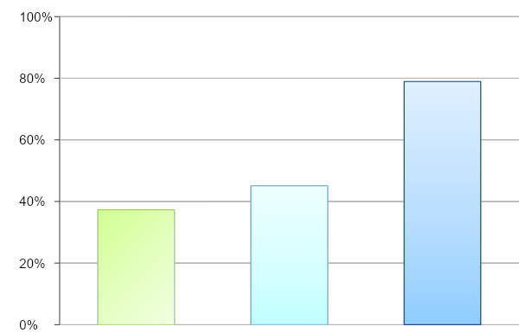
ED-Initiated Buprenorphine
Treatment trial of 329 ED patients with moderate to severe OUD randomized to:
Standard referral
Brief Intervention (BI) with facilitated referral
BI with ED-initiated buprenorphine with primary care follow-up
30-Day Treatment Engagement
Referral
Brief Intervention
Buprenorphine
D’Onofrio et al, 2015
16
Notes:
RCT of ED patients willing to enter treatment trial
-- Secondary outcomes – fewer self reported days of past-7 day opioid use at Day 30 in Bup group; no difference in urine toxicology.
-- Was cost-effective across all willingness to pay thresholds.

Slide 17
Develop System Protocols and Referrals
Is there an OTP, primary care practice, resident clinic, or FQHC that will take a “warm handoff?”
What services do they offer?
Do they take insurance?
Is there a waitlist or mandatory waiting period?
At least one person from the ED should establish an open line of communication to troubleshoot and enhance handoffs.
Discharge plans should be SIMPLE and RELIABLE for patients and providers.
17
Notes:
The easier this is on the provider and the patient, the higher the likelihood of success.

