Slide 1
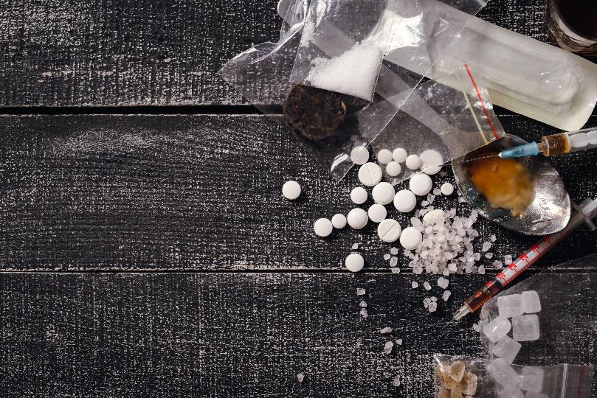
Module #7 Emergency Department Management of Recreational Stimulants
Module Primary Authors
Reuben Strayer
Authoring Group
Steven L. Bernstein, Kathryn Hawk, Lindsey Jennings, Lucinda Lai, Alexis LaPietra, Ryan McCormack, Lewis S. Nelson, and Reuben Strayer
Funding for this initiative was made possible (in part) by grant no. 1H79FG000021-01 from SAMHSA. The views expressed in written conference materials or publications and by speakers and moderators do not necessarily reflect the official policies of the Department of Health and Human Services; nor does mention of trade names, commercial practices, or organizations imply endorsement by the U.S. Government.

Slide 2
Learning Objectives
Describe the initial steps – prior to the administration of medications – in the management of agitated emergency department patients.
Select effective agents in the management acutely agitated patients in the emergency department.
List and describe how to manage the most important dangerous causes and effects of agitation.
2

Slide 3
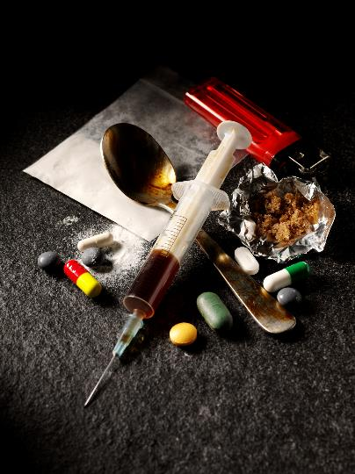
Sympathomimetics activate the sympathetic nervous system.
Cocaine
Methamphetamine
Prescription amphetamines
Psychedelic amphetamines
MDMA
Cathinones (“bath salts”)
Synthetic Cannabinoids
Phencyclidine/Ketamine
3

Slide 4
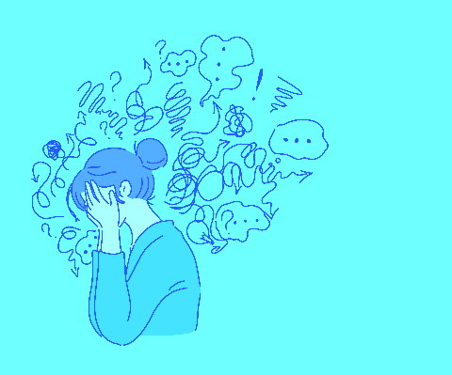
Sympathomimetics activate the sympathetic nervous system.
Agitation
Delirium
Seizures
Coma
Hyperthermia
Hypertension
Tachycardia
Dysrhythmias
Hypoglycemia
Rhabdomyolysis
Electrolyte Derangements
Especially hyperK and hypoNa
DIC
Serotonin Syndrome
Hepatotoxicity
Additionally: mydriasis, diaphoresis, muscle spasms, and bruxism
4

Slide 5
Is the patient controlled/cooperative?
Patients who are thought to be at risk of having a dangerous medical condition and who are too agitated to allow for care to proceed must be controlled immediately so that life threats can be identified and treated.
Stimulant intoxication is the most common cause of excited delirium.
Screaming and thrashing
Disregard for futility, pain, fatigue
Cannot engage/is incoherent
Fluctuating sensorium
Abnormal vitals
5

Slide 6
Management of the Dangerously Agitated Patient
Assemble adequate force and make sure it’s safe to approach the patient.
Face mask oxygen (provides oxygen, controls spit).
Relieve dangerous restraint holds such as neck/chest compression or prone position and especially a hog tie.
Deliver calming medications IM through clothing if the skin is not easily accessible.
As the patient calms, do not use tight restraints and put the head of the bed up.
Resuscitation should be focused on relevant dangerous conditions.

Slide 7
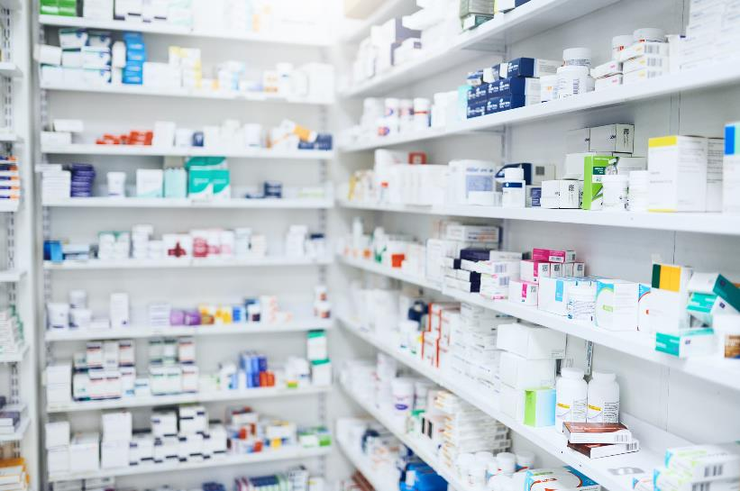
Calming Medications
The mainstay of medication treatment of stimulant-related agitation is benzodiazepines.
Midazolam is much faster and more reliably absorbed IM compared to lorazepam
Neuroleptics (haloperidol, droperidol, olanzapine) should play a secondary role when the etiology is thought to be a stimulant.
Dissociative-dose ketamine appropriate for uncontrollably violent.
7

Slide 8
Monitoring
Patients with a high concern for dangerous medical condition, or who received dissociative dose ketamine or greater than or equal to 10 mg midazolam should be managed in a resuscitation bed.
Most other patients who present with hyperadrenergic stimulant toxicity should be placed on monitor.
8
Notes:
And because clonidine, ibuprofen and phenergan don’t address the problem, which is a billion screaming mu receptors, they don’t work well, so trying to make the patient comfortable enough to be discharged often doesn’t work unless you sedate the patient to unconsciousness, at which point they still can’t be discharged because they’re unconscious and you end up with these 5, 10, 15 hour ED stays where everyone is miserable, the patient, the nurse, the doctor, the other patients…

Slide 9
Pivot to Resuscitation
Vitals (especially temperature)
Capillary blood glucose
Vascular access, crystalloid bolus
Identification of dangerous causes and effects of agitation
Hypoxia, hyperthermia, hypoglycemia, hypoperfusion, hyperkalemia, acidemia, dysrhythmia, seizure, electrolyte disturbance, dehydration, rhabdo, trauma (may be occult), arterial dissection, ICH (from severe HTN)
ddx: sedative withdrawal, serotonin syndrome, NMS, MH, salicylism, environmental hyperthermia, thyrotoxicosis, sepsis, CNS infection, postictal state, pheochromocytoma

Slide 10
Hyperthermia
It must be attended to with highest urgency if temperature is greater than 40°.
The best emergent cooling is ice water submersion.
Use a combination of cool mist and warm fan, or you can use warm mist and cool fan as a second choice.
Ice packs, cooling blanket, cool water internal lavage are comparatively ineffective and should not be used as primary treatment of critically hyperthermic patients unless there are no other options.
Do not place a wet sheet on patients; it interferes with evaporative cooling.
The goal is to have a core temperature of less than 39° in less than 30 minutes.
Paralysis/intubation is often required in severe cases (avoid succinylcholine).
10

Slide 11
Other Aspects of Emergent Treatment of Stimulant Toxicity
If there is wide complex tachycardia, treat sodium channel blockade with sodium bicarbonate, 1 mg/kg bolus, and repeat prn.
Hypertonic saline may be required to treat critical consequences of severe hyponatremia.
Cardiac ischemia may occur from a variety of mechanisms; use benzodiazepines liberally if the patient is hyperdynamic – nitrates are OK.
Beta blocker use is classically contraindicated for vasoconstrictive “unopposed alpha effect,” but data/opinion is shifting on this – esmolol is a reasonable choice.
Sympathomimetic toxicity can be confused with anticholinergic toxicity; the latter is best distinguished by dry skin.
11

Slide 12
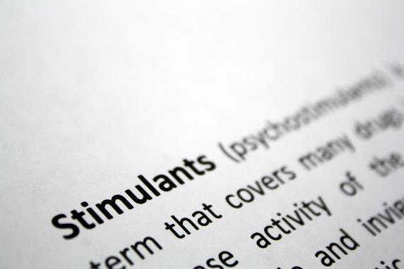
Epidemiology
Stimulants are the 4th leading cause of poisoning deaths.
Cocaine is the most popular, accounting for about 500,000 ED visits.
Methamphetamines are rising in popularity, especially in rural areas in western US; meth causes more deaths than opioids do in some regions.
Cathinones (“bath salts”) and synthetic cannabinoids (“Spice,” “K2”) are highly regional and have episodic spikes in use/morbidity.
12

Slide 13
Long-Term Use
Accelerated atherosclerosis, cardiomyopathy, and pulmonary hypertension
Psychosis (may be irreversible)
Dental decay and skin disease (often from formication)
“Washout” syndrome from catecholamine depletion causes depression, fatigue, and irritability, and may precipitate suicidality.
13
Notes:
OWS can be literally unbearable. some people addicted to opioids would rather die than suffer OWS, they spend their lives terrified, moment to moment, of losing their supply of opioids and withdrawing. Once you understand this, the way that people with OUD behave makes a lot more sense.
quotes c/o Zack Repanshek

Slide 14
Long-Term Use
There are no specific treatments for stimulant use disorder.
There is some evidence for naltrexone, bupropion, and topiramate for treatment of methamphetamine addiction.
Patients should be offered symptomatic “comfort” treatments and be referred to specialist addiction care.
The most effective treatments are behavioral therapy (cognitive-behavior therapy and contingency management) and addressing the psychiatric/social factors that contribute to misuse.

Slide 15
Comfort Treatment in the ED or for Discharge
Trazodone
100 mg, 1 tab at bedtime as needed for sleep
Prochlorperazine
10 mg, 1 tab three times daily as needed for nausea
Clonidine
0.1 mg, 1 tab every twelve hours as needed for anxiety, agitation, rapid heart rate, and/or headache (hold if BP is less than 100/60)
Baclofen
10 mg, 1 tab every eight hours as needed for muscle cramping
15

Slide 16
Key Points
Stimulants are a diverse set of compounds that include cocaine and amphetamines.
Patients with stimulant toxicity may present with agitation that requires immediate management to achieve control so that dangerous medical complications can be identified and treated.
Hyperthermia is the most common lethal consequence of stimulant toxicity; this must be aggressively sought and treated.
Other immediate life threats include hyperkalemia, hypoglycemia, seizures, and dysrhythmias.
The treatment of long-term use is mostly behavioral, and several medications may prove useful.
16

Slide 17
References
Smets G, Bronselaer K, De Munnynck K, De Feyter K, Van de Voorde W, Sabbe M. Amphetamine toxicity in the emergency department. Eur J Emerg Med. 2005 Aug;12(4):193-7.
Zun LS. Evidence-Based Review of Pharmacotherapy for Acute Agitation. Part 1: Onset of Efficacy. J Emerg Med. 2018 Mar;54(3):364-374.
Zun LS. Evidence-Based Review Of Pharmacotherapy For Acute Agitation. Part 2: Safety. J Emerg Med. 2018 Apr;54(4):522-532.

