Slide 1
Saddle Embolism
CORD Simulation Education Cooperative
2010
Zachary Sturges, MD
University of Utah

Slide 2
Background: Saddle Embolism
Occurs in ~5% of all patients with PE¹
Defined as PE straddling bifurcation of both PAs
Dyspnea and syncope most common symptoms
Clinical presentation/degree of symptoms highly variable

Slide 3
Background: Saddle Embolism
Massive PE typically distinguished by systemic arterial hypotension
Literature is sparse on optimal treatment modalities
Mortality from massive PE is at least twice that for patients with submassive PE (90 day mortality ~50%)¹

Slide 4
Thrombolysis
May not decrease 90 day mortality (non significant decrease)¹
ACCP 2008: Grade 1B recommendation²
  “For patient with evidence of hemodynamic compromise, we recommend use of thrombolytic therapy unless there are major CIs…[it] should not be delayed because irreversible cardiogenic shock may ensue.”
  85% of deaths from massive PE occur within first 6 hrs
But: majority of patients should NOT receive thrombolysis (Grade 1B)
  Thrombolysis for submassive PE controversial

Slide 5
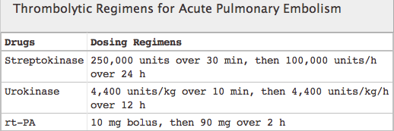
Thrombolysis
Pharmacology³
  Plasminogen activators that result in fibrinolysis
  Selective (tPA) or nonselective (-kinases)
    Selective agents bind to fibrin on clot surface whereas nonselective do not have this affinity
    Pharmacologically but not clinically different
Tenecteplase currently being studied for FDA approval for use in PE

Slide 6
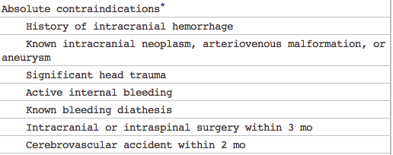
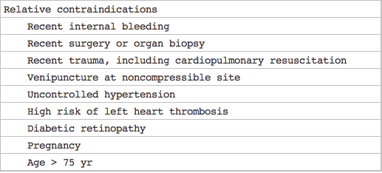
Thrombolysis
tPA recommended due to shortest infusion time³
Contraindications⁴

Slide 7
Bleeding Risk of Thrombolysis⁴
10% risk of major hemorrhage
2-3% risk of intracranial hemorrhage
Prognostication of bleeding risk adversely affected by small study numbers and heterogeneous study designs and populations

Slide 8
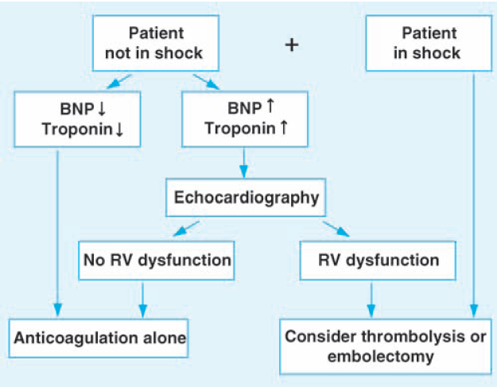
Biomarkers & Algorithm for Use
Risk Stratification Algorithm⁴
Adapted from:

Slide 9
Biomarkers
Troponin and BNP have high negative predictive values for mortality but poor specificity
Increases in both biomarkers correlated with RV dysfunction ^{3,4}
  May be useful in deciding who needs echocardiogram

Slide 10
Mechanics of Thrombolysis
IV is recommended over PA catheter
  Catheter directed tPA may be considered in the future or if there is substantial experience at your center
May use UFH prior to initiation of thrombolytics
  Preferred over unstudied/harder to reverse LMWH
Discontinue UFH just prior to administration of thrombolytics
Resume UFH when aPTT is <2x upper limit of normal

Slide 11
Surgical Embolectomy
2nd Line approach in patients with high risk of bleeding or CIs to thrombolysis
If thrombolysis unsuccessful embolectomy is preferred treatment over repeat thrombolysis⁵
Mortality previously higher but declining with modern surgical techniques⁶
    Some current studies as low as 6%
    Declining from 35% prior to 1990

Slide 12
Catheter Extraction Techniques
Not recommended by ACCP (Grade 1C)²
May be considered as 3rd line therapy if interventional experience is available at your institution
Techniques rapidly evolving and may show improved efficacy with fewer complications in future

Slide 13
Future
Large European trial looking at thrombolytics for acute PE currently ongoing
  To examine RV dysfunction, co-morbidities and role of thrombolytics in submassive PE
Improvement in percutaneous/less invasive embolectomy techniques
Role of tenecteplase in acute PE

Slide 14
References
1. Kucher N, Rossi E, De Rosa M and Goldhaber SZ. (2006) Massive pulmonary embolism. Circulation 113: 577-582.
2. Kearon C, Kahn SR, Agnelli G, et al. (2008) Antithrombotic therapy for venous thromboembolic disease. Chest 133(suppl):454S–545S.
3. Todd, JL and Tapson, VF. (2009) Thrombolytic therapy for acute pulmonary embolism: a critical appraisal. Chest 135: 1321-1329.
4. Jenkins PO, Sultanzadeh J, Bhagwat M and Jenkins PF. (2009) Should thrombolyis have a greater role in the management of pulmonary embolism? Clinical Medicine 9(5): 431-435.
5. Meneveau N et al. (2006) Management of unsuccessful thrombolysis in acute massive pulmonary embolism. Chest 129: 1043-1050.
6. Samoukovic G, Malas T and de Varennes B. (2010) The role of embolectomy in the treatment of acute pulmonary embolism: a literature review from 1968 to 2008. Interact CardioVasc Surg 11: 265-270.

